Slide 1

Members Workshop
Meeting Gypsy & Traveller Pitch Needs
&
Site Identification
4th July 2023

Slide 2
Introduction & Purpose
  Continue evaluating MCC land for potential Gypsy & Traveller pitch development
  Consider 9 areas of MCC land - to remain in or to be removed from evaluation process
  For land that remains in the process, recommend to Cabinet that the Council consult on these sites:
    Sites will be considered by People Scrutiny Committee - make recommendation to Cabinet
    Cabinet to approve land to be consulted upon
  Reminder if required – context and process of land/site sifting undertaken to date

Slide 3
Context – if required
Housing (Wales) Act 2014
  Statutory duty to undertake a GTA every 5 years
  Should a need be identified, a duty on the local authority to provide sites
Positive & proactive participation with G & T Communities to ensure:
  Build links between MCC and the G & T community
  G & T community understand and can influence the process
Need Identified
  9 x pitches to 2025 plus further x 4 over the period of the Replacement LDP to 2033
Meeting the Identified Need
  Support a private household with acquiring Planning Permission for an additional pitch
  Officer working group – site identification using MCC owned land

Slide 4
Site Identification - Process to Date
Stage 1 - An appraisal of All MCC owned land and regard to WG Site Design Guide 2015
  Approximately 1500 council assets have been reviewed and considered
  Sites removed to date through Estates:
    Asset is a MCC property; Cemetery Land; Allocations in the existing adopted LDP; tree planting; Tree Planting Scheme; Woodland; Covered by a ground lease; Council Car Park; Footpath/road
Stage 2 – Sites removed due to the following:
  Site is less than 500sqm – desired pitch size is min 500sqm for public sites. [A pitch capable of accommodating an amenity block, mobile home, caravan and parking for two vehicles]; Equipped Children’s Play Area; Playing Fields (Pitch); County Farm Holdings; Allocations in the existing adopted LDP/ RLDP promotion sites; Known unfavourable topography; Woodland areas that were missed on Stage 1; C1 & C2 Flood Risk – known sites in flood risk removed; Sites with any uncertain inputs have been carried forward to the next stage for further assessment
Approximately 70 sites remained from 1500 sites
Notes:
Unmet need can be met either by facilitating households (who possibly may own or wish to purchase land to meet their own needs) through planning permission. Or alternatively, through the provision of public Council owned pitch(s).

Slide 5
Site Identification – Process to Date
Stage 3 – to assess flood risk as per updated TAN 15. Site removed due to:
Sites wholly or mostly in Zones 2 & 3 of updated TAN15 maps (sea and river)
  Sites where boundary could potentially be amended to remove site out of flood risk kept on list
Surface water flood risk highlighted for further assessment
Any constraints identified in Stage 1 & 2 if picked up at Stage
Approximately 50 sites from 1500 remaining
Also removed:
Brecon Beacons National Park Plan
Within and adjacent to Conservation Areas and/or Historic Park & Garden
Enclosed/surrounded by built environment privacy and amenity / placemaking
National Ecological designations eg SSSI
Notes:
Unmet need can be met either by facilitating households (who possibly may own or wish to purchase land to meet their own needs) through planning permission. Or alternatively, through the provision of public Council owned pitch(s).

Slide 6
Site Identification – Process to Date
Stage 4 – Post Workshop 2.
Site Area | Ecological Designation on whole or part of site (SSSI, SINC, SAC, RAMSAR, national/local nature reserve)
Ability to provide utility infrastructure
Flood Zone (Updated TAN 15 Flood Maps) | Proximity to ecological designation
Within or adjoining a Settlement Boundary | Landscape Sensitivity (as recorded in the Landscape Sensitivity Study)
Greenfield/Brownfield | Mineral Safeguarding Area
Surrounded by Built Development | Proximity to potential ‘bad neighbours’ e.g. dual carriageways, trunk roads, motorway, railway, industrial estates)
Potential for expansion
Within BBNP or AONB | Contamination (as recorded on Monmaps)
Within Green Wedge or potential Green Belt | School Proximity
Within Phosphates Catchment Area | Medical Facility Proximity
Adopted LDP DES2 Allocation | Proximity to other Amenities
DES2 in Review | Public transport proximity and frequency
Within/adjacent to Conservation Area or Historic Parks & Garden | Proximity to Historical Designation (inc Listed Buildings and Con Areas)
Within Archeologically Sensitive Area | Topography
Permanency | Access
Notes:
Unmet need can be met either by facilitating households (who possibly may own or wish to purchase land to meet their own needs) through planning permission. Or alternatively, through the provision of public Council owned pitch(s).

Slide 7
Todays Workshop
Stage 5
17 x sites - visited and further assessed against criteria
  Reduced to 9
Todays Workshop - consider 9 remaining sites and whether to
  Leave in process – recommend consulting on possible development
  Remove from process
Todays Approach
  Overview of individual sites - Ian
  Ward member(s) comments
  Travelling Ahead comments
  General discussion/comments
Notes:
Unmet need can be met either by facilitating households (who possibly may own or wish to purchase land to meet their own needs) through planning permission. Or alternatively, through the provision of public Council owned pitch(s).

Slide 8
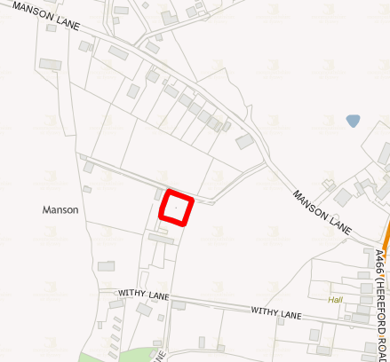
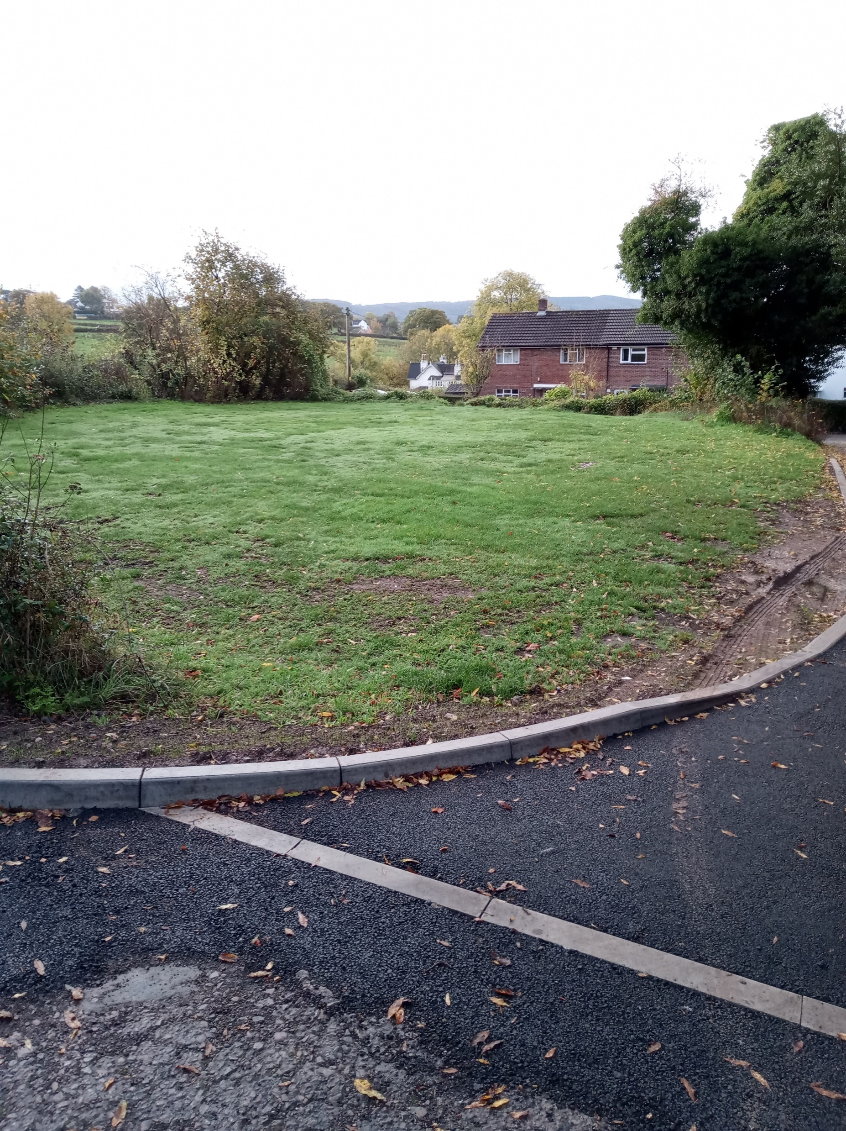
Land – Possibly Consider for Consulting Upon
Site 1 - Manson Heights, Monmouth
Approx 775m² - 1 pitch
Notes:
Coun Jane Lucas

Slide 9
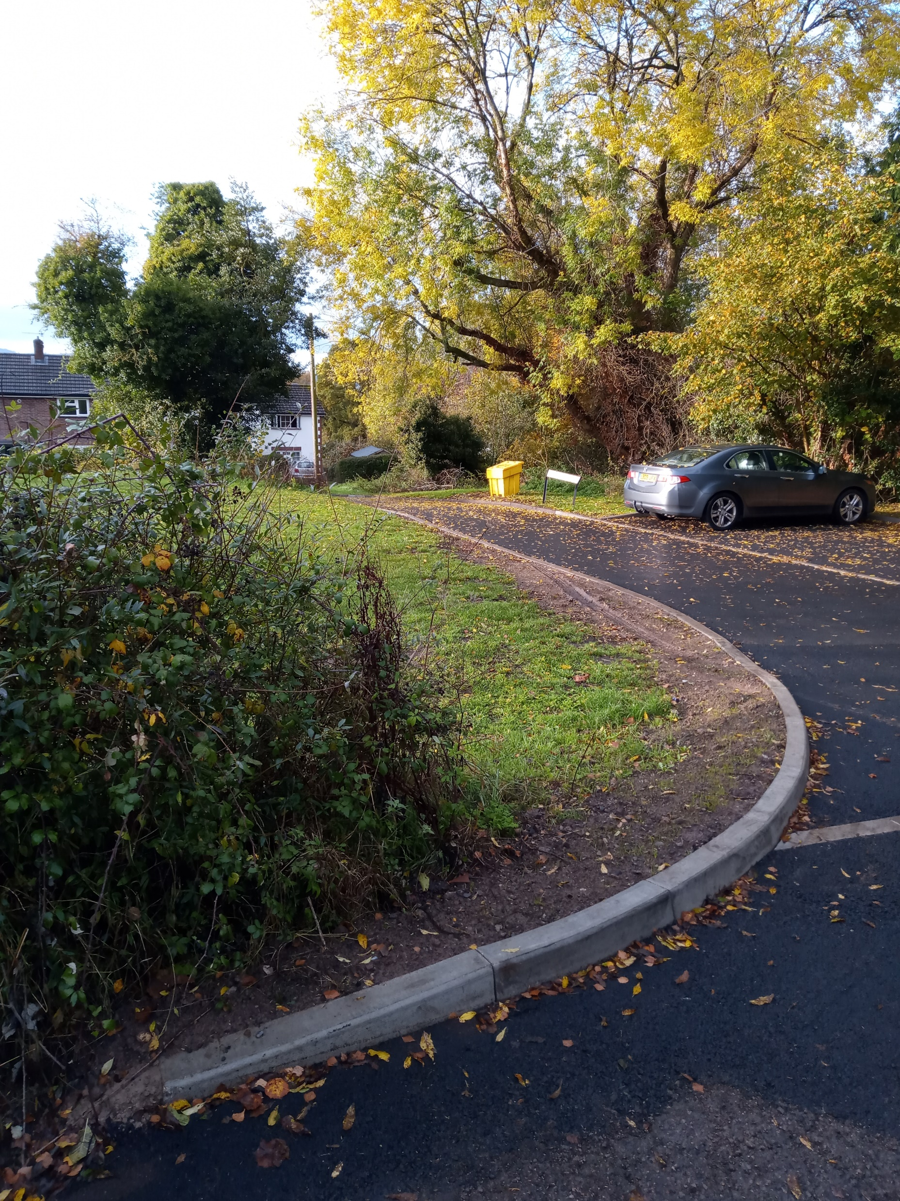
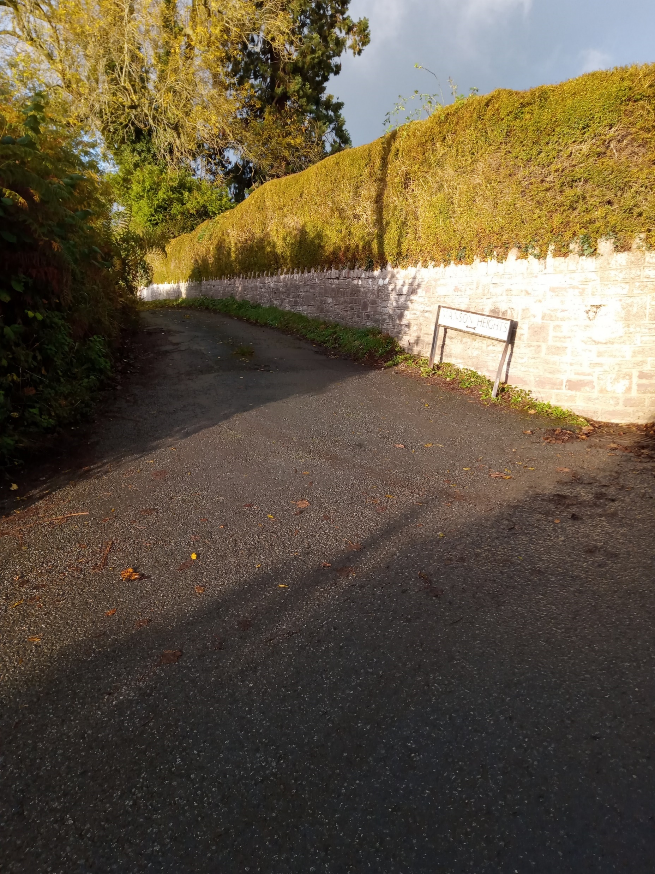
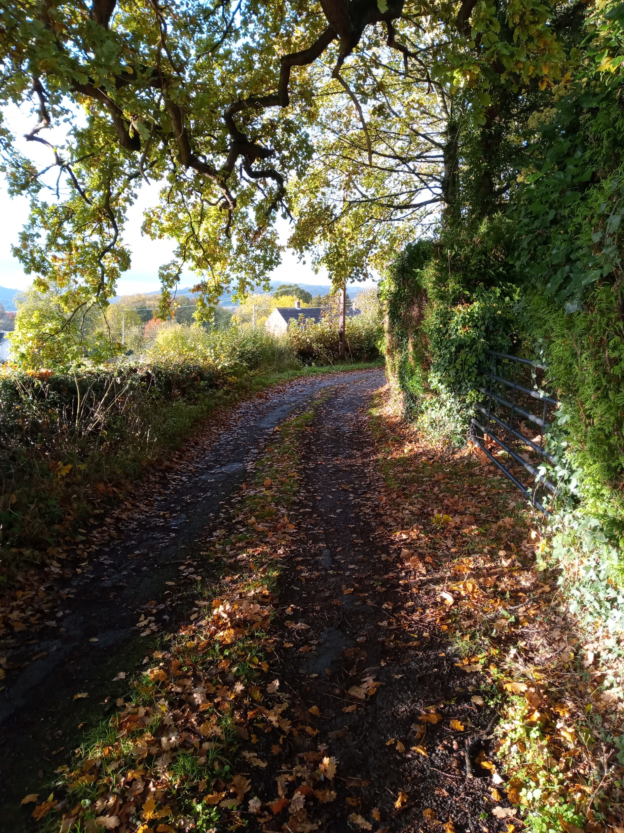
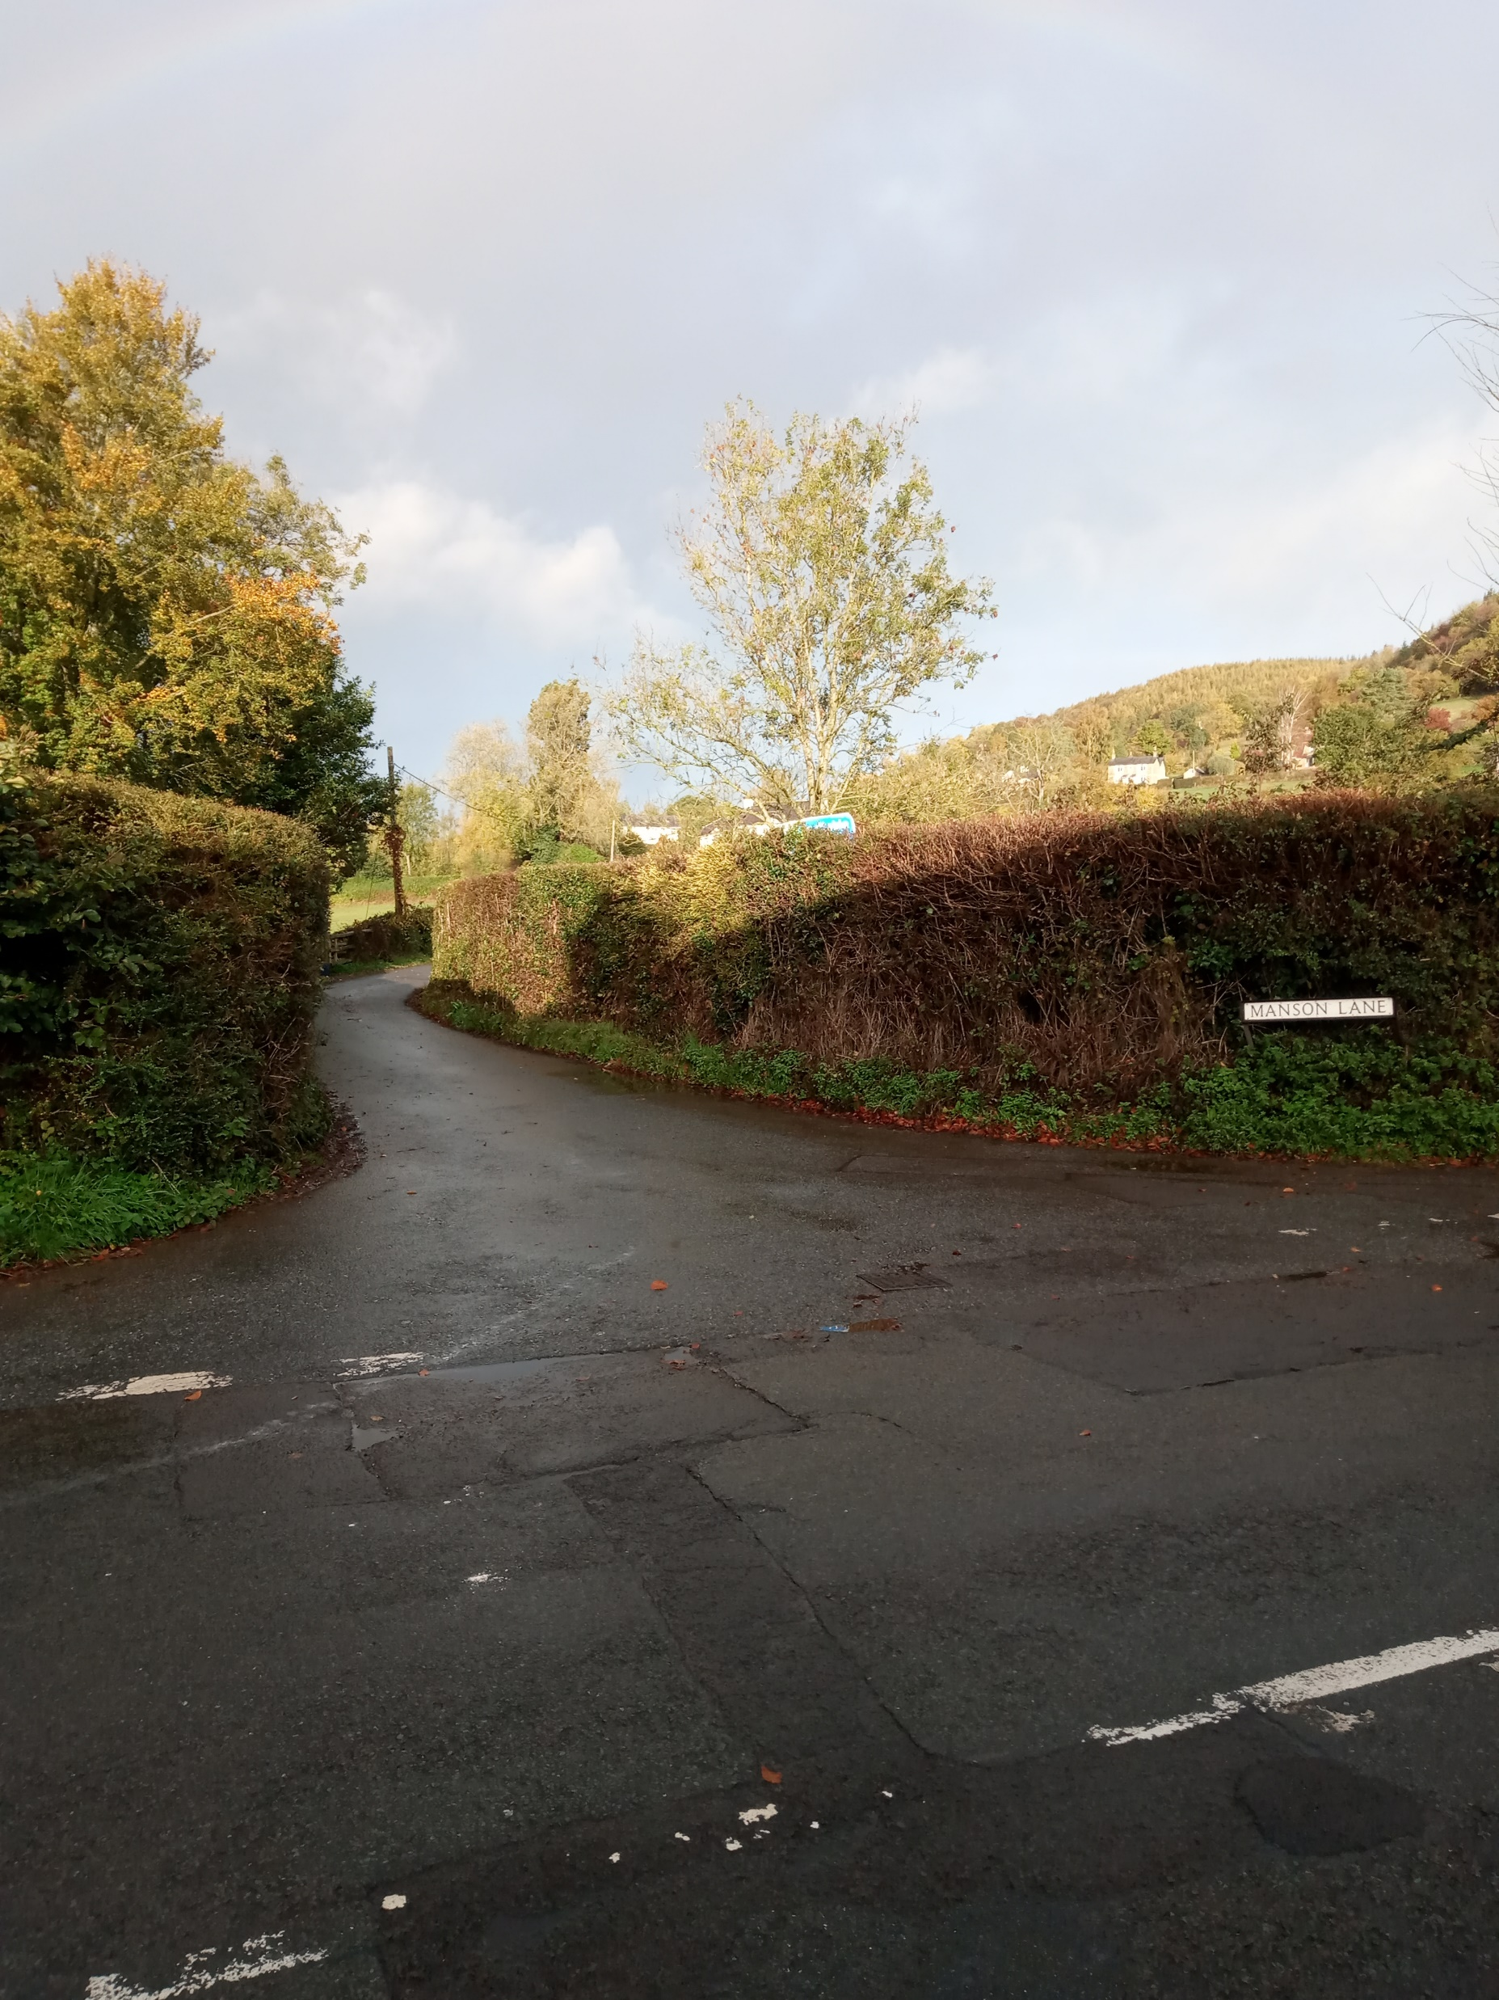
Land – Possibly Consider for Consulting Upon
Site 1 - Manson Heights, Monmouth
Rural
Designated open space
Relatively level and square site.
Adjoins 3 existing homes to the S elevation
Hedged and well screened to N and E elevations.
Pro’s
Rurality
Small – may suit one family.
Easily accessed from Manson Heights. However, access to Manson Heights is via Manson Heights and Manson Lane – very narrow single track lanes from the A466.
Con’s
Close to existing homes
Access via narrow lanes – includes set up implications
Notes:
Coun Jane Lucas

Slide 10
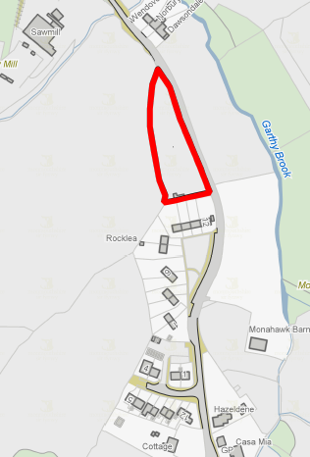
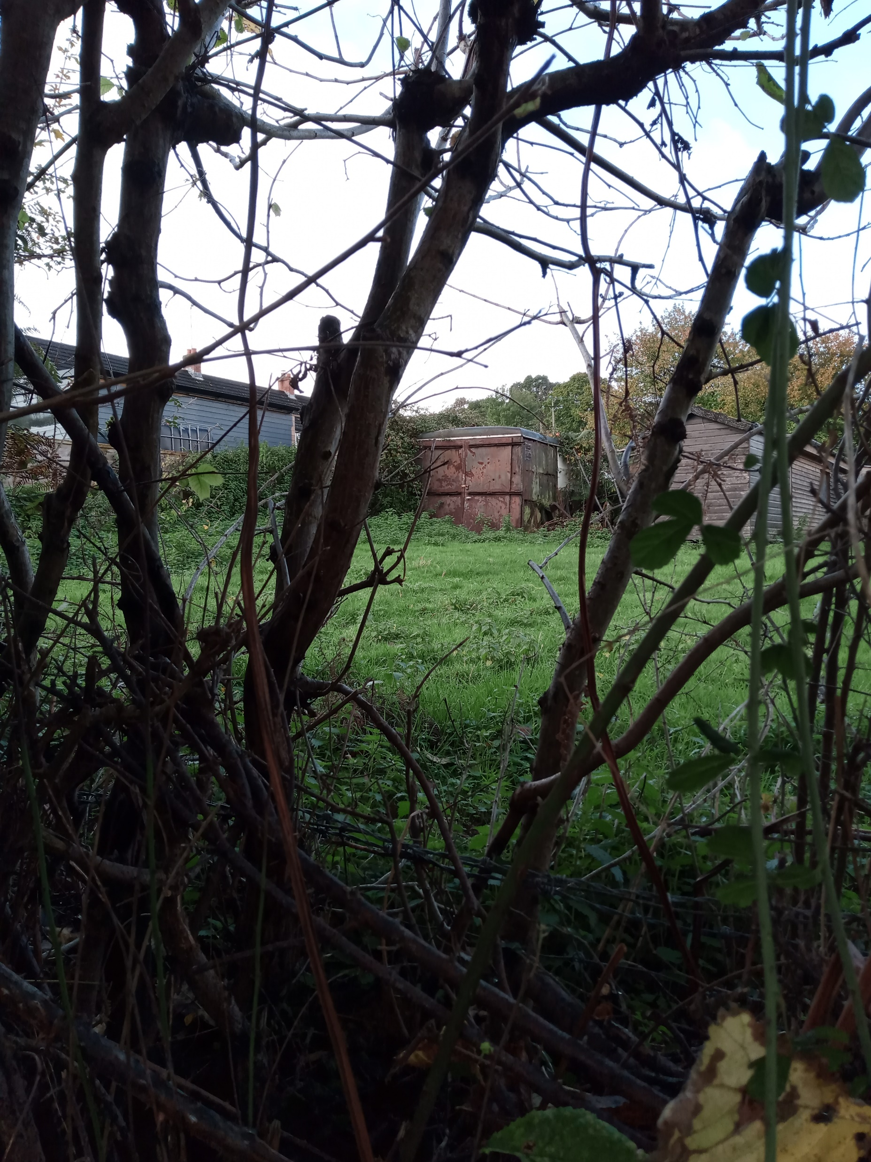
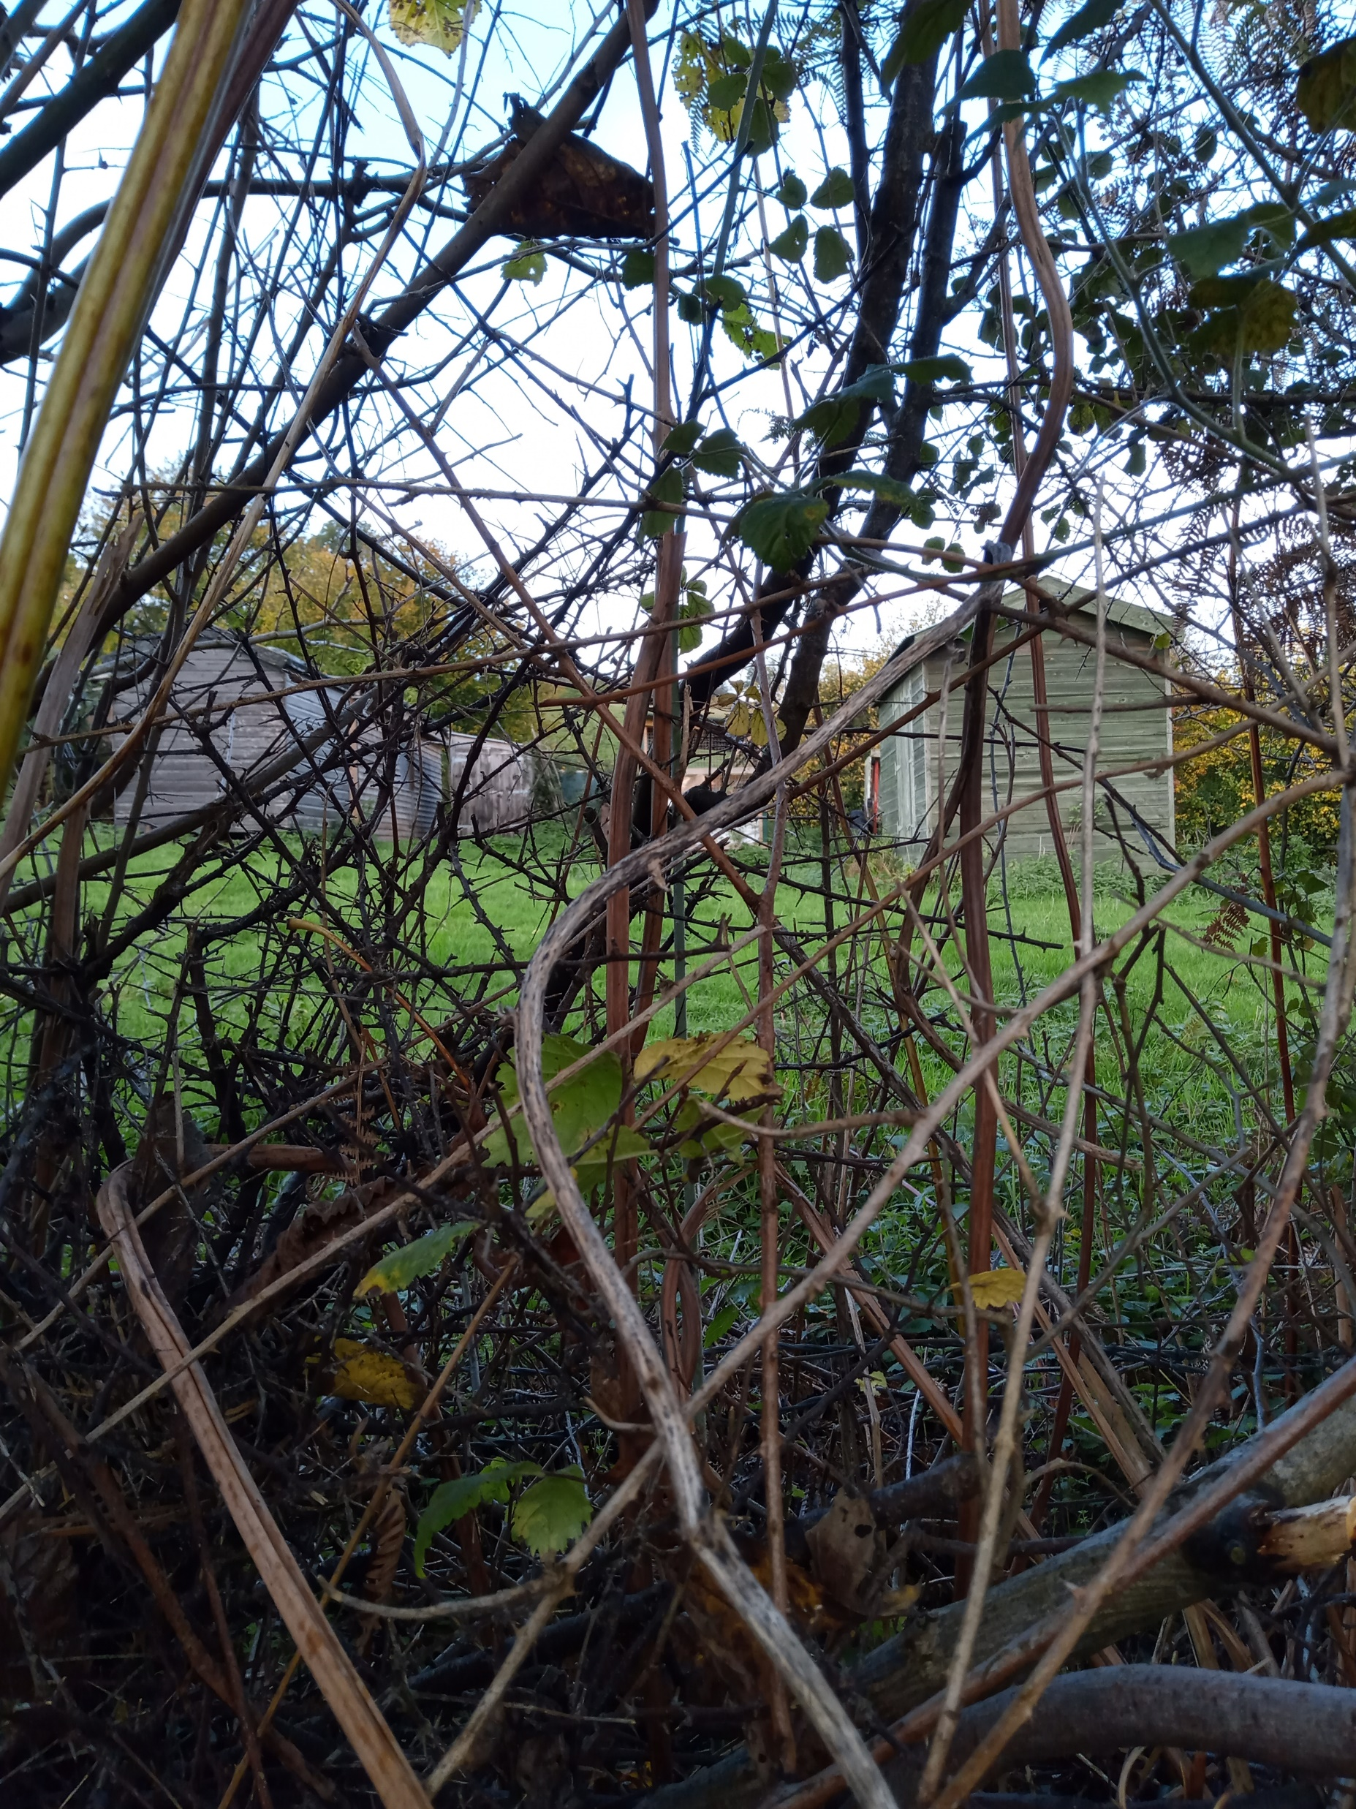
Land – Possibly Consider for Consulting Upon
Site 2 – Rocklea, Mitchel Troy
Approx 3,000m² - 5 pitches
Notes:
Coun Richard John and Coun Jane McKenna

Slide 11
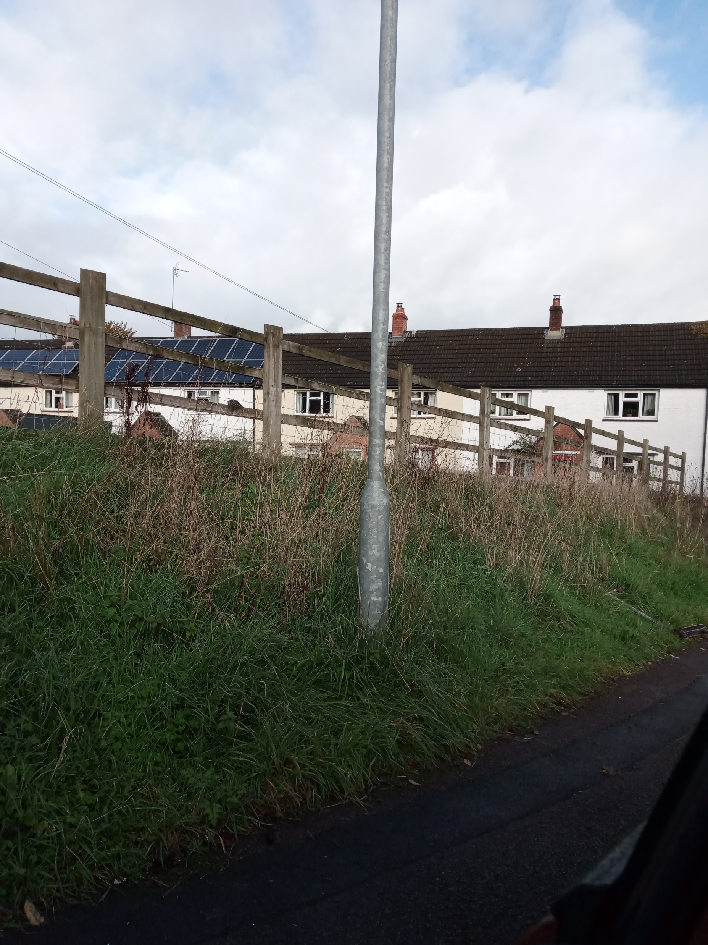
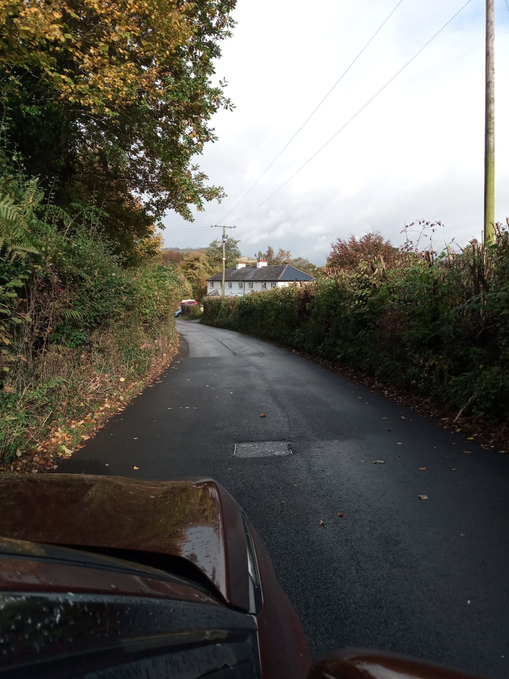
Land – Possibly Consider for Consulting Upon
Site 2 – Rocklea, Mitchel Troy
Approx 5 pitches
Rural
Grassland - currently has a number of small timber sheds/out-buildings situated on the land – possibly unofficial use
Reasonably even topography
Situated adjoining and above (eg head height) Common Road.
Pros
Well screened to East and North elevations.
Area of land lends itself to a good size
Cons
Land adjoins 4 x properties in Rocklea to S elevation
No identified current access. Potential for new access off Common Road – hedge removal
If combined with Garthi Close land, a Transport Statement would be necessary - to determine traffic impact on network.
Notes:
Coun Richard John and Coun Jane McKenna

Slide 12
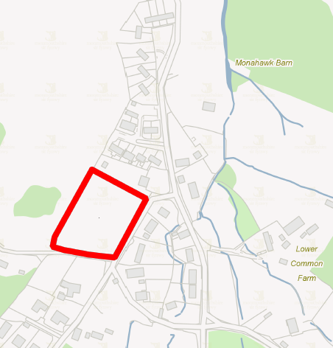
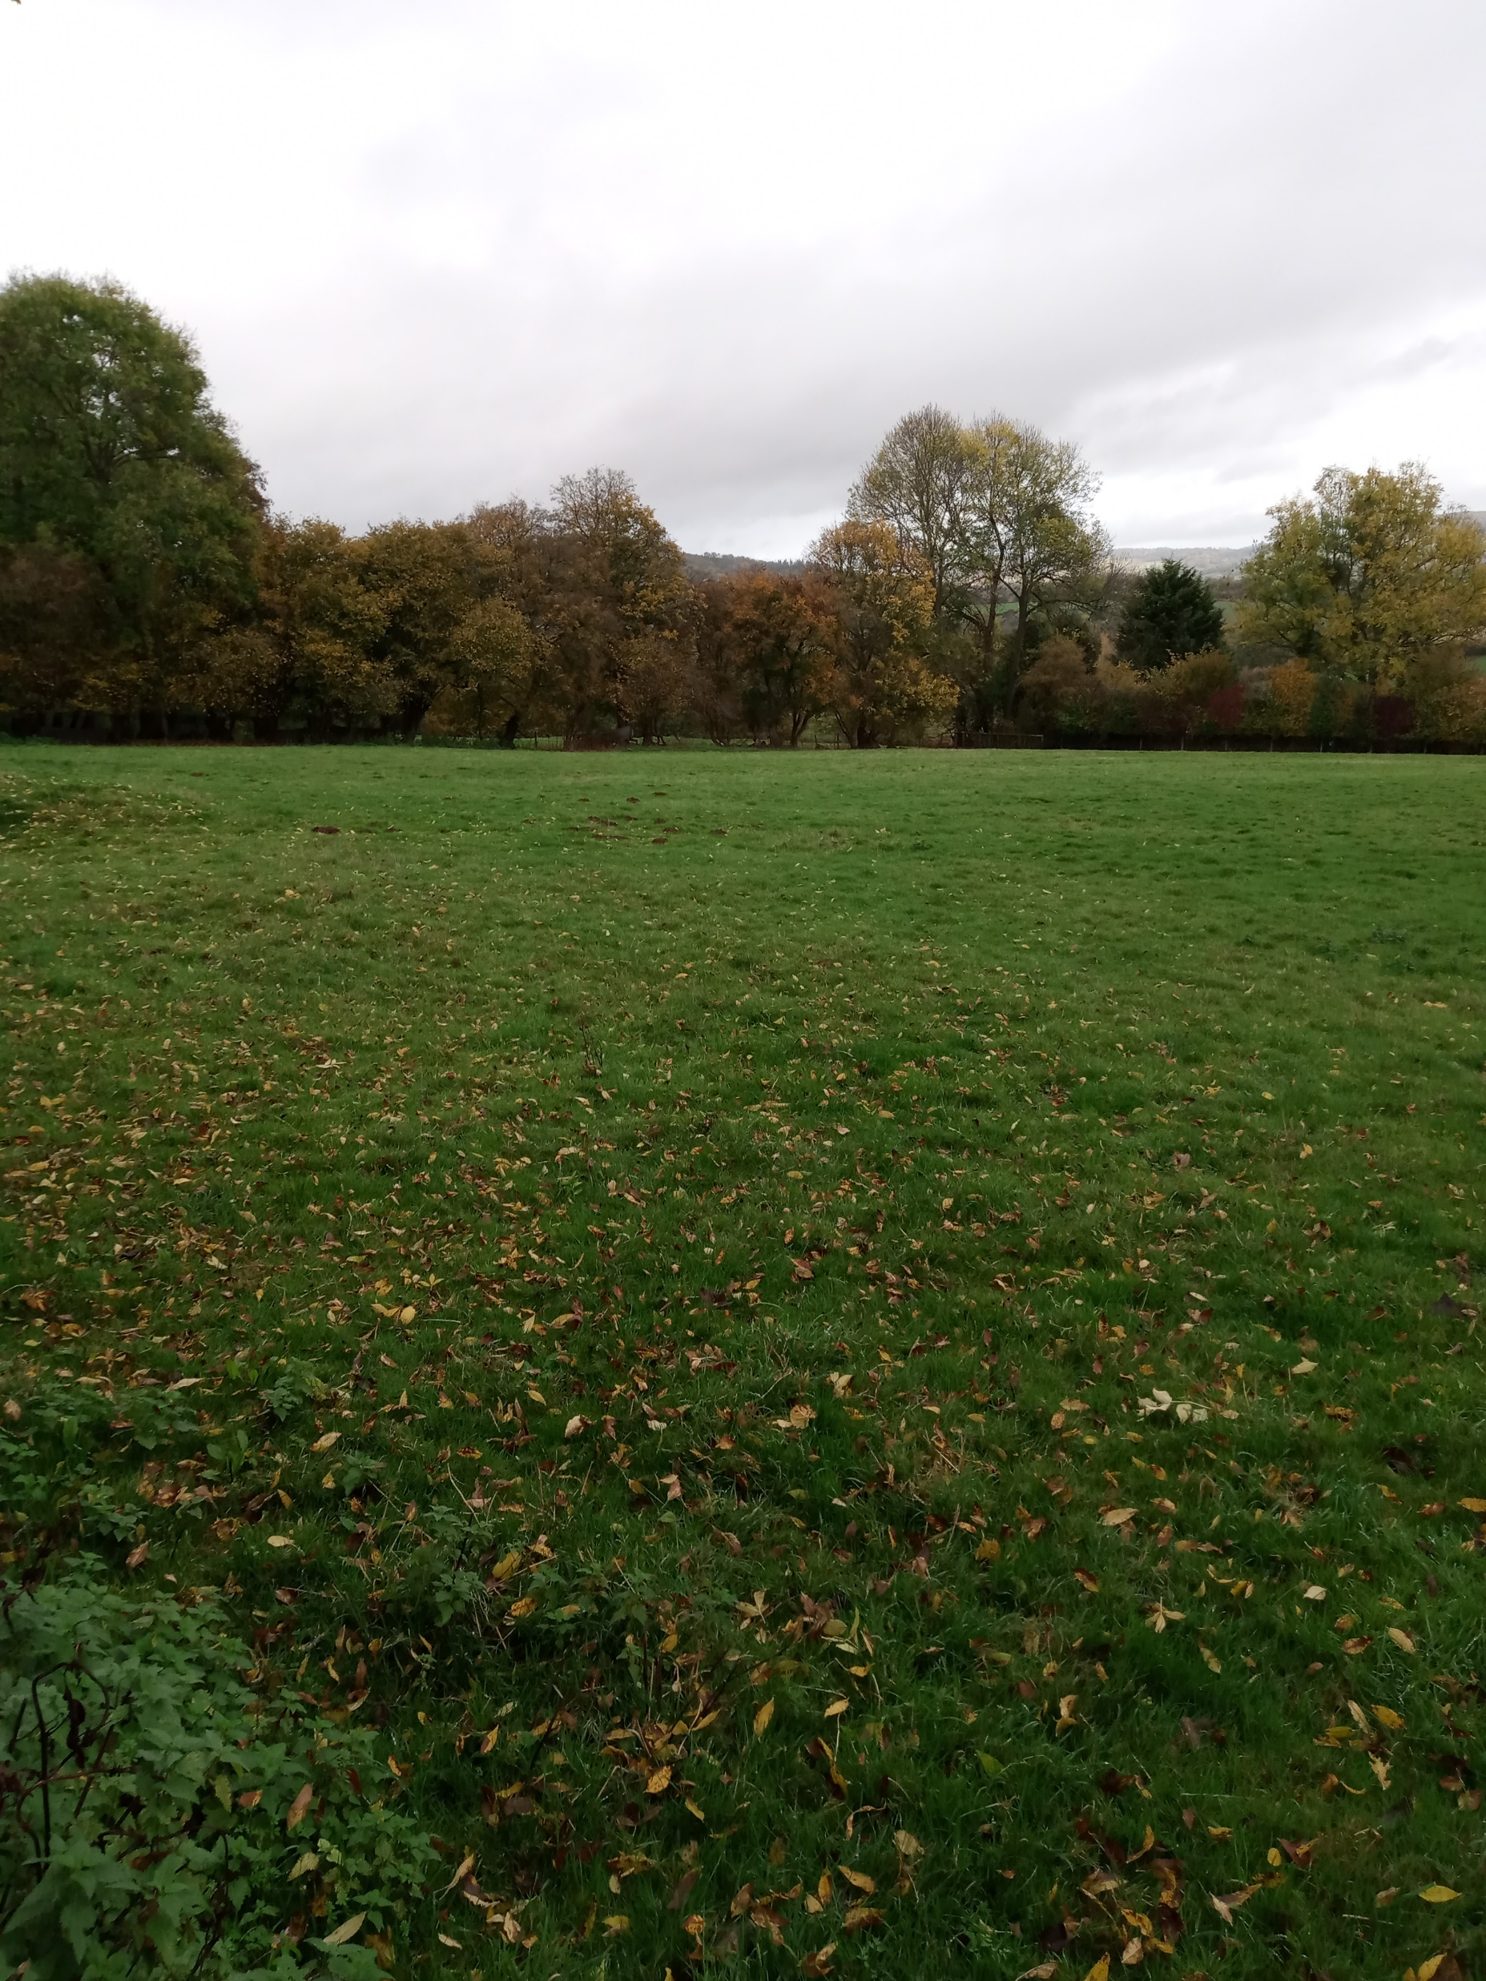
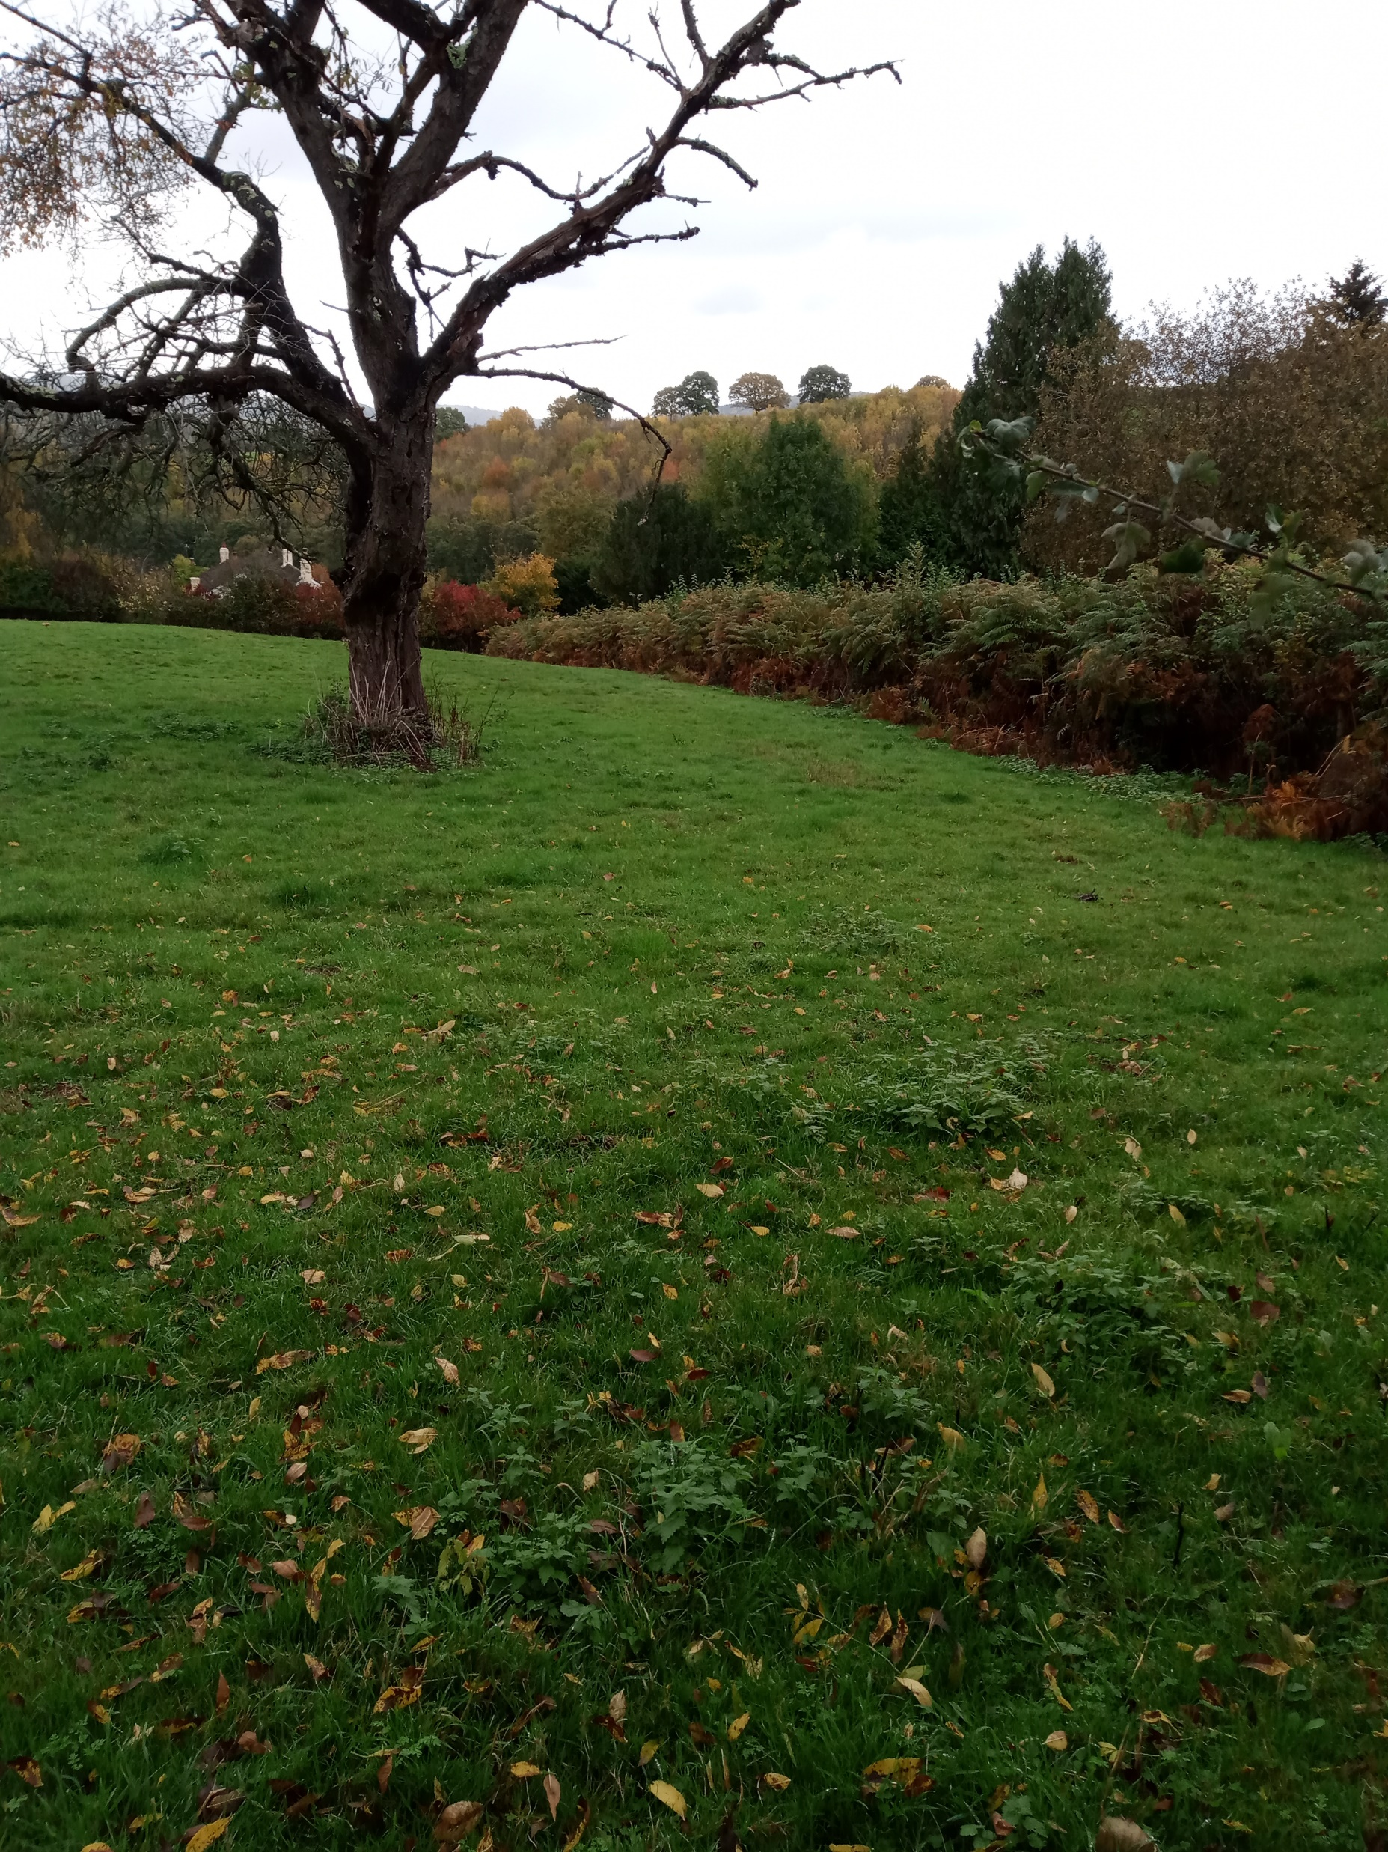
Land – Possibly Consider for Consulting Upon
Site 3 – Garthi Close, Mitchel Troy
Approx 6300m² - 12 pitches (12 pitches not necessarily being recommended)
Notes:
Coun Richard John and Jane McKenna

Slide 13
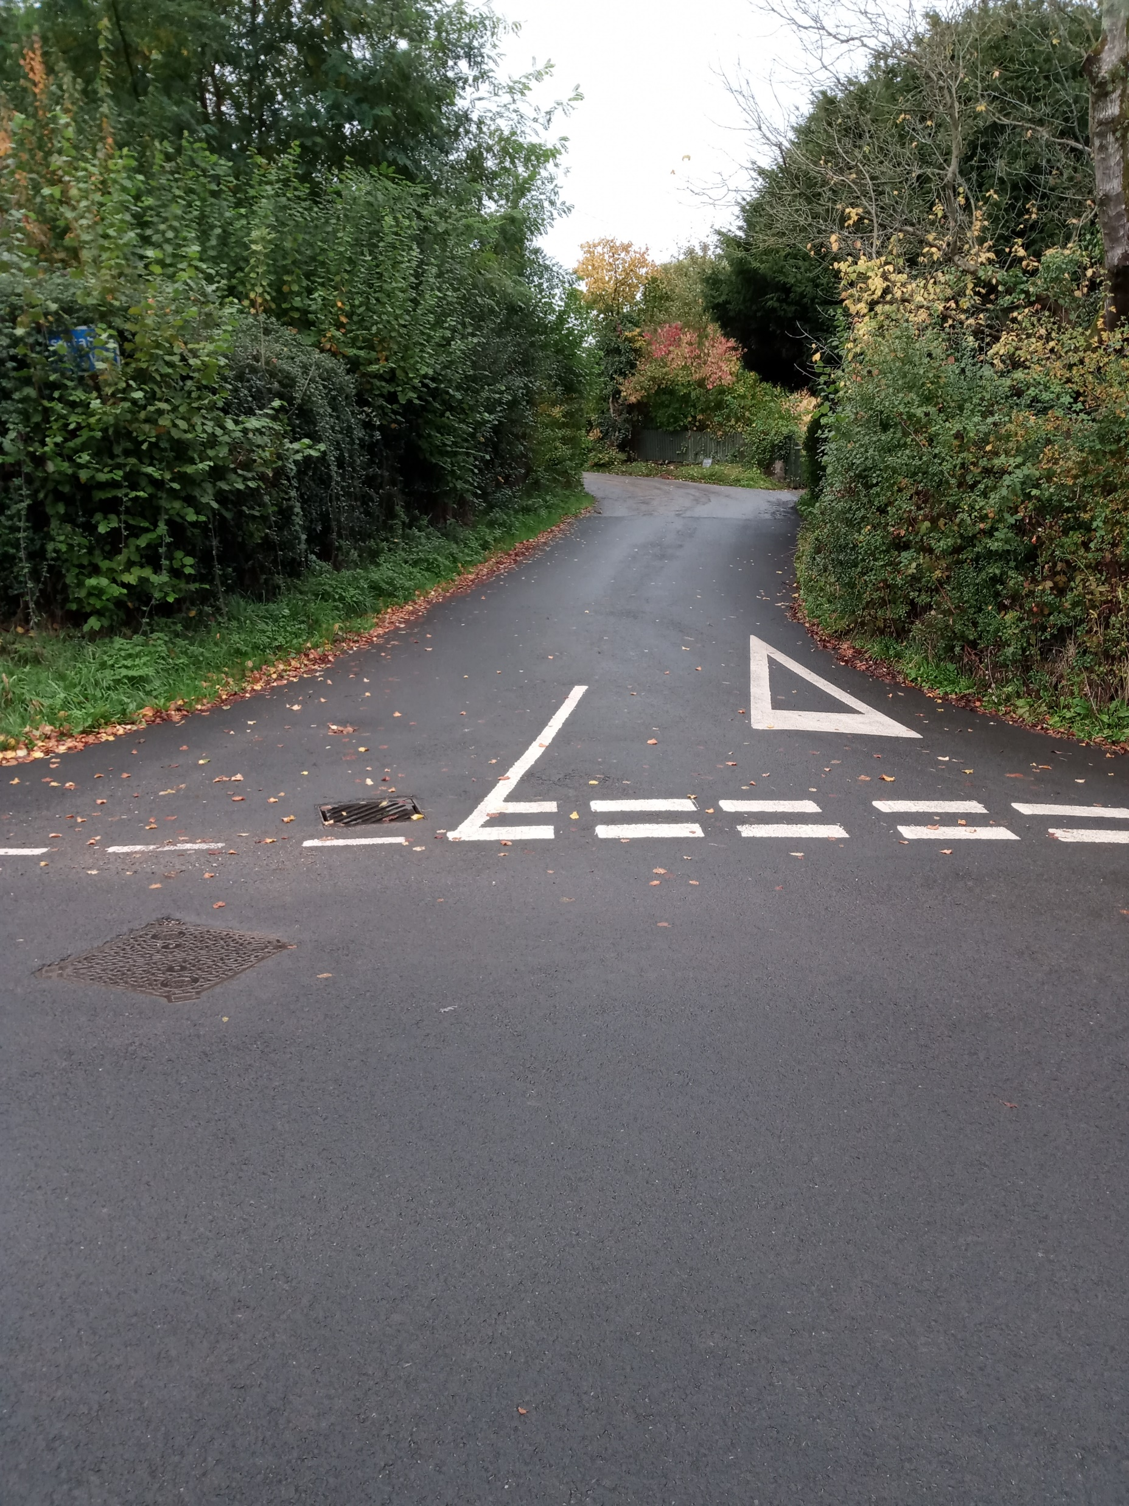
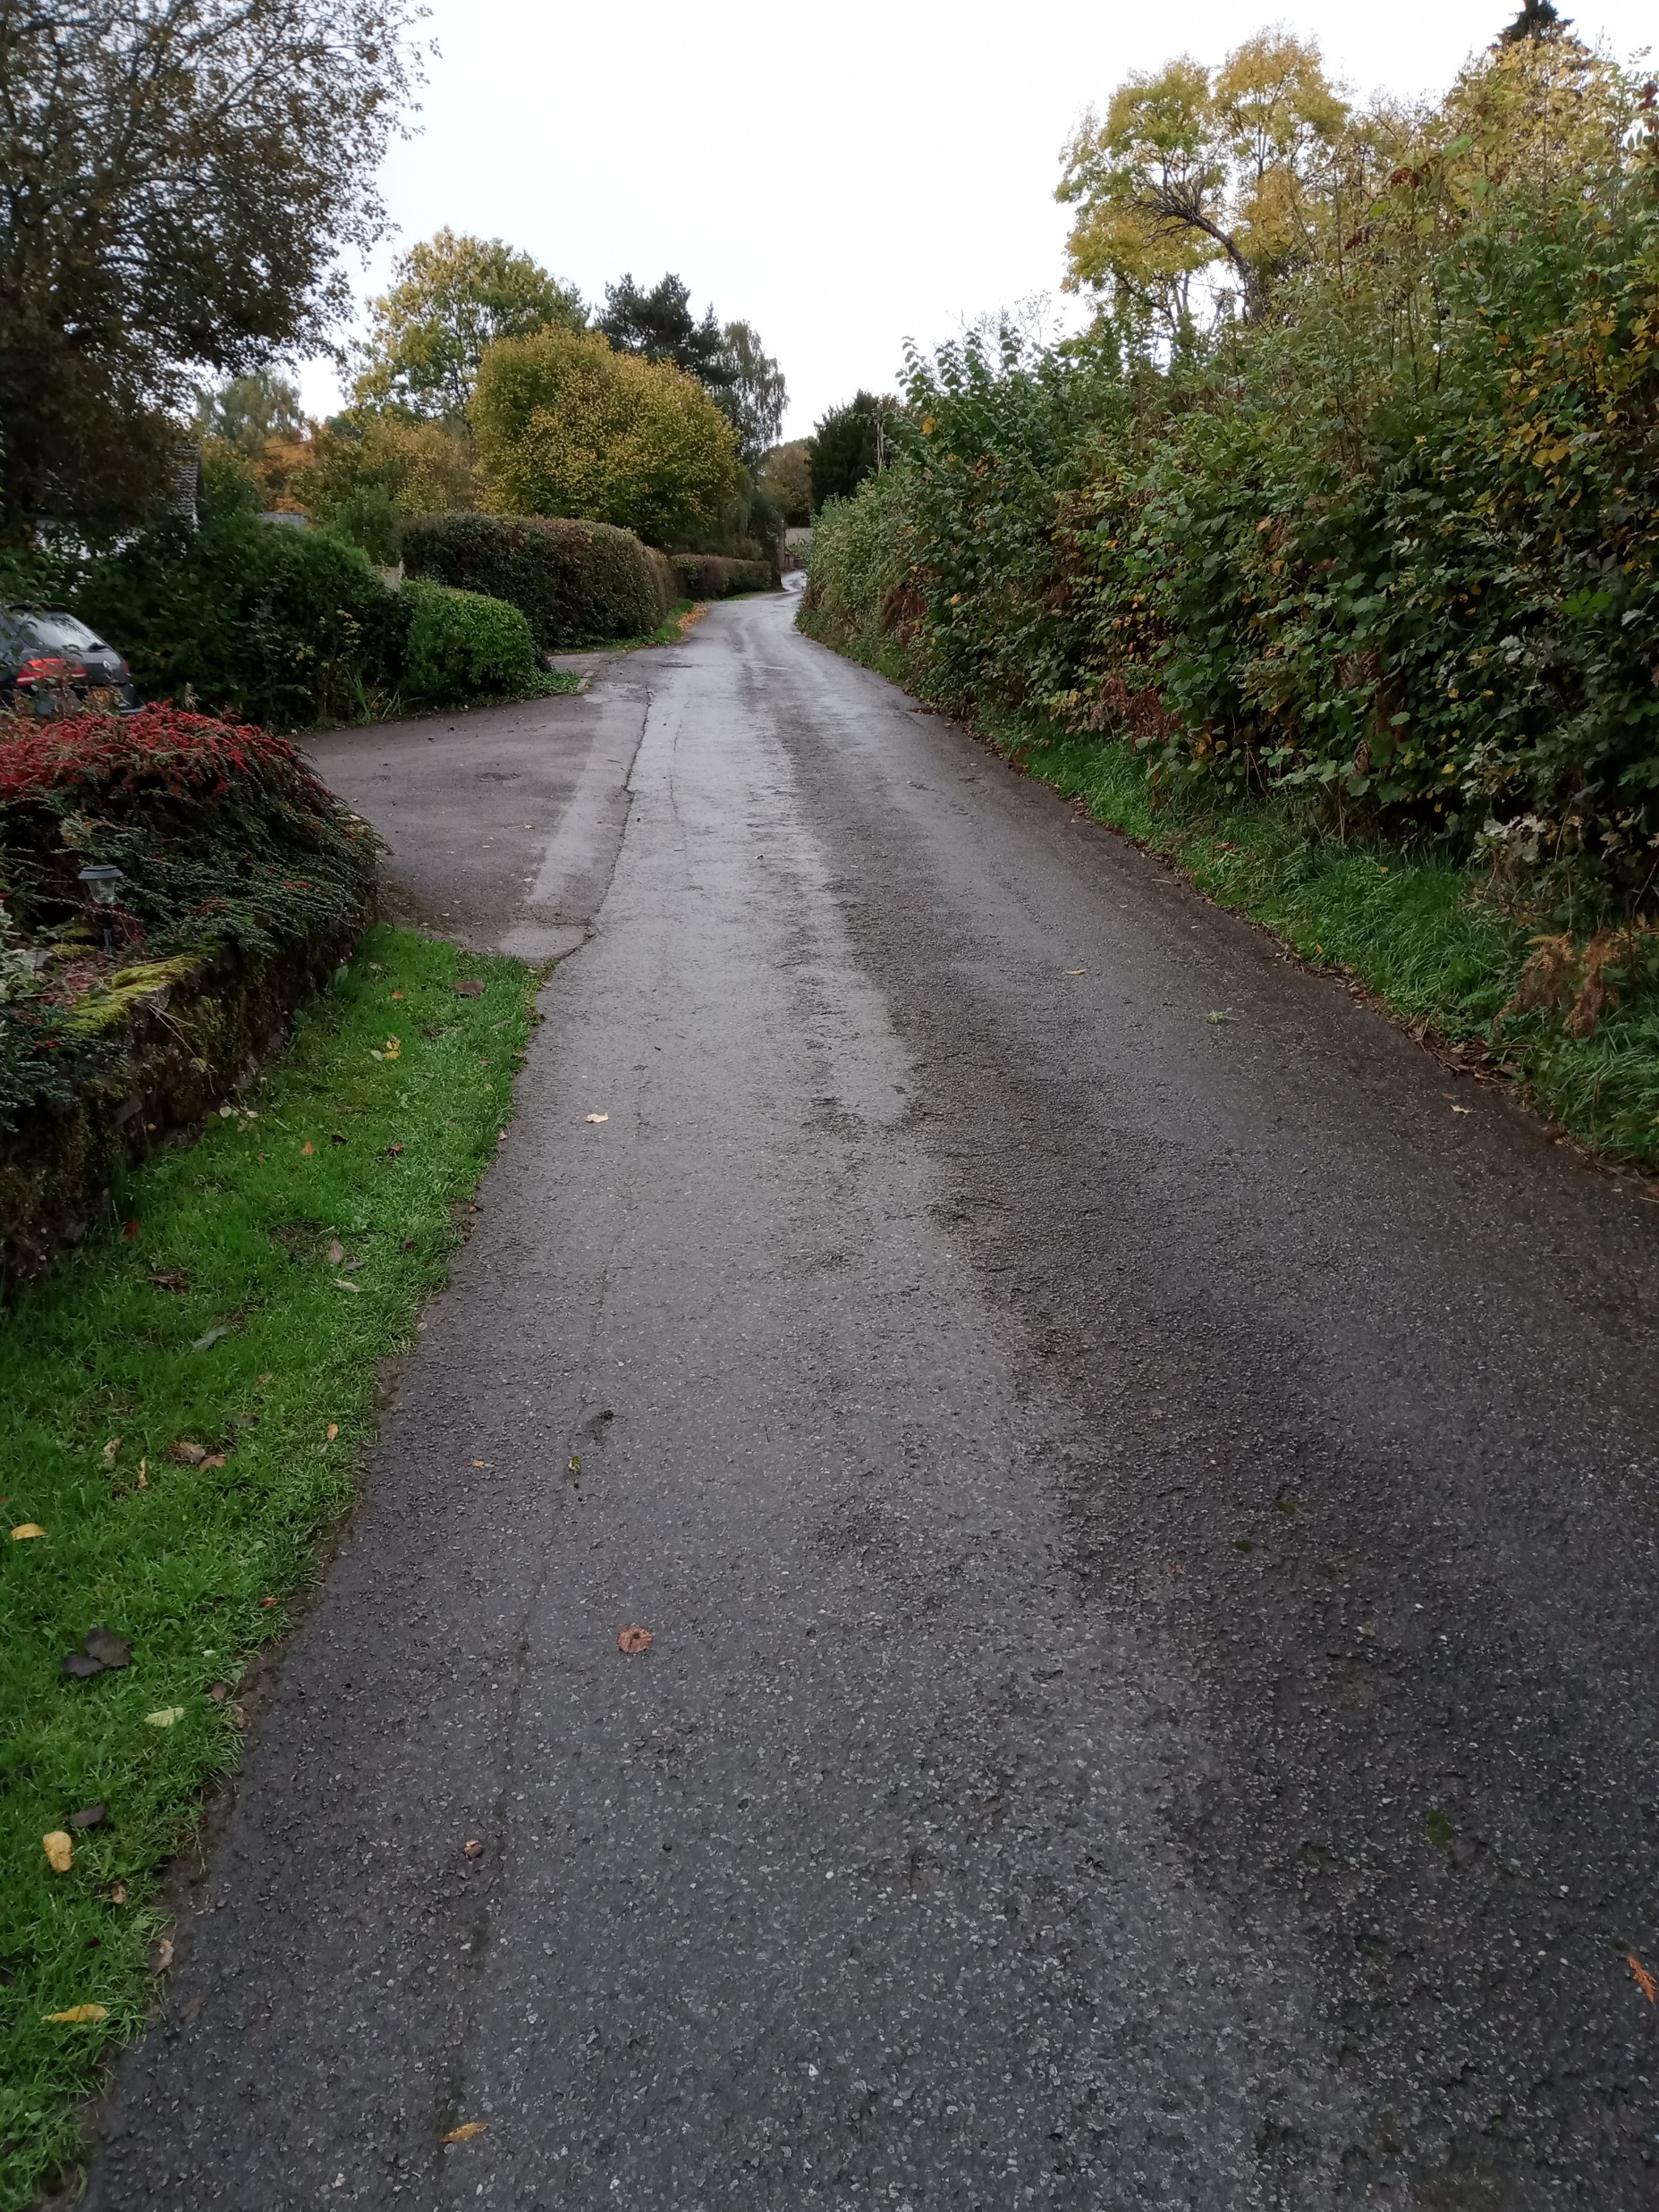
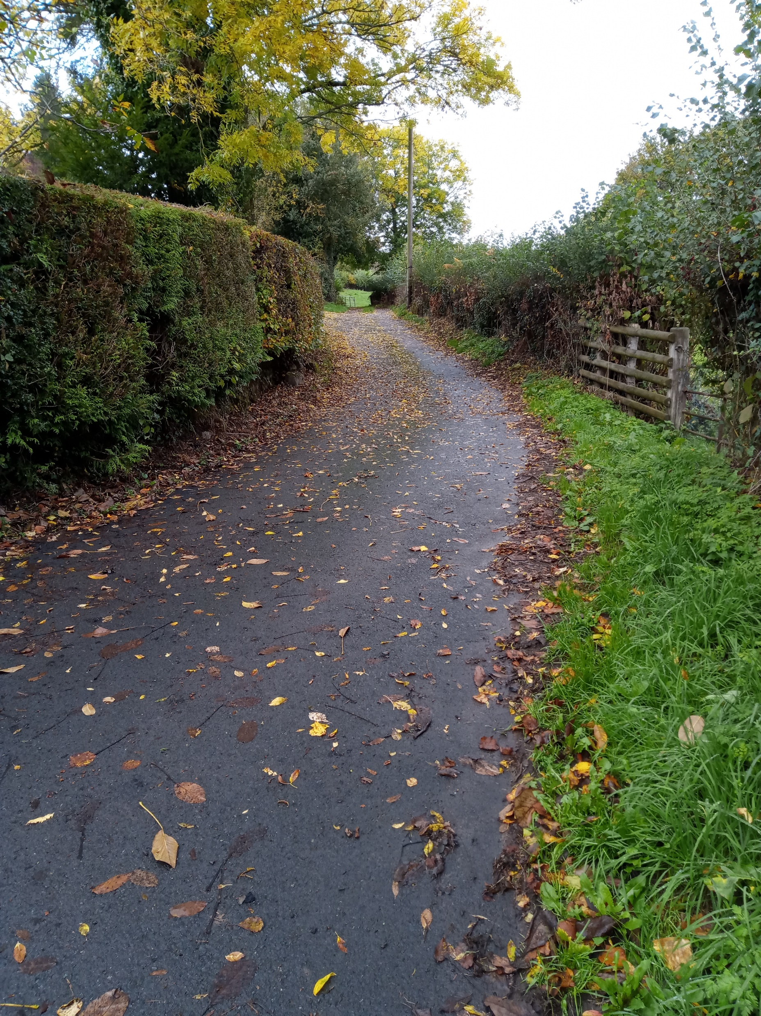
Land – Possibly Consider for Consulting Upon
Site 3 – Garthi Close, Mitchel Troy
Rural
On a narrow lane, approx 100 yards W up from Common Road
Current access via a single-track lane at the S corner
Currently grassland – reasonably even
Pros
Well screened to N, S and E elevations
Scope to develop part of site – create margin, management bens
Even and gently sloping topography
Cons
A need to create a new access, probably off the main lane – would impact on hedge
The site adjoins a property to the N
To the S and E, there are properties on the other side of lane
If combined with Rocklea, a Transport Statement would be necessary - to determine traffic impact on network.
Notes:
Coun Richard John and Jane McKenna

Slide 14
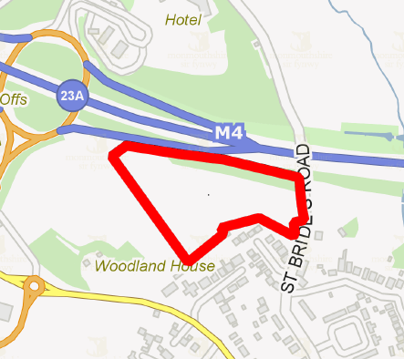
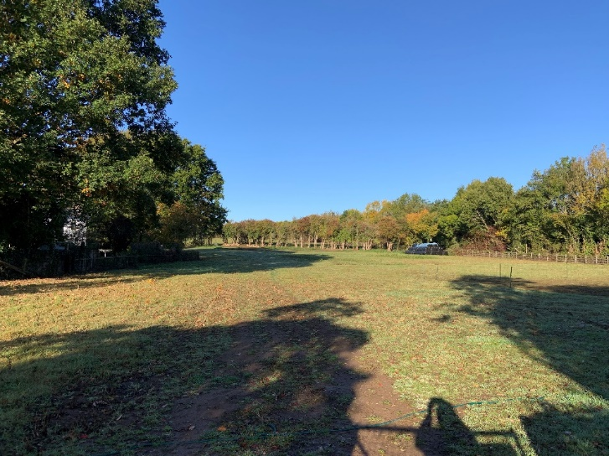
Land – Possibly Consider for Consulting Upon
Site 4 –Langley Close, Magor
Approx 23,431m² - sufficient to meet pitch needs
Notes:
Coun Frances Taylor

Slide 15
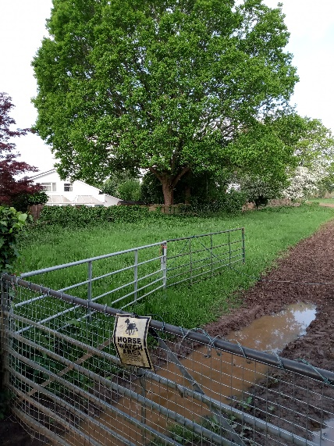
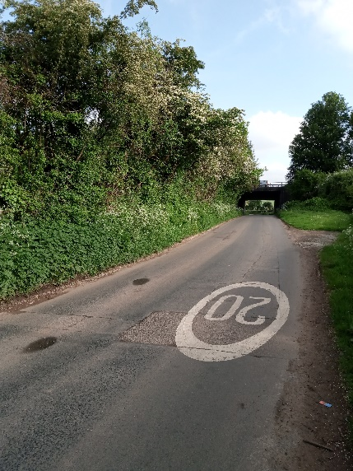
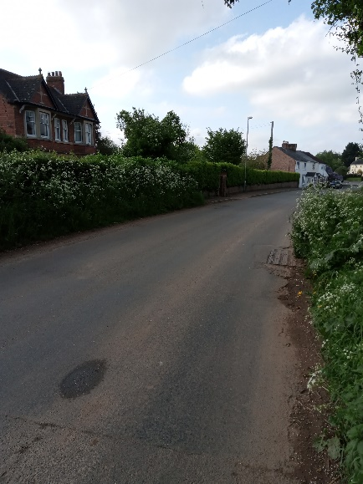
Land – Possibly Consider for Consulting Upon
Site 4 –Langley Close, Magor
Part of County Farm Estate – occupied via grazing licence
Current use grazing land
Access off St Brides Road
Pros
Level land with tree belt around the site.
Open land to E and W
Scope to develop ‘part’ of land – away from homes and M4
New access on St Brides Road could be created
Cons
Existing access not suitable
Residential properties adjoining S boundary.
M4 to N – potential noise and pollutions
Would be a need to serve notice on tenant
Woodland may support dormouse, birds and lizards
Notes:
Coun Frances Taylor

Slide 16
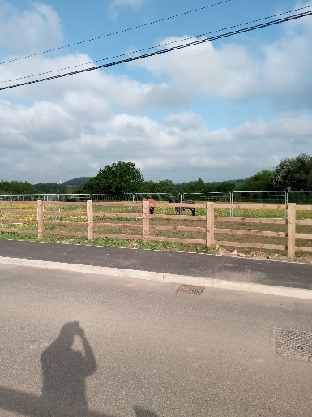
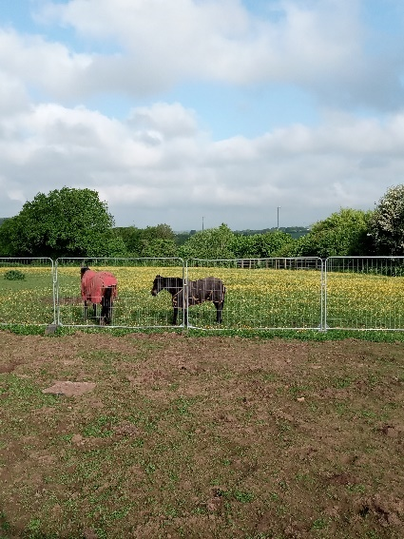
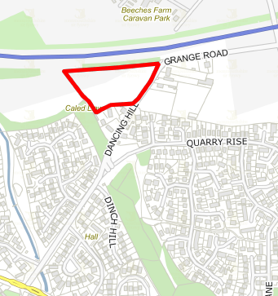
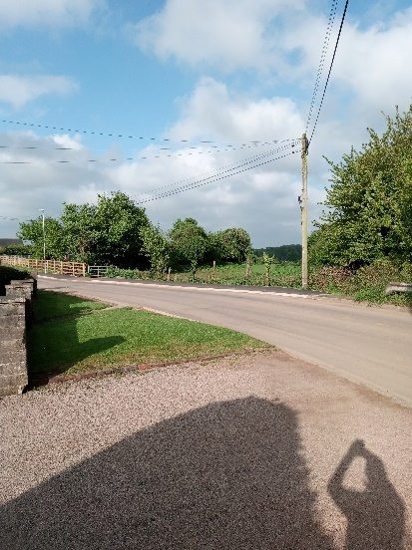
Land – Consider Further Evaluation
Site 5 – Dancing Hill, Undy
Approx 7,486 m² up to 13 pitches
Notes:
Coun Angela Sandles and John Crook

Slide 17
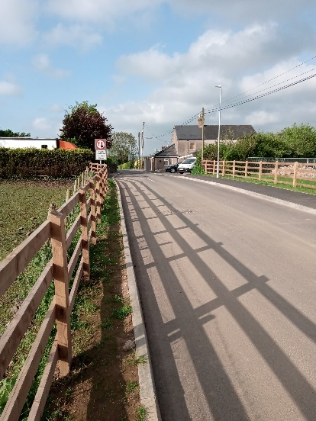
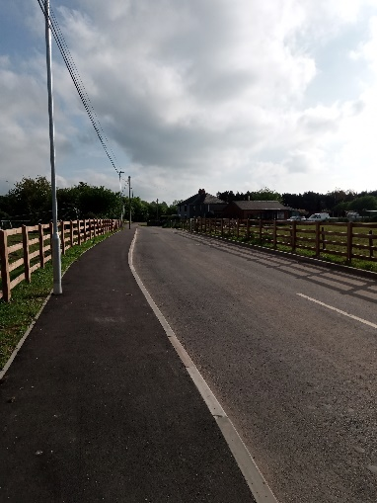
Land – Consider Further Evaluation
Site 5 – Dancing Hill, Undy
Urban
Former landfill site 1940-60
Part of County Farm Estate – occupied via grazing licence
Access off Dancing Hill/Grange Road.
Pros
Even topography
Scope to develop part
Cons
Classed as high risk for human health in MCC’s contaminated land prioritisation list.
Contaminated land site investigation would be needed and potential remediation
Existing access unsuitable – but alternative available
Homes adjacent to S elevation and opposite to E elevation
M4 to N – potential noise and pollution
Trees bordering the boundary. TPO’s to N boundary
Notice would need to be served on tenant
Notes:
Coun Angela Sandles and John Crook

Slide 18
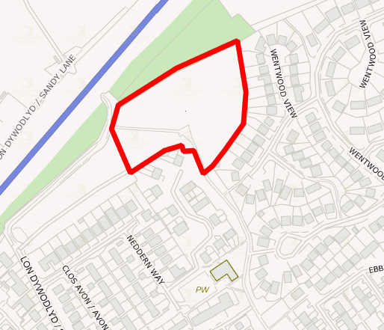
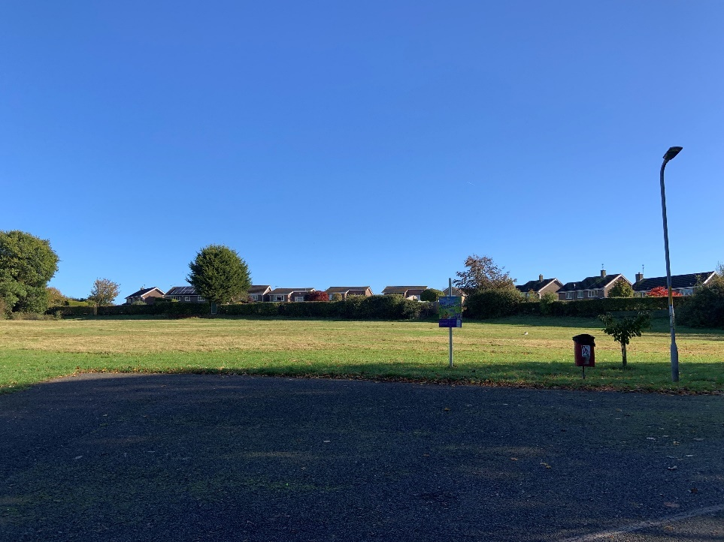
Land – Consider Removing from Process
Site 6 – Brookside, Caldicot
Approx 14,500m² - sufficient to meet pitch requirement
Notes:
Coun Rachel Garrick and Jackie Strong

Slide 19
Land – Consider Removing from Identification Process Site 6 – Brookside, Caldicot
Urban
Access via Sandy Lane and an unmade road
Forms part of public open/amenity space running through Caldicot
Pros
Even area of land
Trees provide buffer to M4 - located adjacent to the N boundary.
Scope to develop part of the land
Cons
No adequate vehicular access – cost implications
Residential properties adjoin the land to the E and S boundaries.
Loss of public open/amenity space
M4 proximity – possible noise and pollution implications
Notes:
Coun Rachel Garrick and Jackie Strong

Slide 20
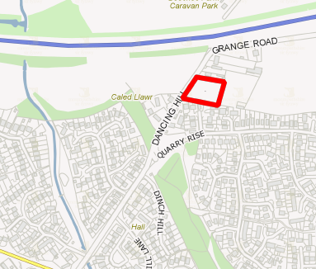
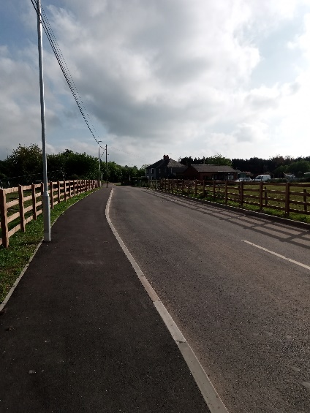
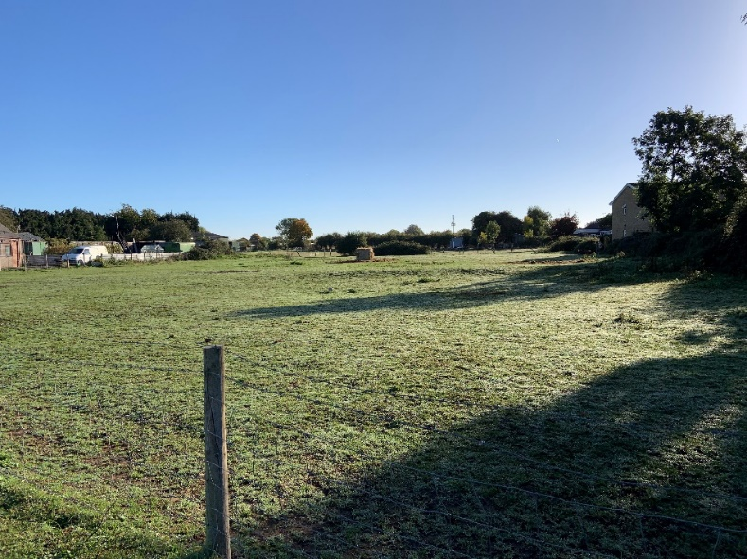
Land – Consider Removing from Identification Process
Site 6 – Dancing Hill x 0.81, Undy
Approx 3,277m² 6 pitches
Notes:
Coun Angela Sandles and John Crook

Slide 21
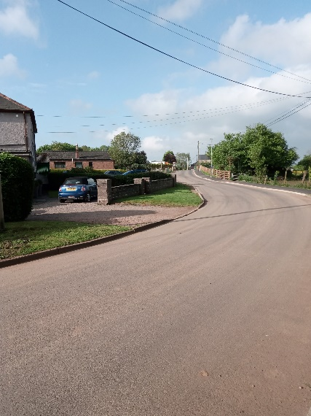
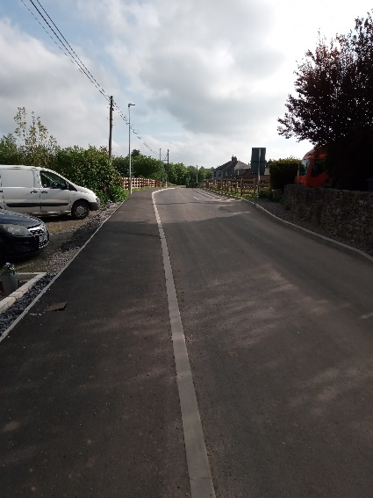
Land – Consider Removing from Identification Process
Site 6 – Dancing Hill x 0.81, Undy
Urban
Part of County Farm Estate – occupied via grazing licence
Level land site.
Access from Dancing Hill/Grange Road.
Pro’s
Area aligns with optimum size – may suit one or two families supports management
Open land to E and W elevation
Con’s
Access is not considered suitable – no alternative
Adjoins existing homes to N and S
Difficult to create margin between existing homes
There would be a need to serve notice on tenant
Notes:
Coun Angela Sandles and John Crook

Slide 22
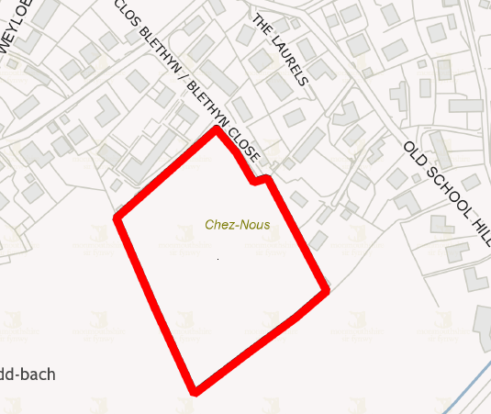
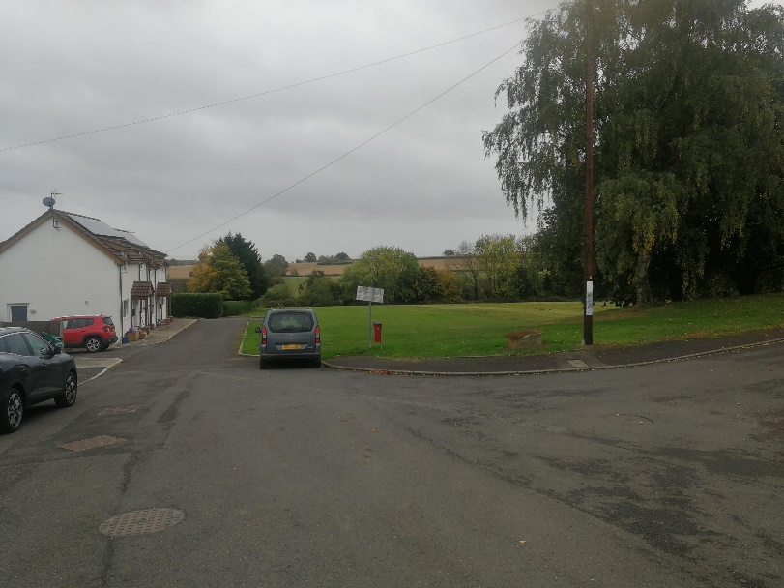
Land – Consider Removing from Identification Process
Site 8 – Mynydd Bach
Approx 14,400m² - sufficient to meet the identified need
Notes:
Louise Brown

Slide 23
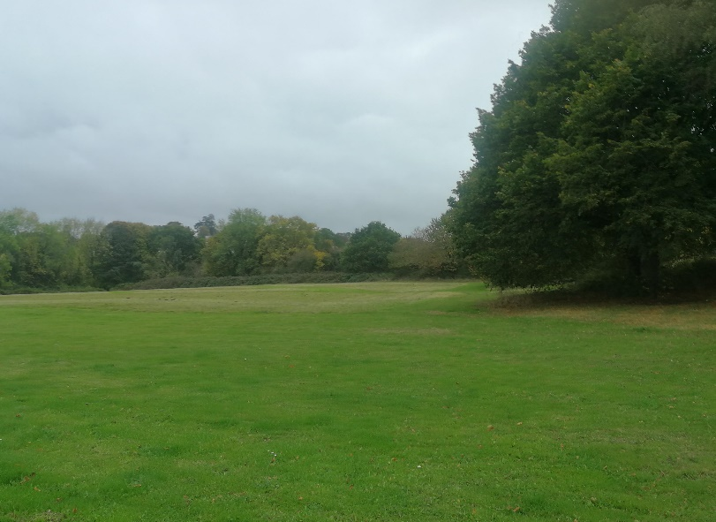
Land – Consider Removing from Identification Process
Site 8 – Mynydd Bach
Rural
Relatively level
Pro’s
Well screened on all boundaries with trees and hedgerows
Large area - scope to develop/utilise just part of land
Con’s
Access concerns – insufficient Highway capacity
Lost of public open space
Residential properties close however could be acceptable intervening distances
Located less than 250m from SSSI - important hibernation roost for lesser horseshoe bats.
Notes:
Louise Brown

Slide 24
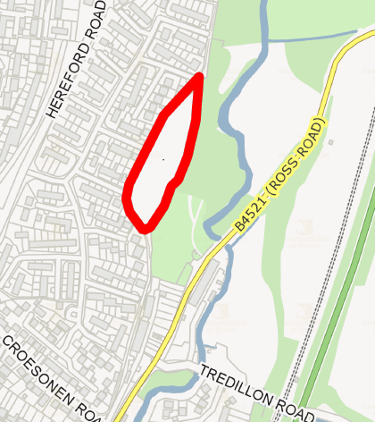

Land – Consider Removing from Identification Process
Site 9 – Croesonen Parc, Abergavenny
Approx 7,890m² - sufficient to meet identified pitch need
Notes:
Su McConnell

Slide 25
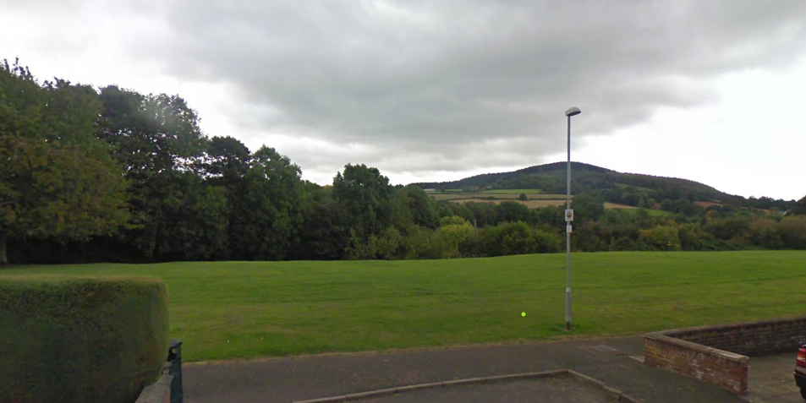
Land – Consider Removing from Identification Process
Site 9 – Croesonen Parc, Abergavenny
Urban
Public open space
Pro’s
Level land
Scope to develop/utilise just part of land
No access issues
Good access.
Trees bordering the eastern boundary.
Con’s
Loss of public open space
No margin or ability to create a margin
Residential properties adjoining W and S boundaries.
Impact on landscape
Access through residential area
Notes:
Su McConnell

Slide 26
Next Steps & Proposed Timetable
People Scrutiny - 19th July 2023 – consider proposal to consult on identified sites
Cabinet – 26th July 2023 – agree proposal to consult on identified sites
August – September 2023 - consult on identified site(s)
  utilise Specialist Planning Agency that supports and advocates for community involvement in planning.
People Scrutiny Committee 5th October 2023
  report on outcome of consultation and make site(s) recommendation for proceeding.
Cabinet 8th November 2023 – agree site(s) to progress for potential development
December 2023 Onwards:
Planning – progress with incorporating identified site(s) into the RLDP
Housing & Communities - engage with Travelling Ahead; MCC Estates and WG
Notes:
bbbbb

