Slide 1


Teithio Ymlaen:
Hyfforddiant Sipsiwn, Roma a Theithwyr
Travelling Ahead:
Gypsy, Roma and Traveller Training
Ar gyfer Cyngor Sir Fynwy Ionawr 2023
For Monmouthshire Council, January 2023
www.tgpcymru.org.uk

Slide 2
Yr hyn y byddwn yn ei gwmpasu
What we will cover
Overview
Timings
Who are Gypsy, Roma and Traveller communities?
A brief history
An overview of legislation, policy and guidance
Delivering culturally appropriate accommodation
Raise awareness of cultural issues
13:00 - 16:00
14:30 Break
Developed with feedback from community members, Dynamix ‘Tackling the tensions’ training programme, Unity Project, BASW Cymru and the Gypsy, Roma, Traveller Social Work Association for some of the content of todays training
www.tgpcymru.org.uk

Slide 3
Making it work
In person and virtual participants
Active participation – not sure? Just ask!
Using hands up/chat function
Confidentiality
Anonymity
Respect for each others opinions/views/experiences
Respectful challenge if necessary
Anything else?
NB we have a researcher observing
www.tgpcymru.org.uk

Slide 4
Teithio Ymlaen 0800 802 0025
Travelling Ahead 0800 802 0025
All Wales Advice and Advocacy Service est. 2017
Freephone Advice Line - rights, entitlement & support- access to services – planning, accommodation, education, roadside support
Supporting voices of Gypsy, Roma and Traveller communities to engage with public bodies & influence decision makers – young people/adults/communities
Engagement Officers visit sites and link with communities
EU Settlement Scheme support and advice for Roma EU Citizens
Tackling discrimination and hate crime
Training and advisory role - developing good practice - learning form community expereinces
www.tgpcymru.org.uk

Slide 5

Questions?
Cwestiynau?
Please write your burning questions on a post-it note ( anon) or in the chat bar and we will endeavour to answer these during the session
www.tgpcymru.org.uk

Slide 6
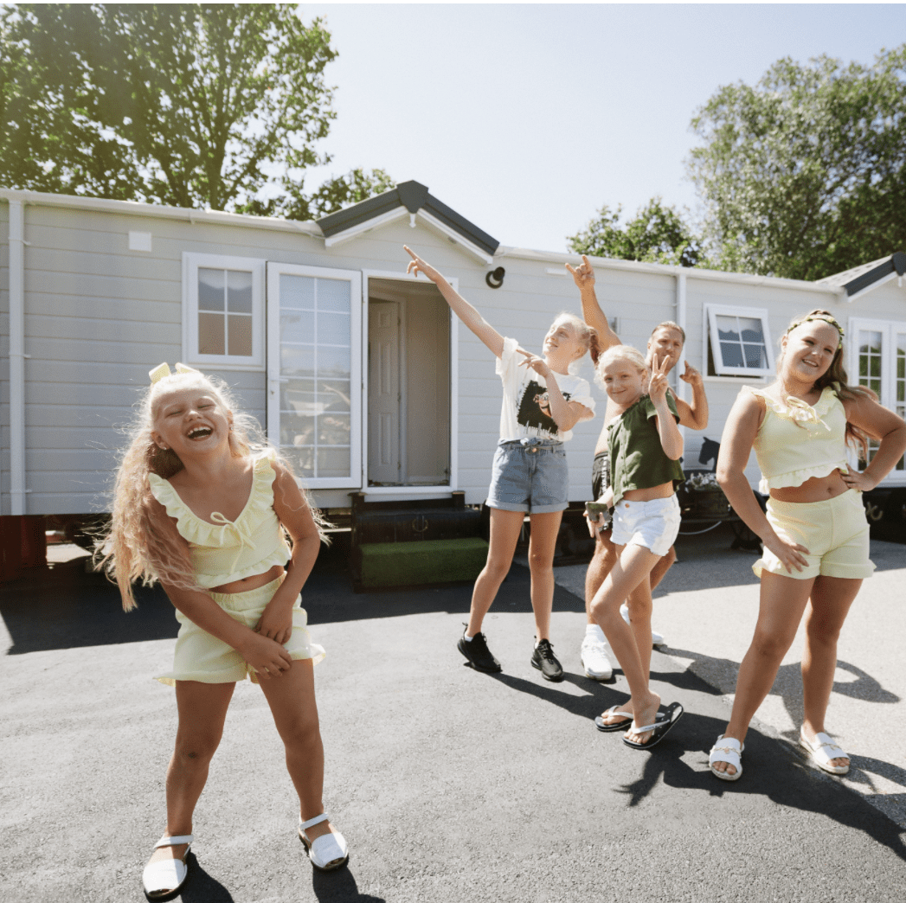
Group Exercise
Undertake a brief online search using the key words Gypsy, Traveller & Roma
If you knew nothing at all about the communities what might your first impressions be, based on what you’ve found?
Try the search on your personal phone or switch to images search – is there a difference?

Slide 7
Pwy yw Sipsiwn, Roma a Theithwyr
Who are Gypsies, Roma and Travellers
Diverse: ‘Gypsy, Roma and Traveller’ is an umbrella term for a diverse group of people who have a nomadic or semi nomadic heritage, or a nomadic or semi-nomadic lifestyle.
Broad definition in Welsh legislation – differs from England
Names should be CAPITALISED – “Traveller/Gypsy/Roma”
www.tgpcymru.org.uk

Slide 8
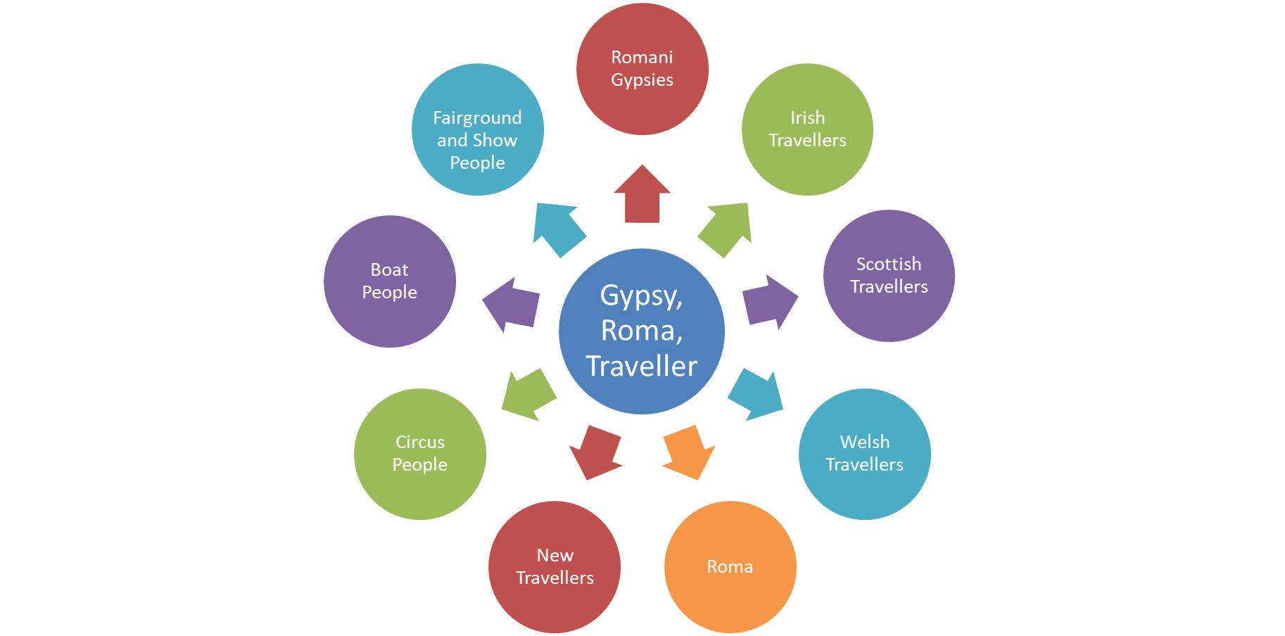
Pwy yw Sipsiwn, Roma a Theithwyr
Who are Gypsies, Roma and Travellers
www.tgpcymru.org.uk

Slide 9
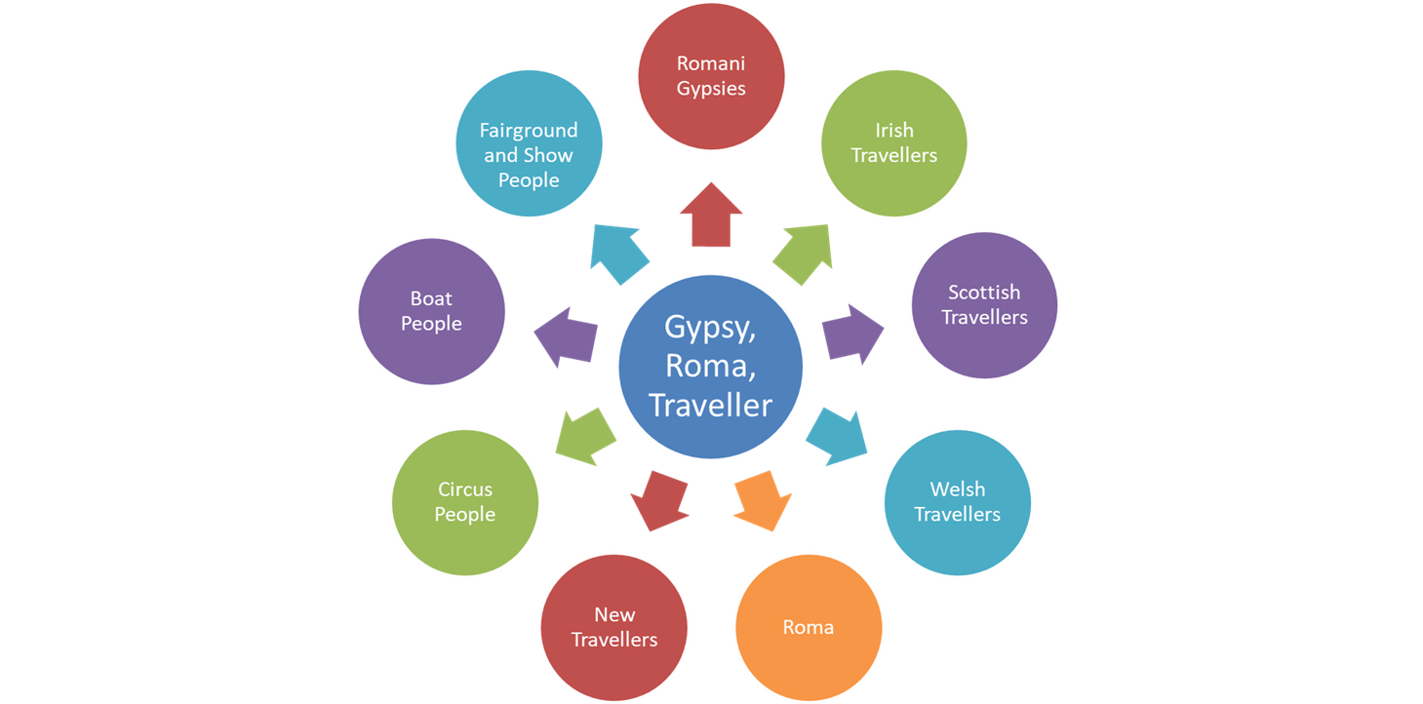
Pwy yw Sipsiwn, Roma a Theithwyr
Who are Gypsy, Roma and Travellers
Can you identify which groups of Gypsies & Travellers are considered as Ethnic groups?
www.tgpcymru.org.uk

Slide 10
Caiff y ddau grŵp eu cydnabod fel Grwpiau Lleiafrifoedd Ethnig o dan Ddeddfwriaeth Cydraddoldebau
Three groups are recognised as Ethnic Minority Groups under Equalities legislation ( Mandla Criteria 1983)
Romani Gypsies and Irish Travellers are recognised ethnic groups for the purposes of the Equality Act 2010. Additionally, the Equality and Human Rights Commission considers Gypsies and Travellers to be amongst the most vulnerable and marginalised minority groups in Britain.
Romani Gypsies were recognised in 1989 (CRE v Dutton) via a case involving a 'No Travellers' sign. Irish Travellers were recognised in 2000 (O'Leary v Allied Domecq) through a case brought in a similar vein.
Romani Gypsies have a shared culture; language and belief system, as do Irish Travellers; both groups may be referred to as Travellers and are often referred to together as the travelling community/communities.
Scottish Travellers in 2008
First able to identify in census 2011, first separate identification for Roma 2021
www.tgpcymru.org.uk

Slide 11
Welsh definitions in law and policy – Housing Act / Planning Circular
The Act defines Gypsy & Travellers as:
(a) persons of a nomadic habit of life, whatever their race or origin,
including—
(i) persons who, on grounds only of their own or their family’s or dependant’s educational or health needs or old age, have ceased to travel temporarily or permanently, and
(ii) members of an organised group of travelling show people or circus people (whether or not travelling together as such), and
(b) all other persons with a cultural tradition of nomadism or of living in a mobile home;
www.tgpcymru.org.uk

Slide 12

‘Ffyrdd o’r Gorffennol’ – Amseroedd Teithwyr
‘Roads From the Past’ - Travellers Times
https://www.youtube.com/watch?v=1bhBbMrF8Z0
www.tgpcymru.org.uk

Slide 13
History of discrimination
Gypsy, Roma and Traveller communities are some of the most disadvantaged and excluded groups in the UK. There exists a long history of persecution, discrimination and unfounded association with vagrancy and criminality, which ultimately leads to vilification, marginalisation, and social exclusion.
600 years of oppression in the UK, Gypsy communities first mentioned in the Egyptian Act 1530 by Henry VIII which began historic demonisation of Traveller communities
Marginalisation of the GRT community in Europe community in Europe reached its climax with the Holocaust – or as it is known by the Roma people themselves; the Porrajmos, or the Devouring ( Hancock 1987, 2007)
The stereotype of nomadism imagines the entire GRT community as “involved in criminal activities, irreverent towards religion, harbouring sinister magical powers and primitive, as evidenced in promiscuity, dancing and baby-snatching” (Woodcock, 2010, p.471)
Legislation and policies have systematically sought to clamp down on the nomadic lifestyle such as the Criminal Justice Act 1994 and the Police Crime Sentencing and Courts act
www.tgpcymru.org.uk

Slide 14
Gwahaniaethu: y ffurf hiliaeth dderbyniol olaf?
Discrimination: the last acceptable form of racism?
Evidence
Impact
(EHRC 2015)
Experience high levels of bullying and exclusion in schools
Have lower levels of economic activity but nearly twice as likely to be self employed
Often experience poor access to healthcare are more likely to suffer bad health.
Negative attitudes towards Gypsies, Roma and Traveller communities are still widely held.
(Traveller Movement 2017)
55% had been refused service in pubs, hotels etc
77% experienced hate speech or hate crime including on-line/social media
(WG Tackling Hate Crime Framework Focus Groups 2017)
Happens every day – “I’m used to it”
Feeling worthless, always on the defensive
Angry
Ashamed
Hide ethnicity
Don’t seek legal help - don’t report
“I’ve heard of hate crime laws, but I think they work more for Muslims or gay people, not us.”
www.tgpcymru.org.uk

Slide 15
Trosolwg o ddeddfwriaeth a pholisi
Legislation and policy overview
Legislation
Guidance
Human Rights Act 1988
Equality Act 2010
Housing Act (Wales) 2014
Planning for Gypsy, Traveller and Showpeople Sites 5/2018
Guidance on Gypsy &Traveller Accommodation Assessments (S)
Designing Sites Guidance
Managing Sites Guidance
Managing Encampments
Travelling to Better Health 2016
Enabling Gypsy, Roma and Travellers Plan 2018
www.tgpcymru.org.uk

Slide 16
Deddf Tai (Cymru) 2014
Housing Act (Wales) 2014
This Act introduces significant changes to way Local Authorities (LA) have to undertake Gypsy Traveller Accommodation Needs Assessments (GTAA) and law regarding site provision
The Act sets a national standardisation of the way that GTAA are undertaken
It places a statutory requirement upon LA to ensure that Gypsy Traveller sites are provided where there is an identified need ( through public and private sites)
The Act provides a legal definition of Gypsy Travellers in Wales
www.tgpcymru.org.uk

Slide 17
Recent developments
Anti-Racist Wales Action Plan
Police, Crime, Courts and Sentencing Act
Local Government and Housing Committee Inquiry into provision of Gypsy and Traveller Sites https://research.senedd.wales/research-articles/a-community-forgotten-limited-progress-in-providing-culturally-appropriate-sites-for-gypsy-roma-and-traveller-communities-in-wales/
ONS Research : https://www.ons.gov.uk/peoplepopulationandcommunity/culturalidentity/ethnicity/bulletins/gypsiesandtravellerslivedexperiencescultureandidentityenglandandwales/2022
www.tgpcymru.org.uk

Slide 18
Y Ddeddf Cydraddoldeb - dyletswyddau cadarnhaol
Equality Act - positive duties
The Public Sector Equality Duty established by the Equality Act 2010 means that those bodies subject to it (including the police and local authorities) must, in the exercise of their functions, have due regard to the ‘general duty’ to:
Eliminate unlawful discrimination, harassment and victimisation and other conduct prohibited by the Act
Advance equality of opportunity between people who share a protected characteristic and those who do not
Foster good relations between people who share a protected characteristic and those who do not.
www.tgpcymru.org.uk

Slide 19
Elected member Codes/Guides
The Code of Conduct for members of local authorities in Wales
Members must carry out their duties and responsibilities with due regard to the need to promote equality of opportunity for all people, regardless of their gender, race, disability, sexual orientation, age or religion, and show respect and consideration for others. (Public and private)
Social Media: A Guide for Councillors
Legal Briefing on Racial Discrimination: Gypsies, Roma, and Travellers and their sites in Wales October 2021
www.tgpcymru.org.uk

Slide 20

20 Minute Comfort Break!

Slide 21
Exercise: A local visit
You have been contacted by a constituent who has an issue they would like to discuss with you
You take their name and address and agree a time when you will call round to see them and their family
How would you normally prepare to visit a constituent – what would you think about in advance, what would your initial thoughts and feelings be as you arrive at address number 1 and address number 2?
Notes:
3 minutes to consider - use chat or share verbally

Slide 22

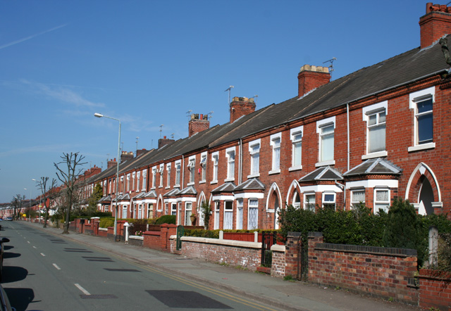
Address 1

Slide 23
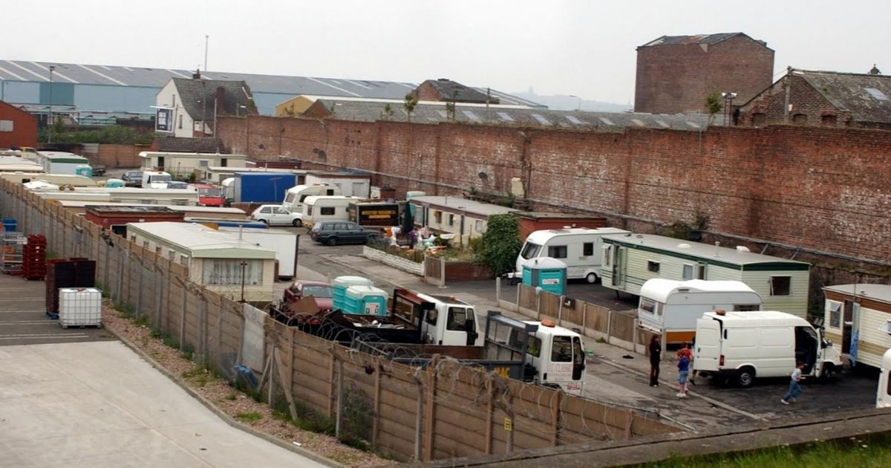
Address 2

Slide 24
Voices from Home
Voices from Home https://youtu.be/Bc5kg7hUpI4
www.tgpcymru.org.uk

Slide 25
Question?
What percentage of caravans in Wales are in:
Authorised sites
Unauthorised on public land
Unauthorised on land owned by Gypsies and Travellers
www.tgpcymru.org.uk

Slide 26
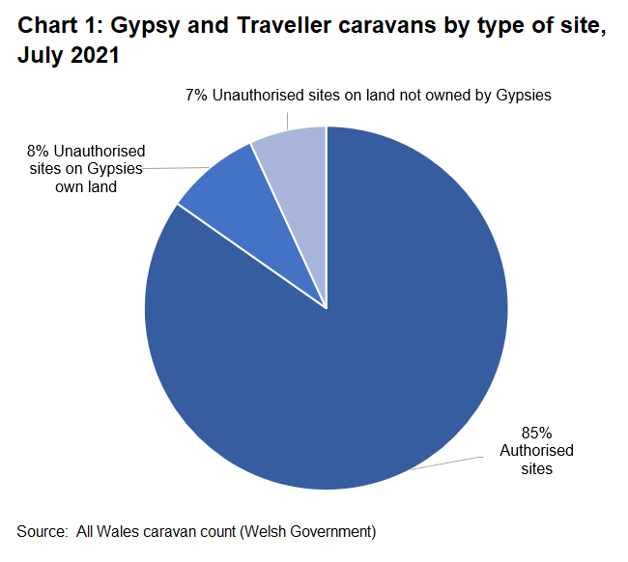
Safleoedd & Carafannau
Sites & Caravans/trailers
www.tgpcymru.org.uk

Slide 27
Gypsy and Travellers sites
Some Gypsy & Travellers live in houses and some live on sites. There are three main types of sites in Wales;
  Local Authority owned and managed sites
  Sites where private landowners (often Gypsy & Travellers) have developed their own sites. If these sites don’t have planning permission then they are called unauthorised developments
  Sites where land can be public or private and the landowner has not given permission for people to live there, these are called unauthorised encampments
Where Gypsy & Travellers live on authorised sites either Local Authority or private the pitch holder is liable for council tax, and on Local Authority sites the pitch holder is liable for pitch rent.
All pitch holders on Local Authority sites are licensees and are covered under the Mobile Homes (Wales) Act which gives them protected tenancies.
A slab is the concrete base that Caravans, Mobiles or Chalets are sited on
A pitch is the area of a site that belongs to a family, usually slab, parking space, garden and a utilities block
The GTAA will assess the number of pitches needed in a Local Authority area not the number of sites needed
www.tgpcymru.org.uk

Slide 28
Pam fod angen safleoedd?
Why are sites needed?
Why are sites needed
Benefits for all
Passporting right – a secure base allows people to access all other services and potentials
Cultural traditions - to facilitate the nomadic way of life – families still travel to different degrees
Changes in work patterns and frequency
Importance of extended family living
Cultural aversion to ‘bricks and mortar’
Changes in legislation & disappearance of traditional stopping places – few authorised places or transit sites
Access to secure accommodation and/or base for GRT families in line with cultural traditions
Families pay council tax and receive
  Access to basic facilities - security, water and utilities
  Access to services – better outcomes in education, health, employment
Less encampments
Less conflict and better community cohesion> fosters good relations
Cost benefits to public services
www.tgpcymru.org.uk

Slide 29
‘We are all so many things’ – Sipsiwn a Theithwyr Llundain
‘We are all so many things’ – London Gypsies & Travellers
https://youtu.be/jT6R5zT_jzw
www.tgpcymru.org.uk

Slide 30

Burning questions - Unrhyw gwestiynau?
www.tgpcymru.org.uk

Slide 31
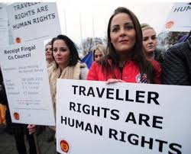
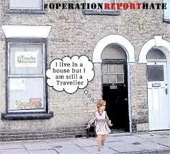
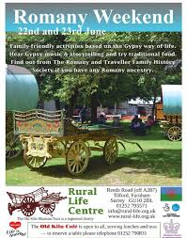
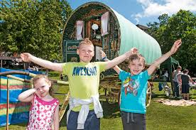
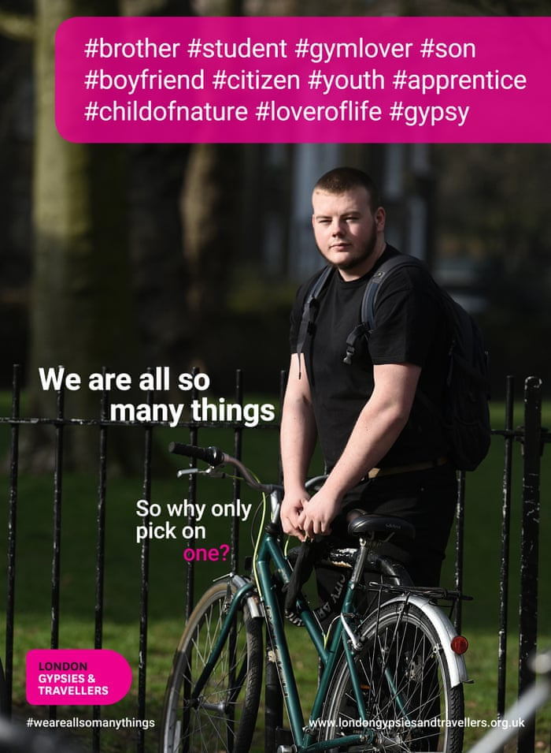
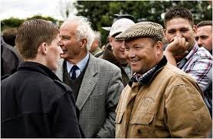
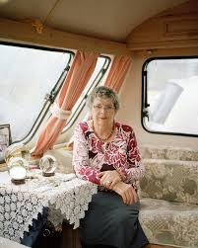
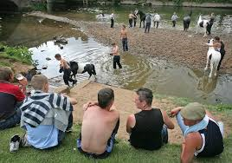
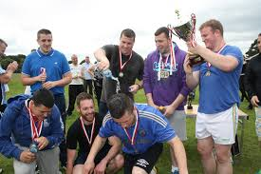
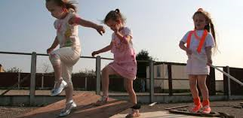
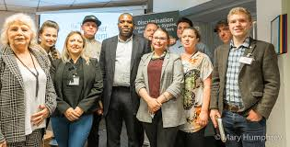
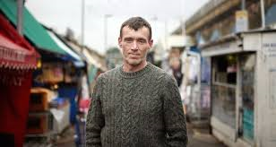

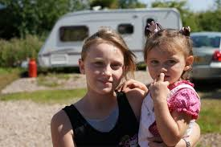
www.tgpcymru.org.uk

Slide 32
Diolch / Thank You
Travelling Ahead
0808 802 0025
travellingahead@tgpcymru.org.uk
www.tgpcymru.org.uk

Slide 33
Mandla Criteria
How can we define Race?
(Mandla (Sewa Singh) and another v Dowell Lee and others [1983] 2 AC 548)
Essential
A long shared history, of which the group is conscious as distinguishing it from other groups and the memory of which it keeps alive;
A cultural tradition of its own, including family and social customs and manners, often but not necessarily associated with religious observance

Slide 34
Mandla Criteria
Relevant but not essential
Either a common geographical origin, or descent from a small number of common ancestors;
A common language, not necessarily peculiar to the group;
A common literature peculiar to the group;
A common religion different from that of neighbouring groups or from the general community surrounding it

