Slide 1

Members Workshop
Meeting Gypsy & Traveller Pitch Needs
&
Site Identification
29th September 2022

Slide 2
Introduction
Introductions
Purpose
  Brief members: MCC responsibilities in respect of Gypsy & Traveller
  Background & Methodology
  Findings
  Planning Implications
  Proposed Approach to Meeting Need

Slide 3
Background
Housing (Wales) Act 2014 – Statutory duty to undertake a GTA every 5 years
  Used Welsh Government Guidance
  Should a need be identified, a duty on the local authority to provide sites
Broad requirement – identify G & T households living in Monmouthshire with a view to engaging with them to capture any possible housing needs.
Production of a robust estimate of Gypsy &Traveller pitch needs:
  Ensure culturally-appropriate accommodation is provided
  Help to reduce unauthorised encampments
Positive & proactive participation with Gypsy & Traveller communities to ensure:
  Best possible assessment of need
  Build links between the Council and the Gypsy & Traveller community
  Ensure communities understand and can influence the process

Slide 4
Gypsy & Traveller Assessment
13 households identified in MCC
  Face to face interviews Oct – Dec 2019 by a consultant
  9 contacted - 7 completed surveys; 2 declined;
  4 couldn’t be contacted
Of the 7 households:
  1 x bricks & mortar; 1 x authorised location; 5 unauthorised location
  5 of 7 households have dependent children
  22 people – 14 x 18+; 8 <18
  6 of 7 were happy with their current location, although 4 households had the risk of eviction

Slide 5
Findings - Assessed Pitch Needs
9 x pitches to 2025
Further x 4 over the period of the Replacement LDP to 2033
No need for a permanent transit site
Should consider the use of short-term toleration or negotiated stopping arrangements to deal with short-term encampments.
Adopted by Cabinet January ’21
  The Council is now required to meet this identified pitch need, which also needs to be factored into the Replacement Local Development Plan.
Notes:
Unmet need can be met either by facilitating households (who possibly may own or wish to purchase land to meet their own needs) through planning permission. Or alternatively, through the provision of public Council owned pitch(s).

Slide 6
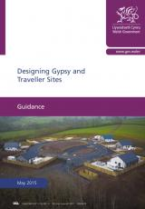
National Planning Policy
Circular 005/2018 Planning for Gypsy, Traveller and Show people Site June 2018 – This document provides guidance on identifying sustainable sites for Gypsies and Travellers
Para 35. Where a GTAA identifies an unmet need, planning authorities should allocate sufficient sites in development plans to ensure that the identified pitch requirements for residential and / or transit use can be met. Planning authorities will need to demonstrate that sites are suitable and deliverable in the identified timescales. With such policies in place there will be more certainty for all concerned when planning applications are determined.
Welsh Government Guidance : Designing Gypsy and Traveller Sites May 2015
3.22 As with all developments, it is likely that Local Authorities will need to follow the ‘line of best fit’ when assessing
potential sites. It may be that none of the potential sites can completely satisfy the guidance in this document.
The general themes Local Authorities should consider are:-
• Access
• Suitability of land – land contamination, flooding etc
• Local Services – Ideally located within reasonable distance from education settings, health services and shops.
• Environment – sites should not be located next to hazards such as rivers or canals, unless appropriate mitigation can be installed.
• Utilities – water, electricity, sewerage, drainage and refuse disposal should be provided on all sites.

Slide 7
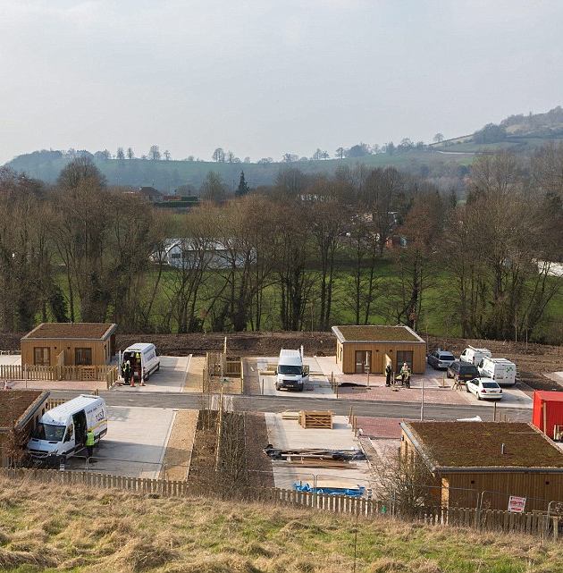
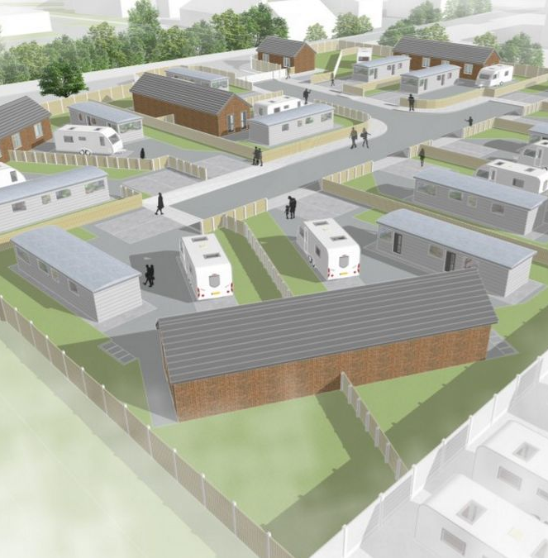
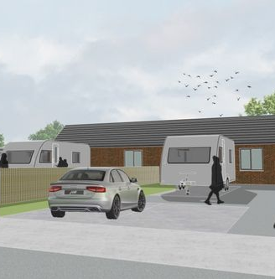
Definition of Pitch
The layout of the pitch will depend on the overall site design. However an important element in the design and size of pitches is the intended capacity. Gypsies and Travellers traditionally have larger families than the settled community and so there is likely to be more of a demand for larger family sized pitches
As a minimum, each pitch should be capable of accommodating an amenity block, a mobile home, touring caravan and parking for two vehicles.

Slide 8
Planning
No site allocations within existing Local Development Plan (LDP) for Gypsy and Traveller residential use.
Existing Planning applications are determined using Policy H8 -Gypsy, Traveller and Travelling Show people Sites, development is permitted subject to the site having regard to highways, accessibility to services, size of the site in terms of a pitch, impact on landscape, avoid flooding areas and areas of pollution, acceptable impact on residential amenity and access to on site services and utilities.
The piece of work for the working group is to establish site allocations within the Replacement Local Development Plan 2018-2033 for 13 pitches to meet the need identified within the GGTA.

Slide 9
Proposed Approach to Meet Pitch Need
1 pitch - facilitate by supporting a private household with acquiring planning permission for an additional pitch on their existing site
Officer Gypsy & Traveller Working Group - includes officers from Housing & Communities, Planning and Estates.
  Officers have undertaken an initial high level ‘sifting’ exercise to review and appraise all Council owned land for potential use as Gypsy & Traveller sites.
  Next step - continue to sift and refine the sites identified to date to effectively create a short-list applying agreed and approved criteria.
20th July – Report to People Scrutiny - completed
Todays members Workshop 1 – raise awareness
Notes:
Unmet need can be met either by facilitating households (who possibly may own or wish to purchase land to meet their own needs) through planning permission. Or alternatively, through the provision of public Council owned pitch(s).

Slide 10
Proposed Timetable
Immediately - Engage with the G & T Community
Inform of proposal and process
Invite to become part of the decision making process - Travelling Ahead to provide support to engage
Seek views about important and relevant site evaluation criteria that the Council should take account of, to help inform site selection.
Provide opportunity to attend meetings and/or provide feedback for the Council to consider
12th October 2022
Member Workshop 2 - share site sifting work to date; consider and make recommendation on RAG rating sites. Planning Team – apply Workshop agreed RAG to sifted sites

Slide 11
Next Steps & Proposed Timetable
3rd November 2022
Member Workshop 3 – Planning report on outcome of applying RAG; Members recommend consulting on determined site(s)
7th December 2022
Cabinet – agree proposal to consult on identified site
Mid November 2022 – January 2023
Housing & Communities - consult on identified site(s)
28th February 2023
Place Select – report on outcome of consultation and make site(s) recommendation for proceeding.
Notes:
bbbbb

Slide 12
Next Steps & Proposed Timetable
1st March 2023
Cabinet – agree site(s) to develop
Mid-March 2023 onwards
Planning – progress with incorporating identified site into Local Development Plan
Housing & Communities - engage with Travelling Ahead; Gypsy, Roma and Traveller Advice & Advocacy Service, MCC Estates and Welsh Government.
Notes:
bbbbb

