Slide 1


2022/23 DRAFT BUDGET PROPOSALS
Budget Consultation Event
27th January 2022
Phil Murphy, Cabinet Member for Resources

Slide 2

Welcome and Context
Welcome to today’s session. I’ll be sharing Monmouthshire County Council’s Budget plans for 2022/23
  In this budget we’re determined to do all we can to support our communities in recovering from the pandemic and protect and enhance the services we know our residents rely on
  This is a budget that delivers on our core priorities, including the longer term challenges that feature in our updated strategic aims and as set out in our strategy to Summer 2022: Looking Ahead and Delivering Now
£

Slide 3
Delivering on our Core Priorities (1)
Offering children the best possible start in life with more money for schools
Helping our older residents retain their independence, with better pay for care workers
Protecting our leisure centres, recognising their important role in mental and physical wellbeing
Working towards a low carbon Monmouthshire
More investment in roads, cycle routes and footpaths and improved broadband – a better connected Monmouthshire
Protecting bus routes and with the continued rollout of 20mph zones in our towns and villages

Slide 4
Delivering on our Core Priorities (2)
A budget that also looks to the future – positioning the council to take on some of the biggest challenges facing our county and society more generally:
We will continue to be at the forefront of the transition to net zero carbon - though requires investment, as does our commitment to eradicate homelessness in the county.
We will focus on narrowing health inequalities that have become increasingly evident during the pandemic.
We are committed to social care reform. Care as a career needs to be valued much more highly.
We will ensure that schools are resourced to help children whose learning has been disrupted by the pandemic, to be able to make up for lost time, with more investment in mental health and wellbeing support and we’ll continue our multi-million pound school investment programme.
We will increase the emphasis of our work to help people protect and manage their own mental health and well-being.

Slide 5
A challenging financial backdrop….. (1)
We have successfully managed to save £18.2m over the last 4 years – though savings become harder to achieve and given the pandemic
The Council continues to face ongoing and significant financial, demographic and demand-led pressures - £10.41m of unavoidable service pressures and £4.96m of pay pressures in 22/23 that continue to bear heavily on the council’s finances
Despite a positive and above average funding settlement we remain the worst funded Council in Wales

Slide 6
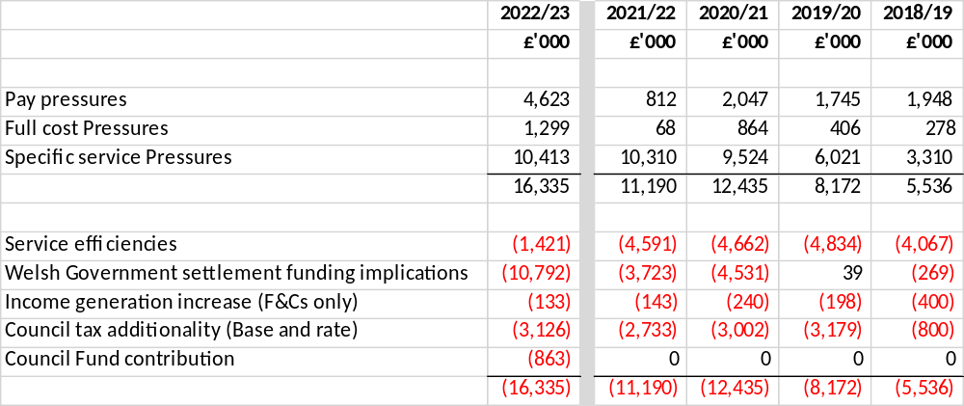
The last 4 years…….
An illustration that shows the extent of the increasing pressures faced by the Council and the budget challenges that result even when a positive Welsh Government settlement is received.

Slide 7
A challenging financial backdrop….. (2)
Another unprecedented year – the pandemic response has continued and its impact is being felt
More cost - our costs are rising with our ageing population, an increased demand for core services, high resident expectations, pay and contract inflation and legislative impacts
A need to invest in the future to ensure services offered remain relevant and appropriate in meeting the County’s needs; whilst making sure everything is as efficient and effective as possible
Insufficient funding – Whilst Welsh Government funding increases it is insufficient to cover all pay and service pressures
A need to make one-off use of reserves to support the Council and alongside the response to the pandemic
We continue to challenge services to sustain themselves rather than see closure of services that matter. If things close they never return – better to scale back rather than withdraw

Slide 8
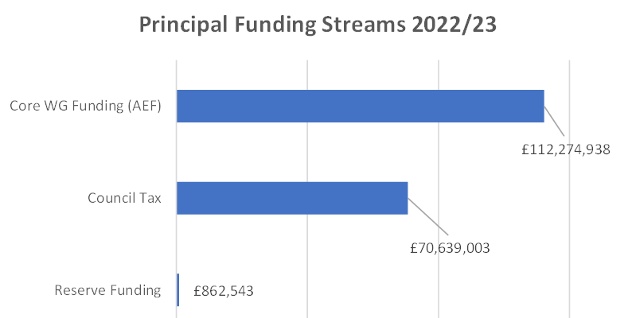
How the Council’s budget is funded…..
Council tax income is in relation to MCC only

Slide 9
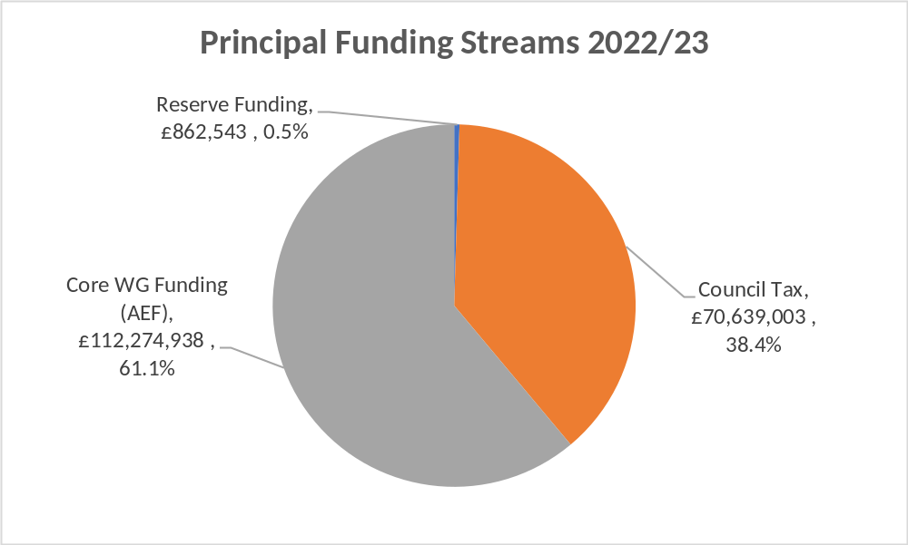
How the Council’s budget is funded…..

Slide 10
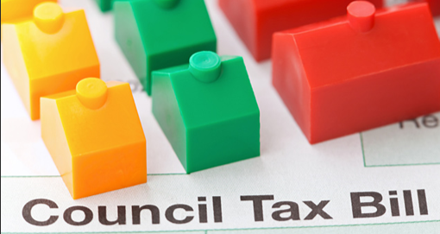
Council tax
Given the extent of pressures on services we are being forced to consider a council tax increase of 3.95% in 22/23
We have no other viable options e.g. our reserve funding (contingency money that the council has to save to plan for the unexpected) is already at low levels and is already being drawn upon to support this budget and to mitigate other risks
Notes:
Need to acknowledge pressure that some households and even more so as a result of the pandemic. However, need to draw attention to council tax reduction scheme and discounts available for single parent households etc.

Slide 11
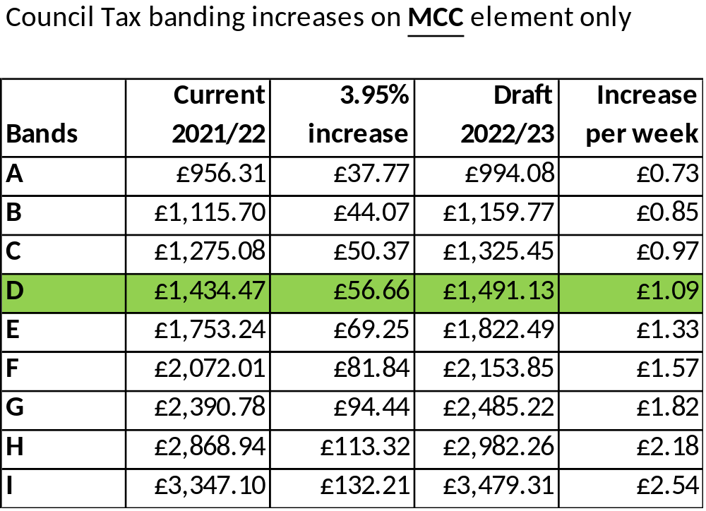
Proposed council tax increases

Slide 12
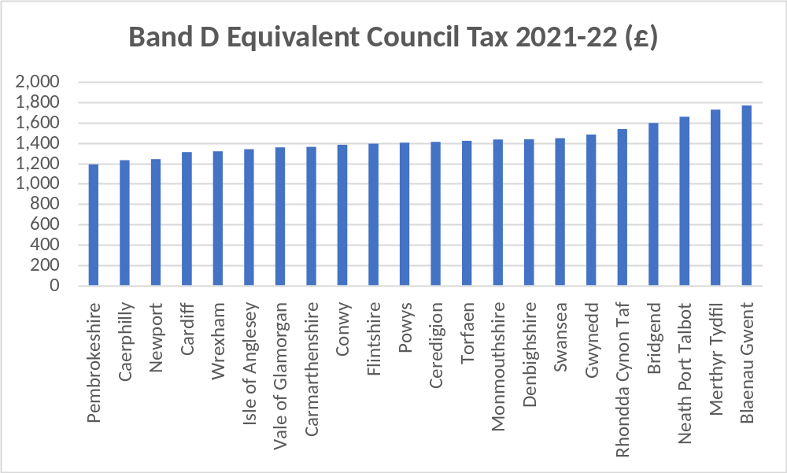
How Council Tax compares across Wales
Band D of £1,434.47 (Council element only) sits just above the Welsh average of £1,402.51 in 2021/22

Slide 13
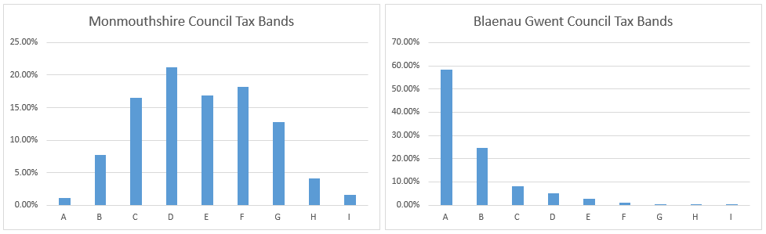
Council Tax as a share of WG funding
Blaenau Gwent had the highest band D in Wales of £1,768.31 compared to MCC (£1,434.47) in 2021/22
Total amount of Council Tax raised is highest in MCC because it has the most significant number of properties in the band D to I range.

Slide 14
Core funding from Welsh Government
MCC saw a 11.2% increase in its core funding from Welsh Government – above the all-Wales average increase of 9.4%
It is welcomed that Welsh Government funding will now go up for a third year following years of ongoing reductions
MCC still remains the worst funded Authority in Wales per head
The settlement does not offset all the Council’s pressures and inflation
Prudent provision has had to be made for pay awards
COVID funding ends in March. Now met from existing budgets
Welsh Government specific (non-core) grant funding is an evolving picture – information and clarification needed
General capital funding from Welsh Government has disappointingly reduced as have some specific capital grants streams. Again further clarification awaited.

Slide 15
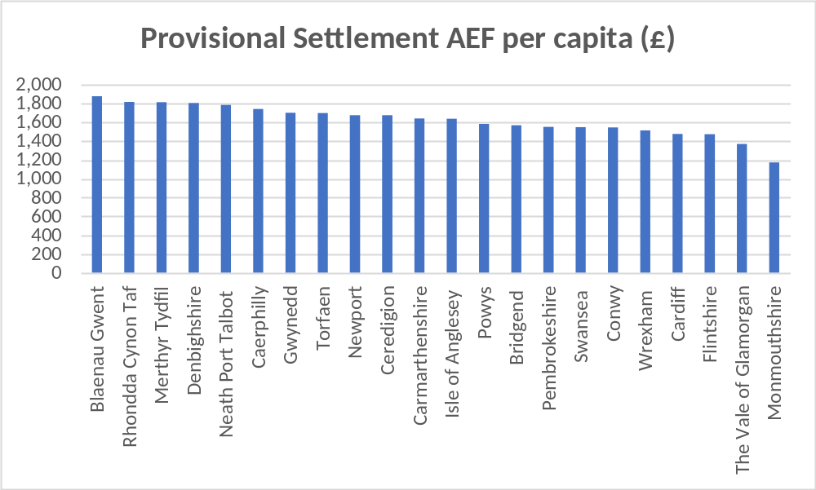
Funding from Welsh Government (1)
MCC gets the least funding per head of population (£1,176) compared to the rest of Wales (average £1,611)

Slide 16
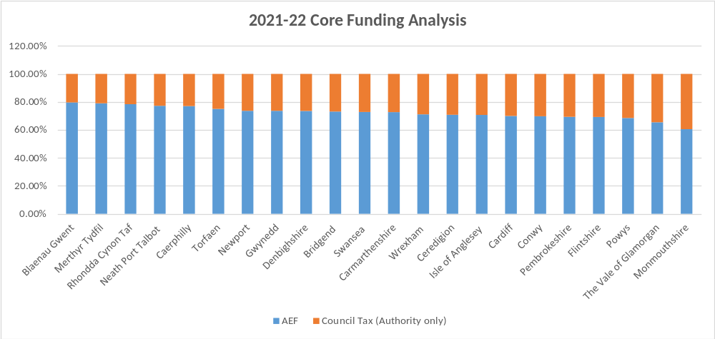
Funding from Welsh Government (2)
This illustrates the level of Council Tax raised by MCC in comparison to core funding from Welsh Government. 39.5% against a Welsh average of 27.5%.

Slide 17
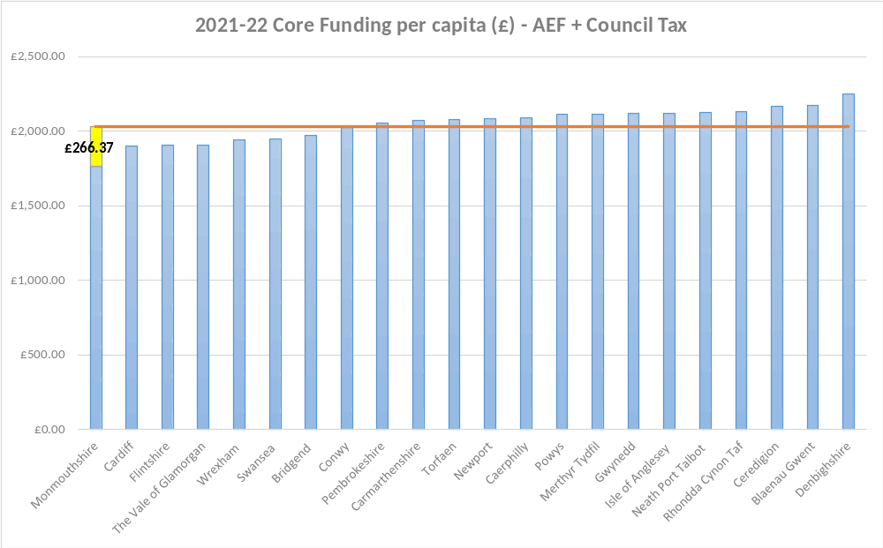
Funding from Welsh Government (3)
MCC still gets the least funding per head of population (£1,762) compared to the rest of Wales (average £2,029, highest Denbighshire £2,251) – with Council Tax and AEF

Slide 18



Budget for 2022/23 will see…
Recognises all pay and pension-related spending pressures in schools, up to a threshold of 3% pay award
Recognises increasing demands placed on children’s and adult social services and children with Additional Learning Needs
Responding to the needs of the homeless
Limited scope for frontline services to make efficiency savings
Continued drive for service efficiency and effectiveness
Fees and charges increases limited as much as possible
All local services still being maintained

Slide 19

Summary position
An in-year forecast over spend of £1.9m
A 22/23 budget that incorporates service pressures of £10.4m, pay pressures of £4.6m and proposed savings of £1.6m
Modelling of medium term budgets creates a further gap of £13.6m over the a 4-year period to be managed

Slide 20
2021/22 In-year Performance
£1.94m over spend forecast at month 6 with the Council’s core service delivery – recurrent pressures are impacting on 22/23
Continued budget recovery taking place to mitigate and reduce the over spend
Expectation of further specific grant funding from Welsh Government before year-end that might assist the end of year position
Council has long history of working within its budget. Important such as to prevent any need to draw on limited one-off reserves
Further £3.97m deficit relating to COVID that the Council expects to be fully funded from Welsh Government’s COVID Hardship Fund
Conclusion of pay award negotiations still awaited
Capital slippage due to ongoing challenging operating conditions and impact both internally and externally in relation to Covid-19

Slide 21
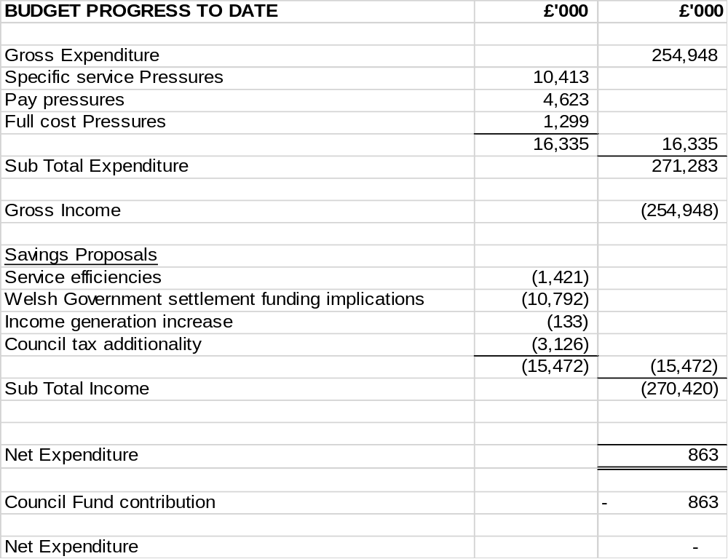
2022/23 Budget Summary

Slide 22
What it costs to deliver services

Slide 23
Understanding how services are grouped
Children and Young People – comprising individual school budgets together with school improvement and LEA run services such as overseeing school admissions and supporting children with Additional Learning Needs
Social Care & Health
Services to adults and which seeks to enable them to live as independently as possible
Services to help the most vulnerable children and families
Services centred around public protection such as trading standards and licencing

Slide 24
Understanding how services are grouped
Enterprise
Supporting economic development in the County
Waste and recycling, highways maintenance, transport and other operational services
Planning and housing services
MonLife
Providing a wide range of tourism, leisure and culture services
Chief Executive’s Unit
Administers the democratic process through member support and democratic services
Legal services and land charges
Corporates services such as communications, customer services, welsh language and equalities

Slide 25
Understanding how services are grouped
Resources – support services such as finance, ICT, HR, payroll, training, emergency planning, estates, property services and commercial activities
Corporate Costs – precepts and levies to other statutory bodies as well as other costs such as insurances, bank charges and audit fees
Appropriations – the costs of borrowing together with contributions to or from earmarked reserves
Financing – comprising core Welsh Government funding, council tax income and any contribution from the Council’s general reserve

Slide 26
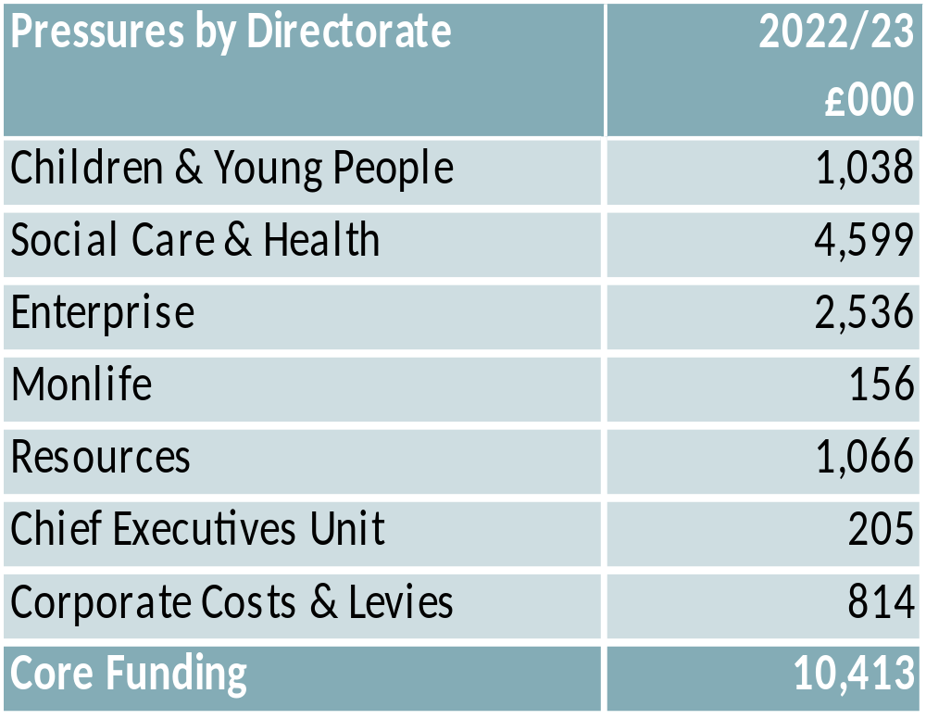
Financial pressures on the Authority

Slide 27
Financial pressures on the Authority
Pressures remain out of the control of the Authority – driven by demand pressures, inflation and legislative changes
Pressures have been challenged and where possible managed or mitigated
Significant pressures totalling £10.4m include:
  Children with additional learning needs demand pressures – £0.96m
  Funding Children’s Services looked after children pressures (LAC) – £1.31m
  Sustaining the model of delivery in adult social care (increased demand and complexity) – £1.0m
  Responding to an unsustainable social care market – budget provision and contingency of £1.9m
  Recycling and Waste – increased service delivery costs due to increased recycling – £1.22m

Slide 28
Financial pressures on the Authority
  Passenger Transport Unit – £644k pressures resulting from increased operating costs and passenger numbers
  Grounds Maintenance – Increases in service demands have resulted in £273k of inflation, maintenance and manpower pressures
  Public Protection – £223k is proposed to ensure that future resilience of this essential service is in place.
  Projected income shortfalls – £781k of pressures that result from the Council’s investment properties
  Energy costs – estimated price increases of £446k in 2022/23.
  Corporate costs – £272k of pressures resulting from increases in precepts and levies and that are subject to change as contributions are confirmed

Slide 29
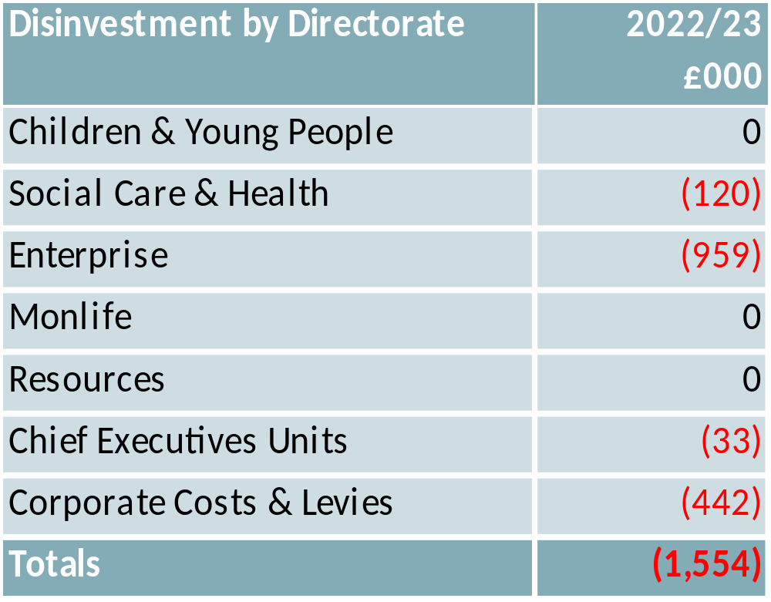
Proposals to make savings

Slide 30
Proposals to make savings
After several years of making significant savings the means of achieving further savings becomes increasingly more challenging
Exacerbated by the pandemic and where officer time has had to be diverted to the emergency response and ensuring vital services are delivered
In-year over spend, whilst being managed via a recovery plan, sees significant service pressures carried through into 22/23
With this already challenging backdrop has made the budget challenge even more acute – though eased by WG settlement
The savings package has therefore principally comprised:
  Saving resulting from in-year decisions already taken
  Flexible use of capital receipts to fund costs of service reform
  Increased income generation from fees and charges

Slide 31
Proposals to make savings
Savings in Waste and Recycling from the successful retendering of waste management contracts (£856k)
The opportunity to make further use of guidance from Welsh Government that allows the Authority to make flexible use of capital receipts to capitalise revenue costs relating to service reform (£442k)
Income generation resulting from anticipated increased income, new charges and increases in existing fees and charges (£133k) – any increases limited as much as possible
Energy savings of £90k from Street Lighting following the successful completion of the LED replacement programme.

Slide 32
Impact of the budget proposals
All proposals assessed early for equality impact and Wellbeing and Future Generation considerations
A number of areas that could impact on residents:
An increase in council tax for modelling purposes 3.95%
Proposals increase fees and charges in a number of areas in line with inflation though kept to a minimum
The Council Tax reduction scheme offers some mitigation for low earners and those in receipt of benefits. Single person households are also eligible for a 25% reduction on council tax
Charges for domiciliary and residential care are also means tested and are capped to mitigate the impact of those on the lowest incomes

Slide 33
Draft capital proposals
Ongoing commitment to fund Future schools programme – business case to be approved for Abergavenny 3-19 (band B); Chepstow comprehensive to follow in band C
Ongoing commitment to Cardiff Capital Region City Deal
Crick Road care home being delivered
Investment maintained at current levels in:
  Core programme circa £5.3 million covers highways and property planned maintenance and county farms
  Disabled Facility Grants – £900k
  Access for All - £250k
Continued flexible use of one-off capital receipts to meet cost of service reform
£2.7m of capital bids still to be assessed alongside £762k funding shortfall due to WG settlement
Clarification being sought with specific WG capital grants

Slide 34
Capital budget pressures & considerations
Backlog maintenance – Property, disability discrimination act work (e.g. access to buildings etc.), improve roads, rights of way, bridges, culverts and walls – review being undertaken to determine whether any risks require more immediate attention
Arrest road closures due to land slips
Ash tree die back disease response
Homelessness and housing related provision
Provision of low cost (affordable) housing
Digital infrastructure investment
Transportation/active travel considerations
Investment in rationalisation of community amenity sites (waste & recycling and depot infrastructure)
MonLife investment considerations
Climate emergency and carbon reduction commitments
Match funding for specific grant funding schemes

Slide 35
Key risks and uncertainties
The continued impact of the pandemic – on the Council, the local economy and its communities
Risk that Welsh Government funding will not be forthcoming to fully meet costs and income losses resulting from the pandemic – notably within homelessness, leisure centre income and adult social care
The extent of any further service pressures and given the volatility in some areas such as social care and children with additional learning needs
The need for early clarification on levels of specific grant funding and that help sustain some services
To the extent that these risks materialise then further budget recovery action will need to be taken in 2022/23

Slide 36
Looking ahead over the medium-term
Public finances and the needs of communities continue to be impacted in a truly unprecedented way as a result of the pandemic
Welsh Government have now provided indicative settlement projections for 22/23 (3.5%) and 23/24 (2.4%), as a result of UK Government and Chancellor publishing a three year Comprehensive Spending Review. But are noted as subject to change.
Council tax increases have been reduced to 3.95% over the medium term and for modelling purposes
Pay award assumptions updated in line with OBR forecasts
Further work being undertaken to update service pressure estimates and savings opportunities over the medium term
New political administration will outline its priorities and that will further inform MTFP strategy and plan

Slide 37
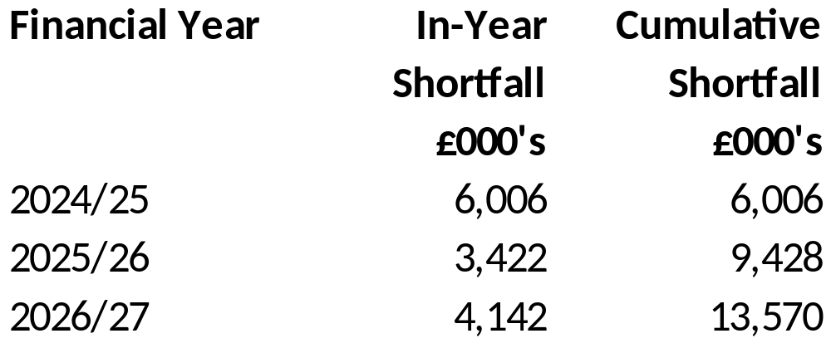
The Challenge over medium term…..

Slide 38

Timescales
Budget proposals available for consultation – 19th Jan 2022 to 16th Feb 2022 (4 weeks)
Select Scrutiny – Jan-Feb 2022
Public consultation to end on 16th Feb 2022
Final Budget Cabinet – 2nd March 2022
Council tax setting and budget – 3rd March 2022

Slide 39

Any questions?
Please share your thoughts?
Budget survey and further information on our website www.monmouthshire.gov.uk/budget-2022-2023
If you’d prefer please tweet us @MonmouthshireCC

Slide 40
School Budget Forum
Investment in services to accommodate revenue pressures:
CYP (£1.009m)
£244k Recoupment pressure
£277k Independent placement costs.
£138k Other LA placement costs.
£298k ALN support for MCC schools
£15k ALN transport
£37k SENCOM

Slide 41
School Budget Forum
ALN Consultation
Consulting on changing how funding is delegated to schools to support pupils with additional learning needs.
Based on either 70% pupil numbers / 30% ALN or 80% pupil numbers / 20% ALN.
Consultation closes on 11th February with a cabinet decision in March.
Changes will apply for 2022-23 financial year.

Slide 42
School Budget Forum
Investment in services to accommodate revenue pressures:
Schools (£1.256m)
£876k Teacher’s pay (2.67%)
£351k non-teaching pay (3%)
£29k Monmouth rates
Pay increases to be held centrally and distributed when final award is paid.

Slide 43
School Budget Forum
Welsh Government grants
Revenue Maintenance grant £1,089,288
Winter of Wellbeing £117,306
ALN new funding system £184,076
RRR’s £668,971
Total £2,059,641

