Slide 1


2021/22 DRAFT BUDGET PROPOSALS
Budget Scrutiny
CYP Select Committee
19th January 2021
Phil Murphy, Cabinet Member for Resources

Slide 2

Welcome & context
Welcome to today’s session. I’ll be sharing Monmouthshire County Council’s Budget position and 2021/22 plans
  We have successfully managed to save £22.0m over the last 4 years
  The Council continues to face ongoing and significant financial, demographic and demand-led pressures - £10.1m in 21/22
  Despite an above average funding settlement we remain the worst funded Council in Wales
  Despite this we continue to support the priorities of the Council – including those set out in the Winter COVID-19 plan
£
Notes:
The draft budget proposals look to support the priorities of the council. Specifically, they seek to recognise in full, all pay and pension-related spending pressures in our schooling system and the increasing demand placed on children’s social care services, adult social care and our children with additional learning needs budgets. As well as significant operational pressures in frontline services such as recycling and waste and the passenger transport unit.

Slide 3
Introduction & context
A truly unprecedented year – severe flooding followed by the pandemic response and its impact
More cost - our costs are rising with our ageing population, an increased demand for core services, high resident expectations, contract inflation and legislative impacts
A need to invest in the future to ensure services offered remain relevant and appropriate in meeting the County’s needs; whilst making sure everything is as efficient and effective as possible
Insufficient funding – Whilst Welsh Government funding increases it remains insufficient to cover service pressures
A need to make one-off use of reserves to support the Council and alongside the response to the pandemic
We continue to challenge services to sustain themselves rather than see closure of services that matter. If things close they never return – better to scale back rather than withdraw

Slide 4
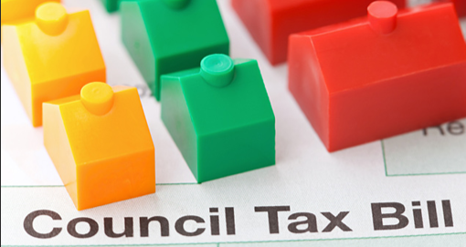
Council tax
Given the extent of pressures on services we are being forced to increase council tax by 4.95% in 21/22
We have no other viable options e.g. our reserve funding (contingency money that the council has to save to plan for the unexpected) is already at low levels and is being drawn upon to mitigate other risks
Notes:
Need to acknowledge pressure that some households and even more so as a result of the pandemic. However, need to draw attention to council tax reduction scheme and discounts available for single parent households etc.

Slide 5
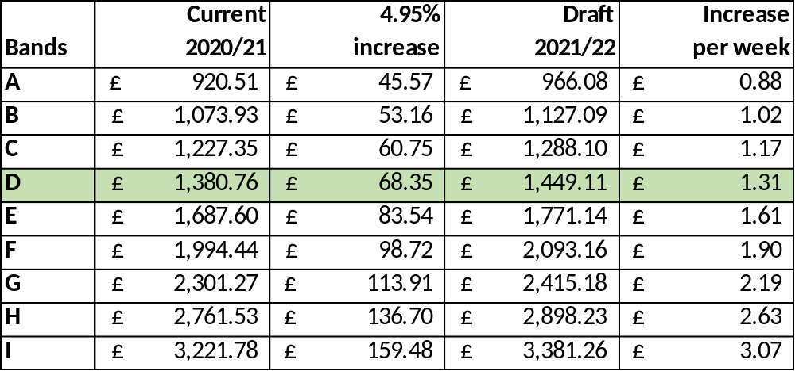
Proposed council tax increases
Council Tax Banding increases on MCC element only

Slide 6
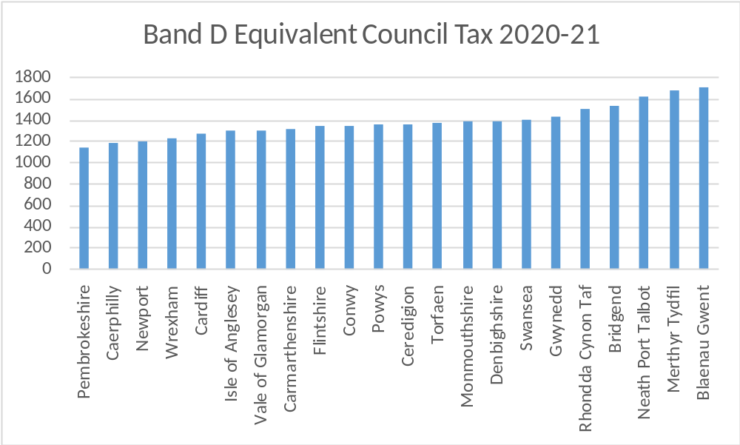
How Council Tax compares across Wales
Band D of £1,380.76 (Council element only) compares to Welsh average of £1,354.02 in 2020/21.

Slide 7
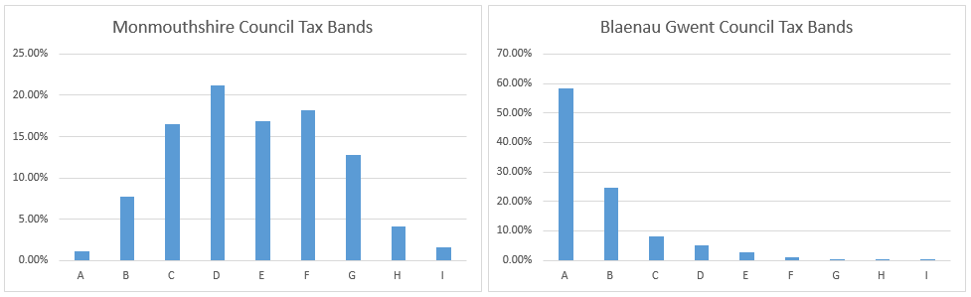
Council Tax as a share of WG funding
Blaenau Gwent had the highest band D in Wales of £1,711.83 compared to MCC (£1,380.76) in 2020/21
Total amount of Council Tax raised is highest in MCC because it has the most significant number of properties in the band D to I range.

Slide 8
Core funding from Welsh Government
MCC saw a 3.9% increase in its core funding from Welsh Government – above the all-Wales average increase of 3.8%
It is welcomed that Welsh Government funding will now go up for a second year following years of ongoing reductions
MCC still remains the worst funded Authority in Wales per head
The settlement does not offset all the Council’s pressures and inflation
Any subsequent pay awards will need to be accommodated
Welsh Government specific (non-core) grant funding is an evolving picture – information awaited
General capital funding from Welsh Government has been broadly maintained. Again clarification awaited on specific capital funding streams
COVID funding for next year still to be confirmed
Clarification still awaited on reliefs available to businesses

Slide 9
Funding from Welsh Government (1)
MCC gets the least funding per head of population (£1,067) compared to the rest of Wales (average £1,471)

Slide 10
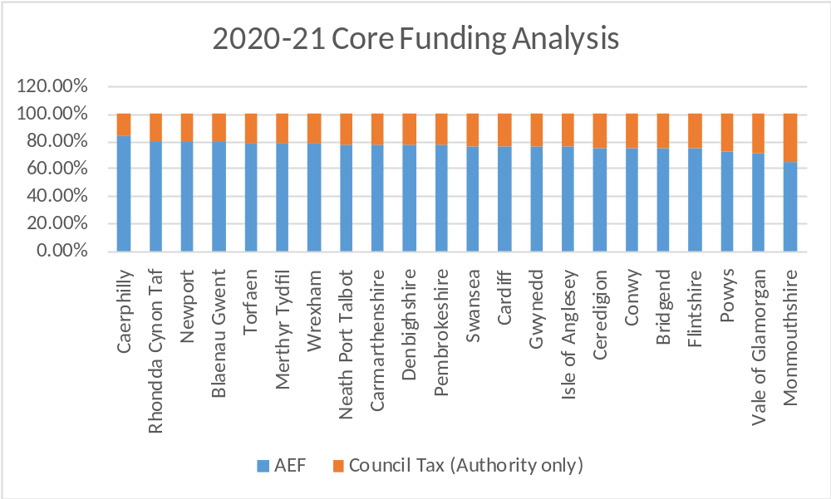
Funding from Welsh Government (2)
This illustrates the level of Council Tax raised by MCC in comparison to funding from Welsh Government. 34.4% against a Welsh average of 23.0%.

Slide 11
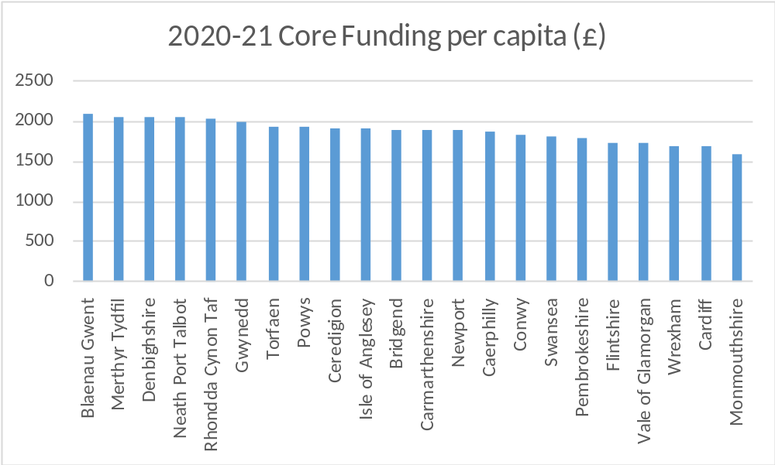
Funding from Welsh Government (3)
MCC still gets the least funding per head of population (£1,593) compared to the rest of Wales (average £1,852, highest Blaenau Gwent £2,096) – with Council Tax and AEF

Slide 12



Budget for 2021/22 will see…
Recognises in full all pay and pension-related spending pressures in schools
Recognises increasing demands placed on children’s and adult social services and children with Additional Learning Needs
Responding to the needs of the homeless
Limited scope for frontline services to make efficiency savings
Continued drive for service efficiency and effectiveness
Fees and charges increases limited as much as possible
All local services still being maintained

Slide 13

Summary position
Modelling the budget using the assumptions and including the pressures created an initial gap of £5.3 million and £22.5m over 4-year MTFP
Revised pressures of £10.1m then included
Proposed savings of £3.7m included

Slide 14
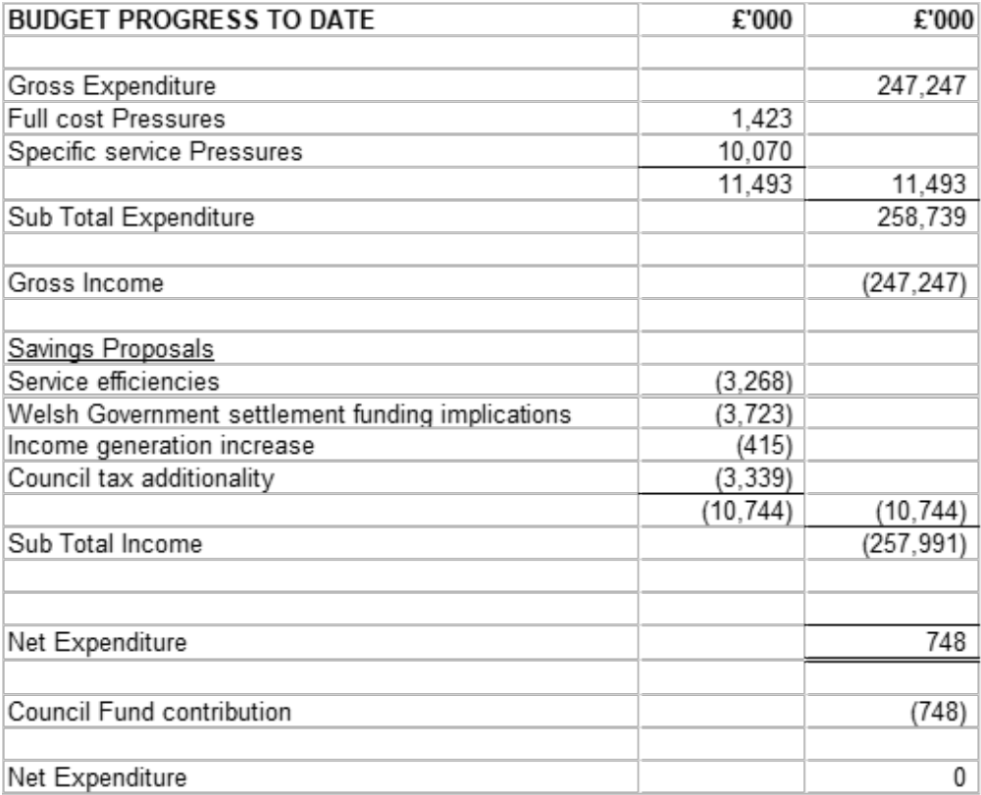
Budget Summary

Slide 15
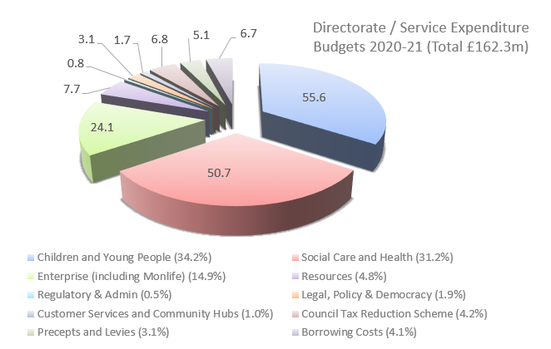
What it costs to deliver services

Slide 16
Understanding how services are grouped
Children and Young People – comprising individual school budgets together with school improvement and LEA run services such as overseeing school admissions and supporting children with Additional Learning Needs
Social Care & Health
Services to adults and which seeks to enable them to live as independently as possible
Services to help the most vulnerable children and families
Services centred around public protection such as trading standards and licencing

Slide 17
Understanding how services are grouped
Enterprise
Supporting economic development in the County
Waste and recycling, highways maintenance, transport and other operational services
Planning and housing services
MonLife
Providing a wide range of tourism, leisure and culture services
Chief Executive’s Unit
Administers the democratic process through member support and democratic services
Legal services and land charges
Corporates services such as communications, customer services, welsh language and equalities

Slide 18
Understanding how services are grouped
Resources – support services such as finance, ICT, HR, payroll, training, emergency planning, estates, property services, procurement and commercial activities
Corporate Costs – precepts and levies to other statutory bodies as well as other costs such as insurances, bank charges and audit fees
Appropriations – the costs of borrowing together with contributions to or from earmarked reserves
Financing – comprising core Welsh Government funding, council tax income and any contribution from the Council’s general reserve

Slide 19
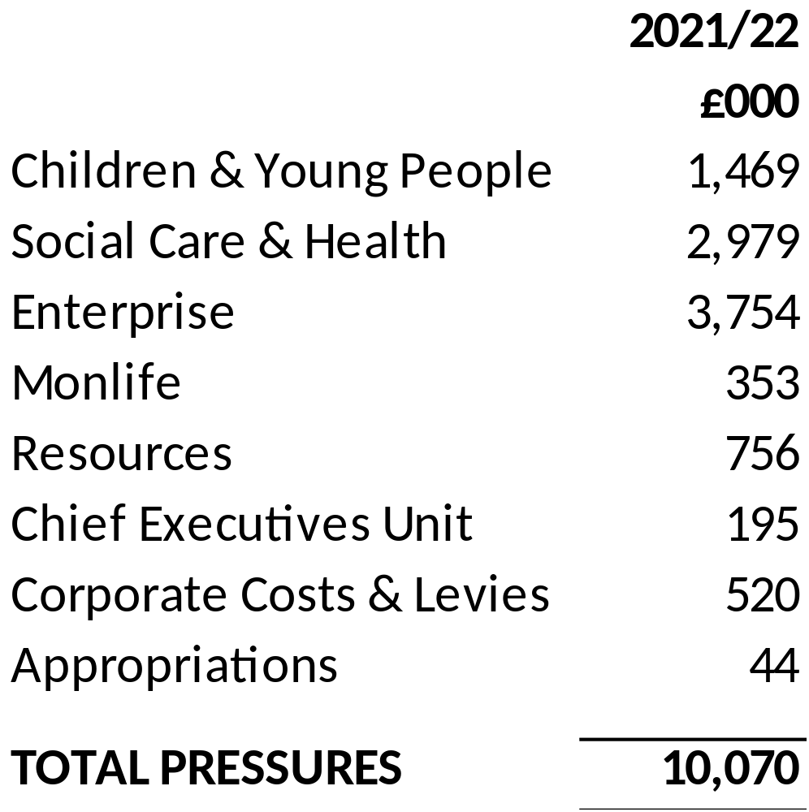
Financial pressures on the Authority

Slide 20
Financial pressures on the Authority
Pressures remain out of the control of the Authority – driven by demand pressures, inflation and legislative changes
Pressures have been challenged and where possible managed or mitigated
Significant pressures totalling £10.1m include:
  Children with additional learning needs demand pressures – £1.47m
  Funding Children’s Services looked after children pressures (LAC) – £1.46m
  Recycling and Waste – increased cost of treatment and disposal, contract inflation, reduced grant funding and costs associated with new service provision – £1.44m
  Passenger Transport Unit – pressures resulting from catchment changes and increases, increased staffing costs resulting from an increase in-house provision required and a loss of private hire income (£917k)

Slide 21
Financial pressures on the Authority
  Pressures within adult social care –uplifts to fees for external care providers (£536k) and £250k to deliver to address shortfall in commissioned care in Usk area – £0.79m
  Pressures to respond to needs of the homeless and in line with Welsh Government’s revised policy position – £874k
  Pressures relating to the unbudgeted element of the 20/21 pay award and staff efficiency savings that cannot be absorbed due to service demand pressures, most notably in social services – £918k
  Income shortfalls – £777k of pressures that result as an indirect consequence of the pandemic or that have been deemed not achievable
  Corporate costs – £474k of pressures resulting from increases in precepts and levies from the South Wales Fire and Rescue Authority and Coroner’s service, increased insurance premiums and pension strain costs

Slide 22
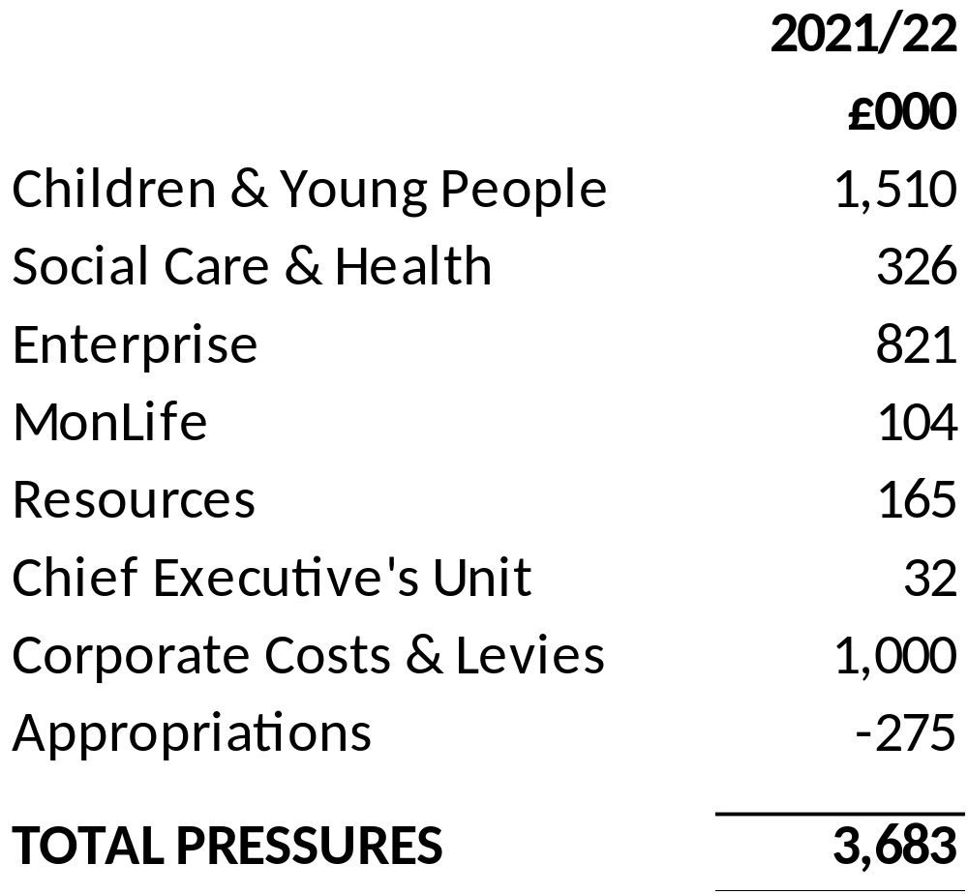
Proposals to make savings

Slide 23
Proposals to make savings
After several years of making significant savings the means of achieving further savings becomes increasingly more challenging
Exacerbated by the pandemic and where officer time has had to be diverted to the emergency response and ensuring vital services are delivered
In-year over spend, whilst being managed via a recovery plan, sees significant service pressures carried through into 21/22
With this already challenging backdrop has made the budget challenge even more acute
The savings package has therefore principally comprised:
  Saving resulting from in-year decisions already taken
  Flexible use of capital receipts to fund costs of service reform
  Increased income generation from fees and charges
  Additional specific grant funding

Slide 24
Proposals to make savings
Savings of £1.258m from Mounton House special school following its closure
Flexible use of capital receipts to capitalise revenue costs relating to service reform (£1.0m)
Recycling and waste – £685k of savings notably resulting from in-year decisions by the Council (garden waste collection, introduction of polypropylene bags and HWRC changes) and reduced tonnages to landfill
Income generation resulting from anticipated increased income, new charges and increases in existing fees and charges (£415k) – including £252k from additional ALN recoupment income

Slide 25
Proposals to make savings
Additional specific grant funding – an increase in the social care workforce and sustainability grant from Welsh Government from £40m to £50m in 2021/22 will provide an additional £247k grant income – that will offset existing and relevant pressures in adult social care
Targeted accommodation and mileage savings and that look to ensure that efficiencies are realised from new ways of working in response to the pandemic (£121k)

Slide 26
Impact of the budget proposals
All proposals assessed early for equality impact and Wellbeing and Future Generation considerations
A number of areas that could impact on residents:
An increase in council tax for modelling purposes of 1% to 4.95%
Proposals increase fees and charges in a number of areas in line with inflation though kept to a minimum
The Council Tax reduction scheme offers some mitigation for low earners and those in receipt of benefits. Single person households are also eligible for a 25% reduction on council tax
Charges for domiciliary and residential care are also means tested and are capped to mitigate the impact of those on the lowest incomes

Slide 27
Draft capital proposals
Ongoing commitment to fund Future schools programme – business case being developed for Abergavenny 3-19 (band B); Chepstow comprehensive to follow in band C
Ongoing commitment to Cardiff Capital Region City Deal
Borrowing for commercial investments and acquisitions – commercial risk appetite reviewed as a result of pandemic
Severn View care home replacement being delivered on Crick Road site
Investment maintained at current levels in:
  Core programme circa £5.3 million covers highways and property planned maintenance and county farms
  Disabled Facility Grants – £900k
  Access for All - £250k
Flexible use of one-off capital receipts to meet cost of service reform

Slide 28
Capital budget pressures & considerations
Band B and Band C schools – MCC match funding element
Backlog maintenance – Property, disability discrimination act work (e.g. access to buildings etc.), improve roads, rights of way, bridges, culverts and walls – review being undertaken to determine whether any risks require more immediate attention
Arrest road closures due to land slips
Ash tree die back disease response
Homelessness and housing related provision
Provision of low cost (affordable) housing
Digital infrastructure investment
Transportation/active travel considerations
Investment in rationalisation of community amenity sites (waste & recycling and depot infrastructure)
MonLife investment considerations
Climate emergency and carbon reduction commitments
Match funding for specific grant funding schemes

Slide 29
Key risks and uncertainties
The continued impact of the pandemic – on the Council, the local economy and its communities
Risk that Welsh Government funding will not be forthcoming to fully meet costs and income losses resulting from the pandemic
The extent of any further service pressures and given the volatility in some areas such as social care and ALN
The need for early clarification on levels of specific grant funding and that help sustain some services
The impact of any nationally set pay awards for teachers and local government staff – any pay award in excess of 1% will result in a further pressure for the Council
Use is being made of limited capital receipt balances and the Council’s general reserve to support the budget – this is not a sustainable approach but is necessary this year

Slide 30
Looking ahead over the medium-term
Public finances are being impacted in a truly unprecedented way as a result of the pandemic
The chancellor was only able to announce a one-year spending review for 2021/22 – rather than over 3 years
Welsh Government unable to provide indicative settlement projections for 22/23 and 23/24
Unclear as to what approach UK Government and the Chancellor is going to take in restoring public finances, when this impact will be felt and how local government in Wales will be impacted
Introduces significant challenges and uncertainties in setting the budget for 22/23 ahead of a local government election – best and worst case scenarios offer very different outcomes

Slide 31

Timescales
Budget proposals available for consultation – 20th Jan 2021 to 17th Feb 2021 (4 weeks)
Select Scrutiny – Jan 2021
Public consultation to end on 17th Feb 2021
Final Budget Cabinet – 3rd March 2021
Council tax setting and budget – 11th March 2021

Slide 32

Any questions?
Please share your thoughts?
Budget survey and further information on our website www.monmouthshire.gov.uk/budget-2021-2022
If you’d prefer please tweet us @MonmouthshireCC

