Slide 1


Home Learning Strategies for SpLD Students
(Spring Term 2021)
Your SpLD Team presents:
Having fun with literacy

Slide 2
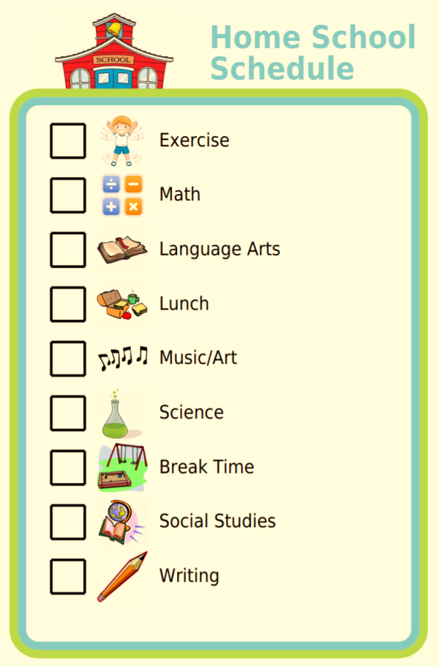
Set a Routine
Visual Timetables & Study Location
Having structure to the day is important for almost all of us, but particularly for a child with specific learning difficulties.
A visual timetable is helpful so your child has a clear picture of the day’s activities which can be checked off when completed.
Decide where your child is going to be working. For book work think about suitable lighting as well as clear table space. By a window for natural daylight or using soft lamplight will be less stressful than harsh overhead lighting.

Slide 3
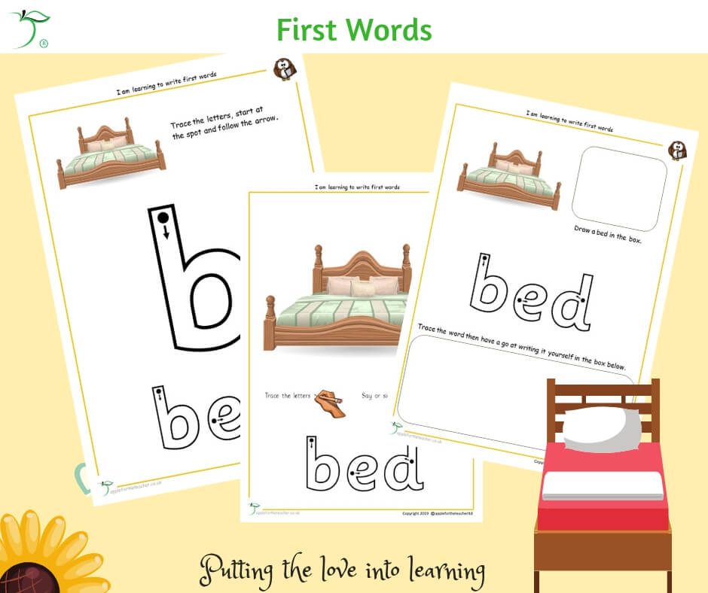
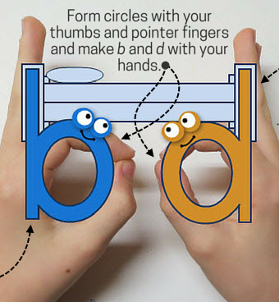

Decide What To Teach
Children enjoy learning all the more when they meet with success.
Decide on the aim of what is being taught:
Is it to teach the correct orientation of a letter ?
Is to answer questions on a passage of reading? If so, oral answers are sufficient. You can record answers!

Slide 4
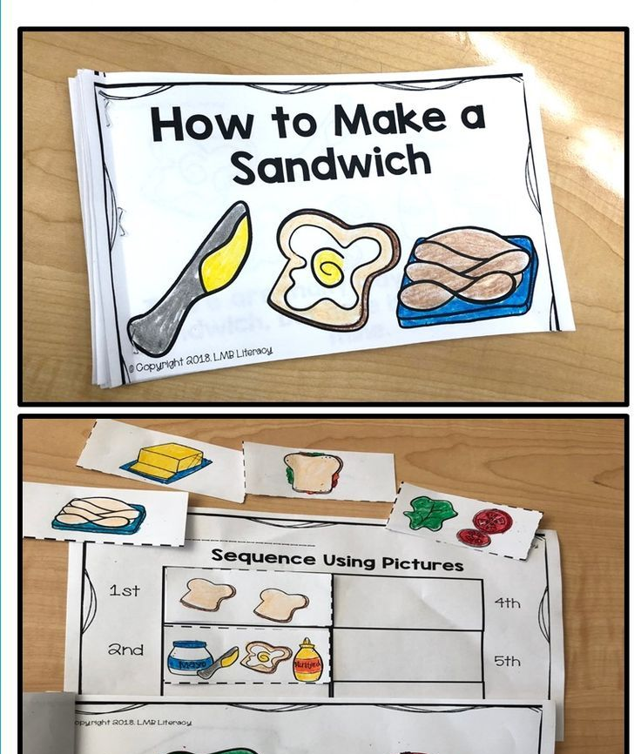



Enjoyable Activities
Cooking, Gardening, Playing – Lots of Ways to Learn !
Life Skills are important so enjoy cooking and sewing, gardening or playing with your child. All sorts of maths and language skills can be employed at the same time.
If you child has a particular interest then gearing learning to that interest can make learning so much more enjoyable and meaningful for them..

Slide 5
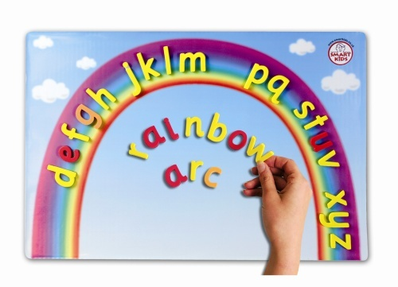
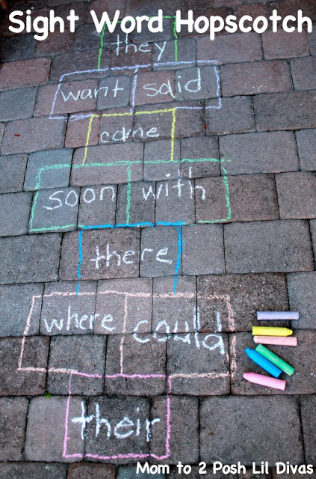
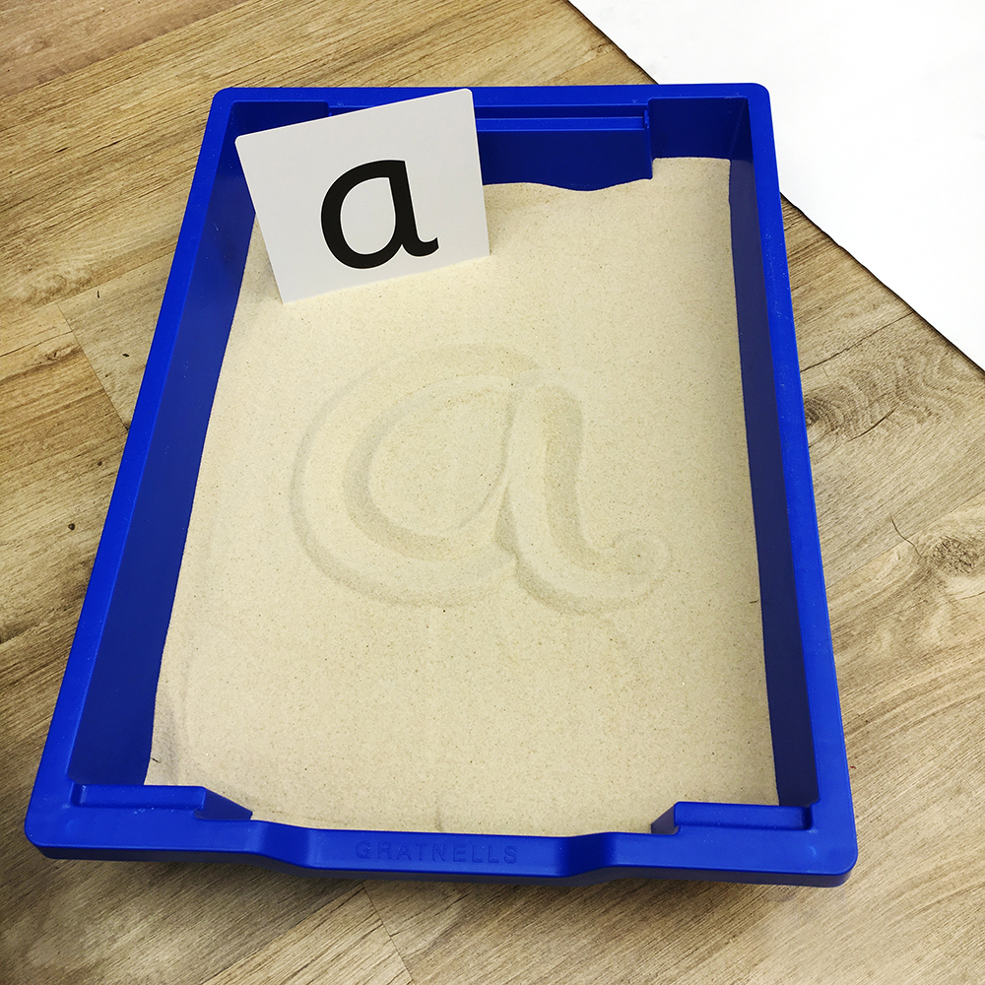

Multisensory Learning
Multi-sensory learning involves using many of your child’s senses at a time. This type of learning is the best for retaining information. If an activity involves seeing, hearing, doing (writing, speaking/singing) – kinaesthetic) and touching/feeling then it is truly a multi-sensory activity! An example would be using a rainbow arc – a child can see the letters, can hear their letter names and sound as they say or even sing the alphabet song as they place them, can move and manipulate the letters around to make words.The child can then find objects and match them to the letter that they begin with, the child can write the letters in sand or salt, can mould the letters out of playdough, etc.
Hop Scotch with letters or words is an entertaining outdoor way of learning in a multi-sensory way.
Read our leaflet on fun outdoor learning activities for children.
Older children might enjoy a multi-sensory Virtual Museum Tour. There are plenty available free in lockdown.
https://www.virtualiteach.com/post/2017/08/20/10-amazing-virtual-museum- tours#:~:text=%2010%20amazing%20virtual%20museum%20tours%20%201,YouVisit%20has%20really%20been%20gathering%20steam...%20More

Slide 6

Making Reading Easier
Dyslexic children have a specific difficulty with the
written word. To make it easier for them to read try:
Coloured background on paper or laptop or use a coloured overlay.
A Dyslexia friendly font(Comic Sans MS) will be easier to read.
Kind lighting environment using natural daylight or soft lamp light.
Try particular book schemes such as Barrington Stoke that offer Dyslexic friendly publications for children with a clear font, layout and a off white background. Moreover you can choose books that are geared to your child’s interest age but are written to appropriate reading age.
https://www.barringtonstoke.co.uk/parents-and-carers/
https://www.journalism.co.uk/press-releases/pearson-launches-rapid-reading-online-for-struggling-learners-and-children-with-sen/s66/a552005/
https://www.phonicbooks.co.uk/product/talisman-series-series-1/

Slide 7

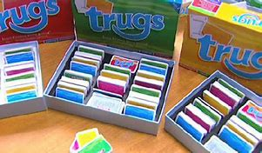
Play Games
Monmouthshire SpLD children love playing literacy reading games such as POP TRUGS and TALISMAN cards.
https://www.crossboweducation.com/pop-for-sight-words
Pop offers handfuls of fun as children recognise and read aloud high frequency words. Fast-paced game play is great for improving fluency.
Crossbow Education also sells games and resources designed to aid and teach dyslexic students of all ages.
Teach Reading Using Games
TRUGS
Where to buy TRUGS (Teach Reading Using Games) https://www.readsuccessfully.com/

Slide 8
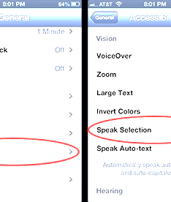


Embrace Technology
Computers, Tablets and Smart Phones have many free features that can make a huge difference.
Text to Speech and Speech to Text applications – help with reading. Downloading on your phone/tablet is easy.
Speech to text – allows your child to dictate their work to device.
Advance spelling and grammar checkers.
Text can be highlighted.
Learn how to touch type – There are some free resources like the
BBC Typing Dance Mat.
https://www.bbc.co.uk/bitesize/topics/zf2f9j6/articles/z3c6tfr

Slide 9

Audio Books
Listening to books enables the magical world of storytelling to open up
Can hear expanded vocabulary.
Stories can be enjoyed without the pressure of decoding.
Listen with headphones or share with family members to discuss and critique
Enables the awareness of story beginnings, different sentence structure and length, the use of dramatic language, punctuation, etc.
Penguin Audio Books https://www.penguin.co.uk/articles/children/2019/jan/children-s-audiobooks-for-a-listen-aloud-adventure.html
tps://www.audible.co.uk/ep/alexa-free-audiobook?source_code=M2M30DFT1Bk12809041902DH&&msclkid=a0e9510b16911d43255e310e60625c74&gclid=a0e9510b16911d43255e310e60625c74&gclsrc=3p.ds

Slide 10



Online programs
Fun Free Online Resources for Literacy
There are many great free online resources. Nessy produces many entertaining videos on different phonic patterns or spelling rules. These are freely accessible on You Tube, or you can pay for some of their game apps for use on phones or ipads.
Sir Link-a-Lot is readily available with great fun ways to learn spellings.
https://www.youtube.com/user/greenandfriendly
Nessy Website:
https://www.nessy.com/uk/
Sir Link-a-Lot Website:
https://www.sirlinkalot.org/

Slide 11
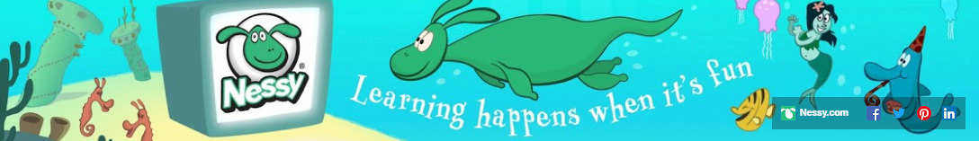
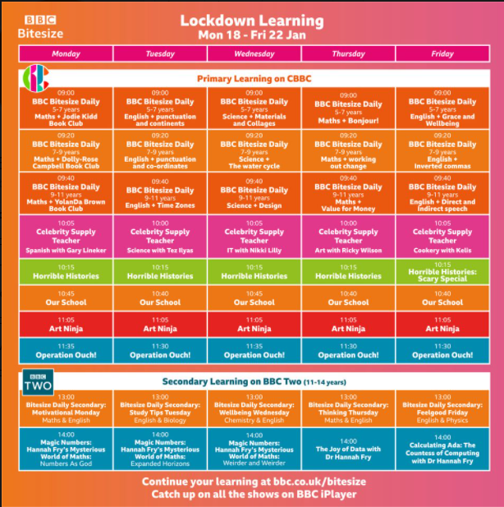
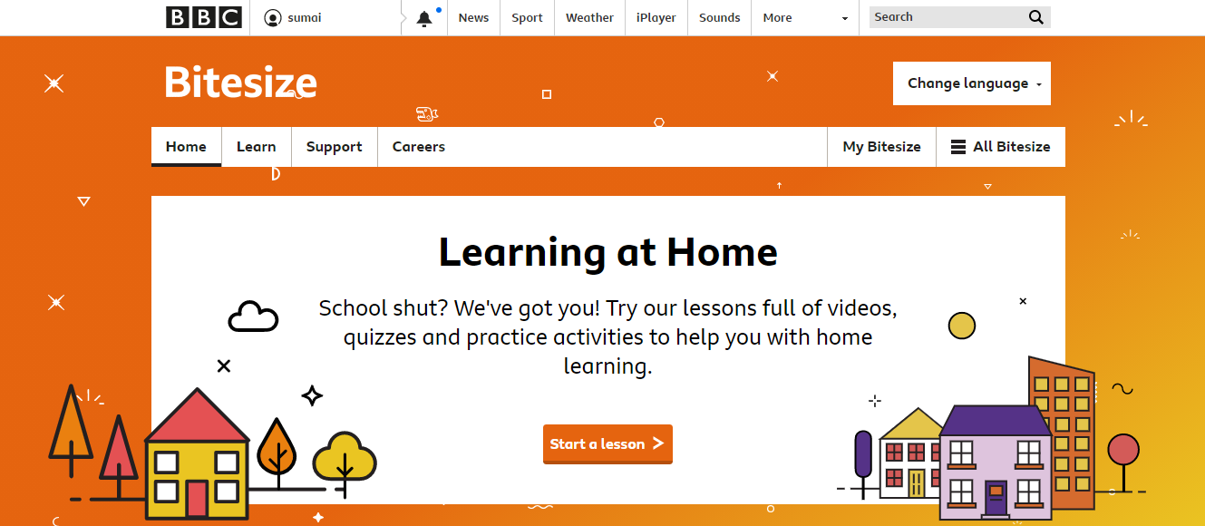
Watch YouTube and Online and BBC for grammar and spelling tricks:
https://www.youtube.com/user/greenandfriendly

Slide 12
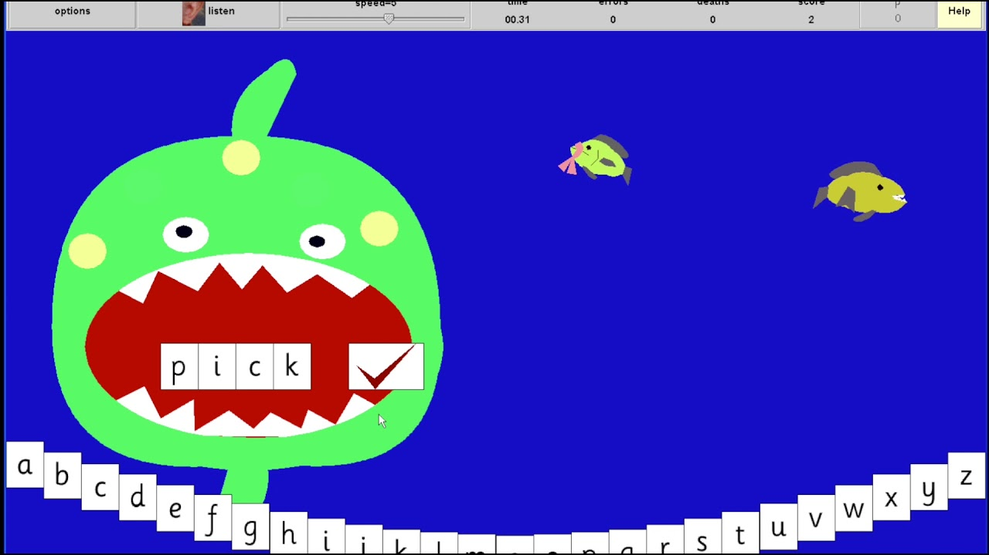
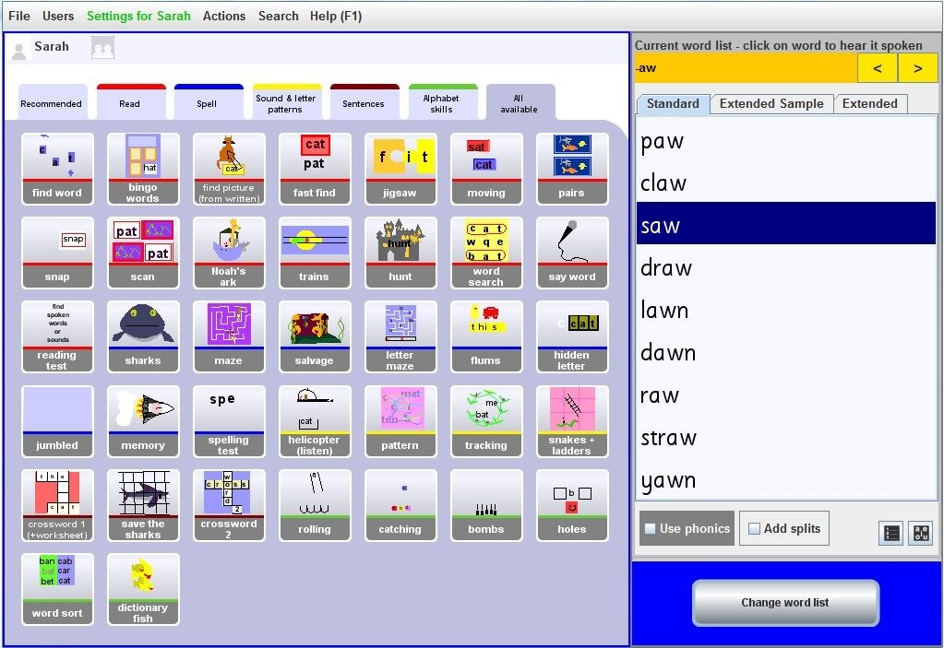

Wordshark
Monmouthshire SpLD Service has teamed up with Wordshark to enable your child to enjoy learning their spellings and reading words.
Plug in your special Wordshark log in details and your child will be able to access the fun, bright multi-sensory games in the trusted Wordshark programme.
https://www.wordshark.co.uk/

Slide 13
Contact our Team!
Teacher | Schools
Ruth Davies Email: RuthDavies@monmouthshire.gov.uk | Durand Castle Park | Llanvihangel Crucorney | Usk Osbaston CiW
Brenda Rees Email: BrendaRees@monmouthshire.gov.uk | Shirenewton The Dell Undy | Pembroke Rogiet | Thornwell St. Mary’s Dewstow
Kath Kippax Email: KathKippax@monmouthshire.gov.uk | Goytre | Gilwern Cantref | King Henry VIII
Jo Fox Email: JoanneFox@Monmouthshire.gov.uk | Arch Bishop Rowan Williams Overmonnow | Magor Trellech | Kymin View Llandogo
Claire Jones: Email: ClaireJones@monmouthshire.gov.uk | Y Fenni Y Ffin Llantilio Pertholey | Cross Ash OLSM Llanfoist Fawr | Deri View Raglan
For further advice and ideas.
Feel free to contact your child’s designated SpLD tutor

Slide 14



Enjoy home learning!
Monmouthshire SpLD

