Slide 1


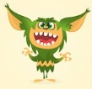

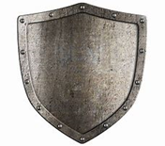
SpLD Challenge 2:
ck and k endings
Watch the video links and read the PowerPoint.
Try to explain this rule to someone else by:
  having a go at explaining it orally.
  or, by creating games
Upload your entries on Twitter or send via HWB email using:
  Videos
  Powerpoint
  Picture/ poster
  Voice recording
Hello Grammar Gremlins! Today we learn about the killer k. Don’t be scared I have my protector shield!
Click on me
ck

Slide 2
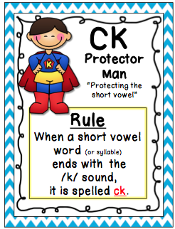
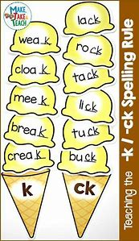
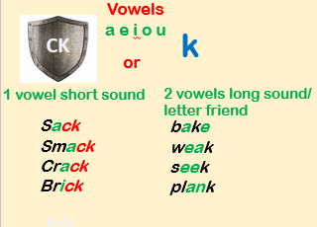
The Rules: ck and k endings
Watch these first:
https://www.youtube.com/watch?v=xQbQ6iP7eck
https://www.youtube.com/watch?v=XTmXI3cjCUA&t=4s
Click on me

Slide 3
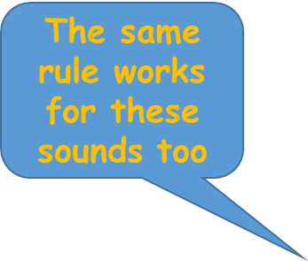
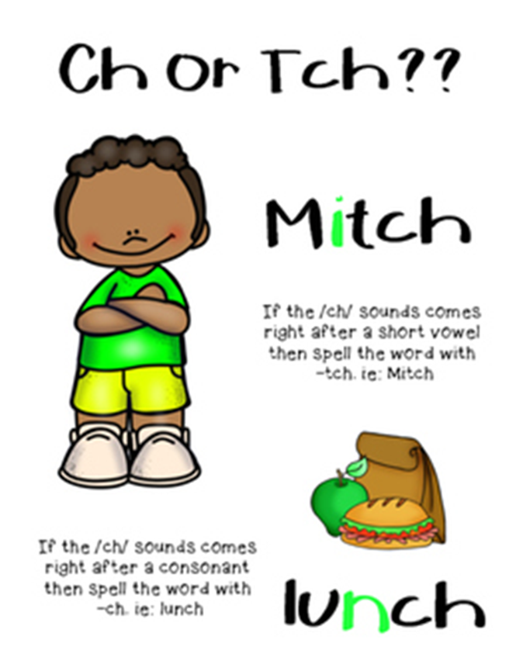
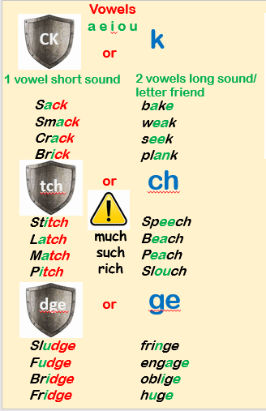
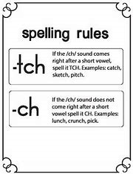

Slide 4
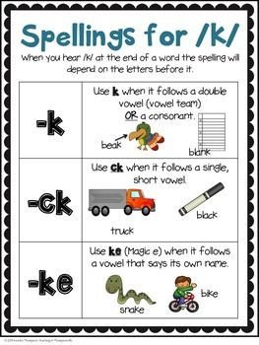
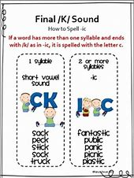
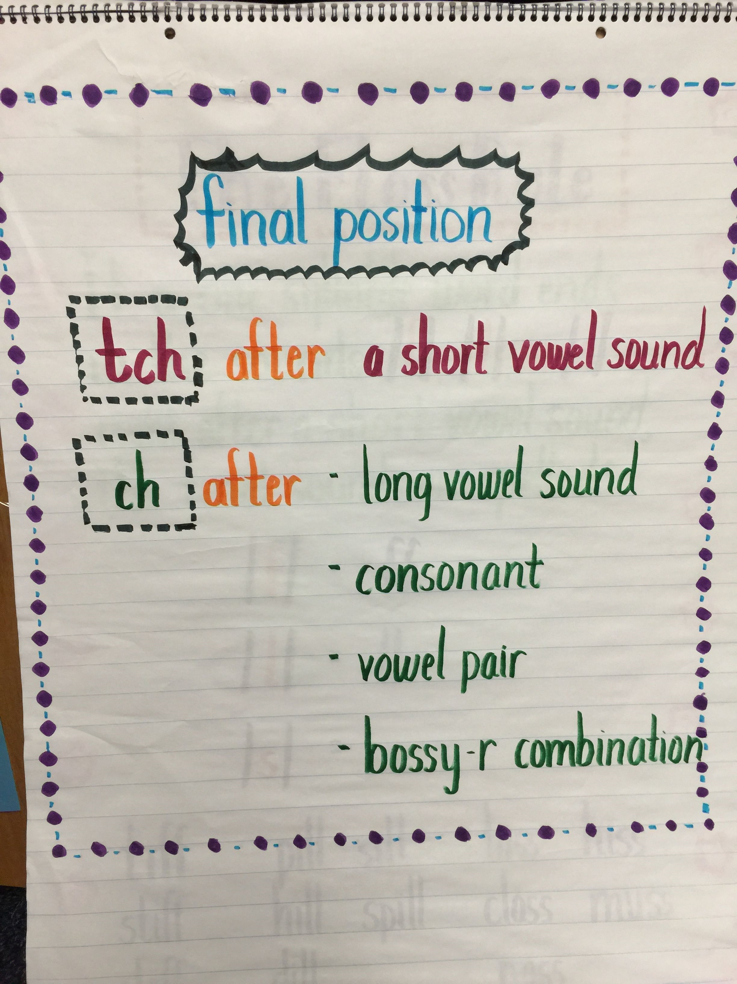
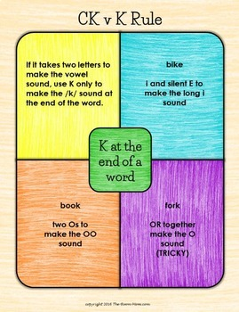
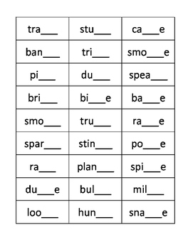
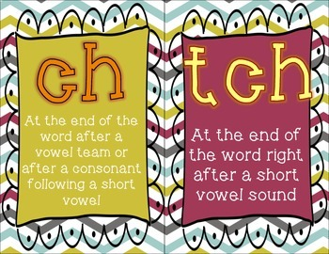
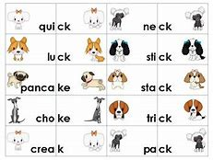
How would you teach this rule?
Poster? Card game? Wordsearch?

