Slide 1


2020/21 BUDGET PROPOSALS
Budget Consultation
January 2020
Cllr Phil Murphy, Cabinet Member for Resources

Slide 2

Welcome & context
Welcome to today’s session. I’ll be sharing Monmouthshire County Council’s Budget position and 2020/21 plans
  We have successfully managed to save £23.2m over the last 4 years amidst reduced Welsh Government funding
  The Council continues to face ongoing and significant financial, demographic and demand-led pressures - £9.7m in 20/21
  We are disappointed that yet again we are again the worst funded Council in Wales
  Despite this we continue to support the priorities of the Council
£
Notes:
The draft budget proposals look to support the priorities of the council. Specifically, they seek to recognise in full, all pay and pension-related spending pressures in our schooling system and the increasing demand placed on children’s social care services, adult social care and our children with additional learning needs budgets.

Slide 3
Introduction & context
Less budget – Whilst Welsh Government funding is increasing next year it is insufficient to cover service pressures and inflation
More cost - our costs are rising with our ageing population, an increased demand for all services, high resident expectations, contract inflation and legislative impacts
A need to invest in the future to ensure services offered remain relevant and appropriate in meeting the County’s needs; whilst making sure everything is as efficient and effective as possible
To continue to challenge all services to improve rather than see closure of services that matter. If things close they never return – better to scale back rather than absolutely withdraw

Slide 4
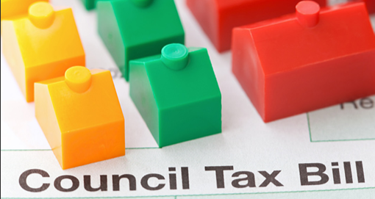
Council tax
Given the reduction in funding we are being forced to increase council tax by 4.95% in 20/21
We have no other options e.g. our reserve funding (contingency money that the council has to save to plan for the unexpected) is already at low levels

Slide 5
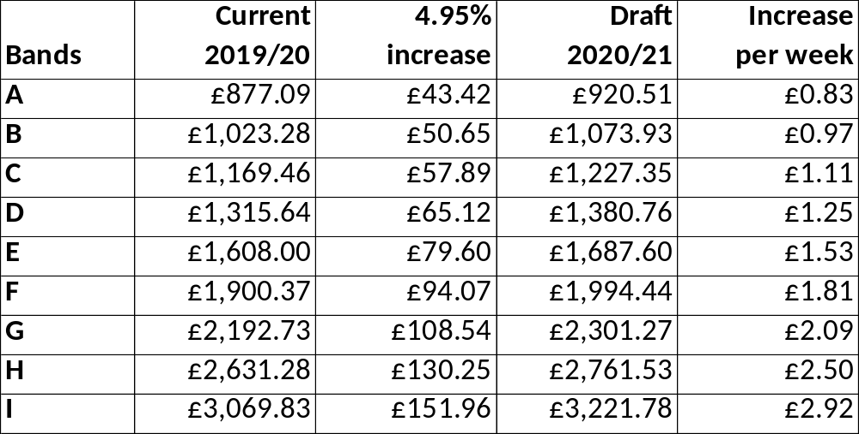
Proposed council tax increases
Council Tax Banding increases on MCC element only

Slide 6
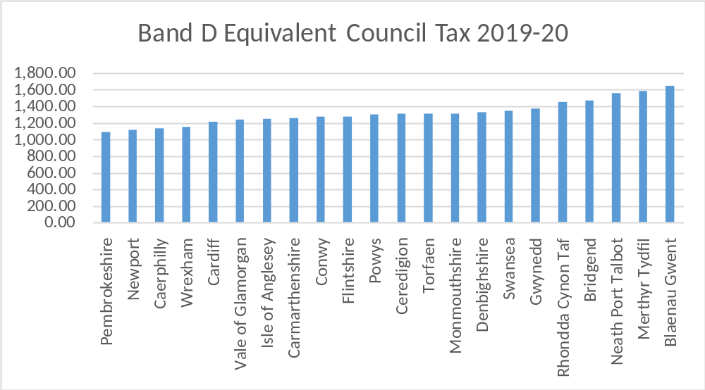
How Council Tax compares across Wales
MCC Band D of £1,315.64 compares to Welsh average of £1,294.22 in 19/20.

Slide 7
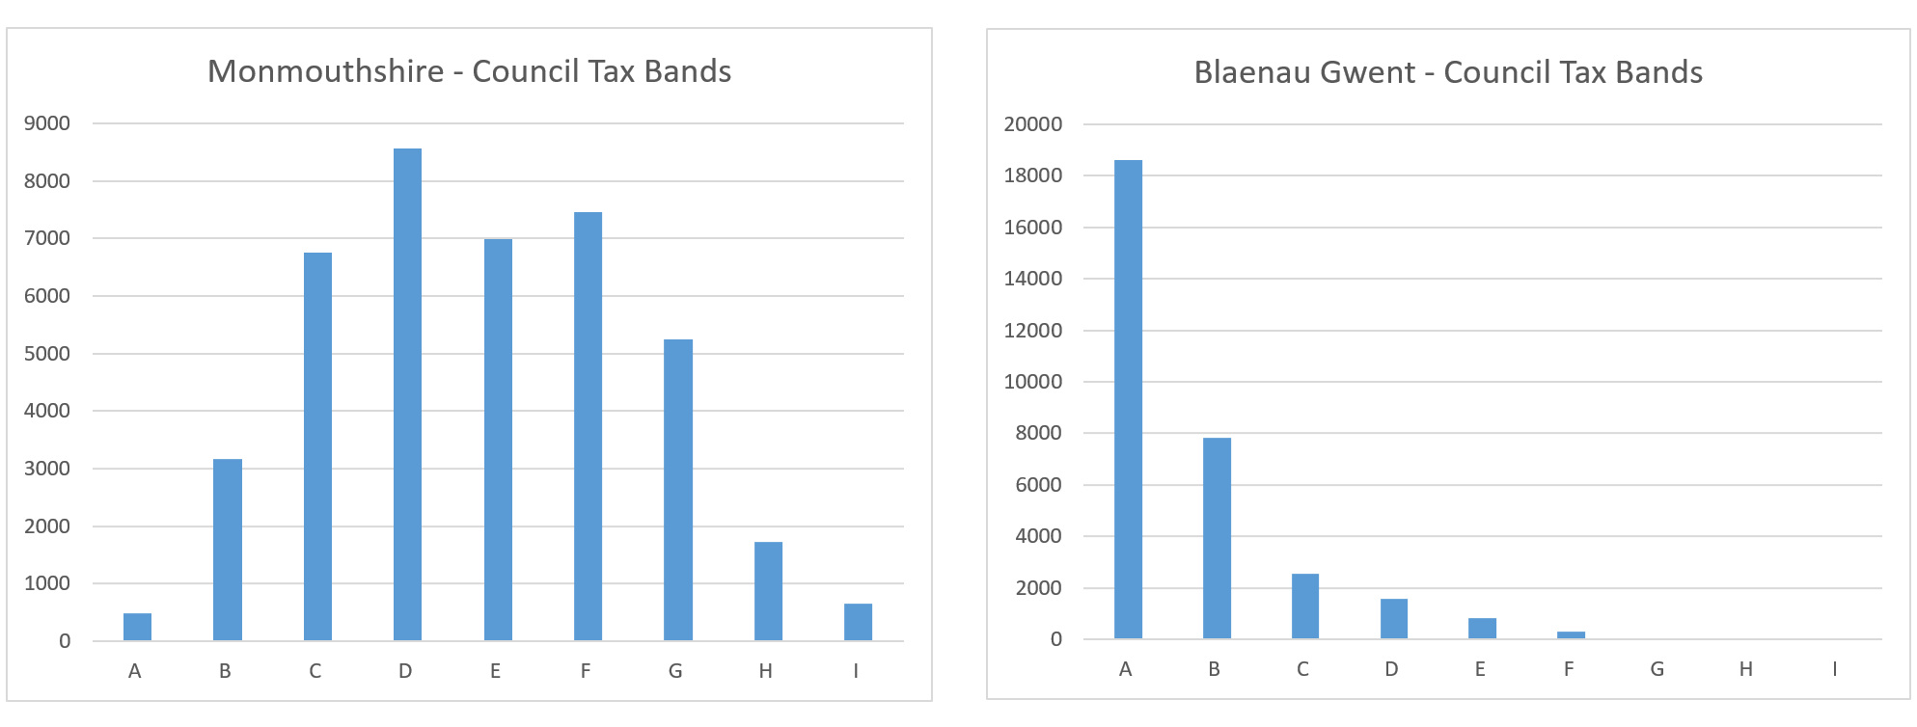
Council Tax as a share of WG funding
Blaenau Gwent have the highest band D in Wales of £1,647.59 compared to MCC (£1,315.64).
Total amount of Council Tax raised is highest in MCC because it has the most significant number of properties in the band D to I range.

Slide 8
Core funding from Welsh Government
It is welcomed that Welsh Government funding has gone up following years of ongoing reductions
However the provisional settlement for MCC is disappointing
  3.0% year on year cash increase (£2.8m)
  Massive disparity between the lowest proposed settlement of 3% for Monmouthshire, the average for Wales of 4.3% and the highest of 5.4%.
  MCC remains the worst funded Authority in Wales
  Welsh Government is being lobbied directly and through the WLGA to introduce a funding floor

Slide 9
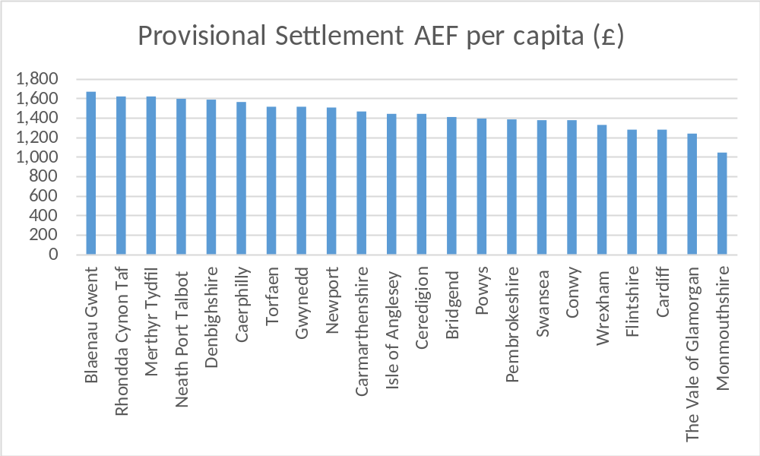
Funding from Welsh Government (1)
MCC gets the least funding per head of population (£1,044) compared to the rest of Wales (average £1,426)

Slide 10
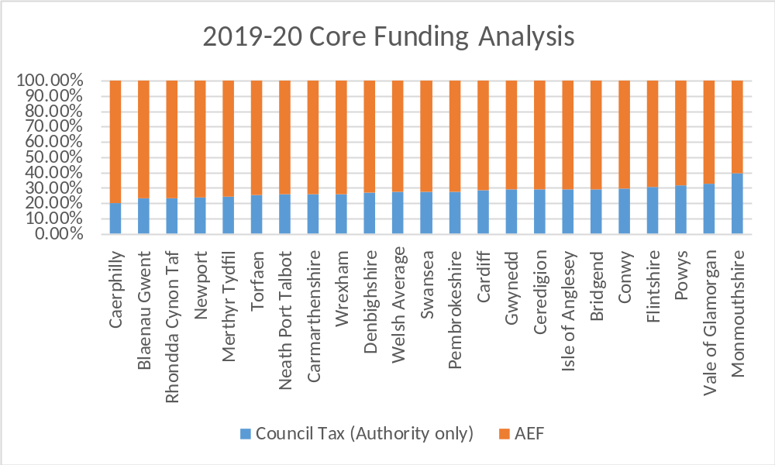
Funding from Welsh Government (2)
This illustrates the level of Council Tax raised by MCC in comparison to funding from Welsh Government. 39.4% against a Welsh average of 27.2%.

Slide 11
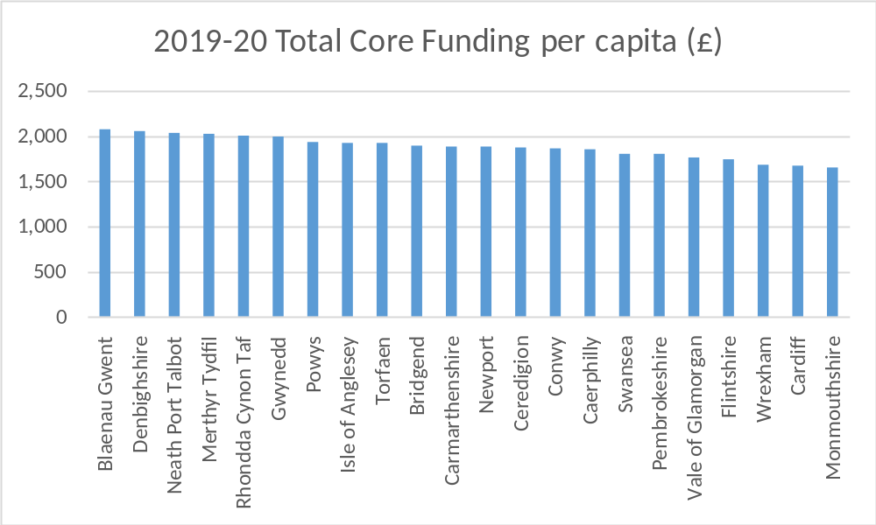
Funding from Welsh Government (3)
MCC still gets the least funding per head of population (£1,653) compared to the rest of Wales (average £1,857, highest Blaenau Gwent £2,077) – with Council Tax and AEF

Slide 12



Budget for 2020/21 will see…
Recognises in full all pay and pension-related spending pressures in schools
Recognises increasing demands placed on children’s and adult social services and children with Additional Learning Needs
Limited scope for frontline services to make efficiency savings again
May need schools to make small contribution towards savings
Continued drive for service efficiency, effectiveness and income generation
All local services still being maintained

Slide 13

Summary position
Modelling the budget using the assumptions and including the pressures created an initial gap of £5.4 million and £21m over MTFP
Revised pressures of £9.7m then included
Proposed savings of £8.0m brought forward

Slide 14
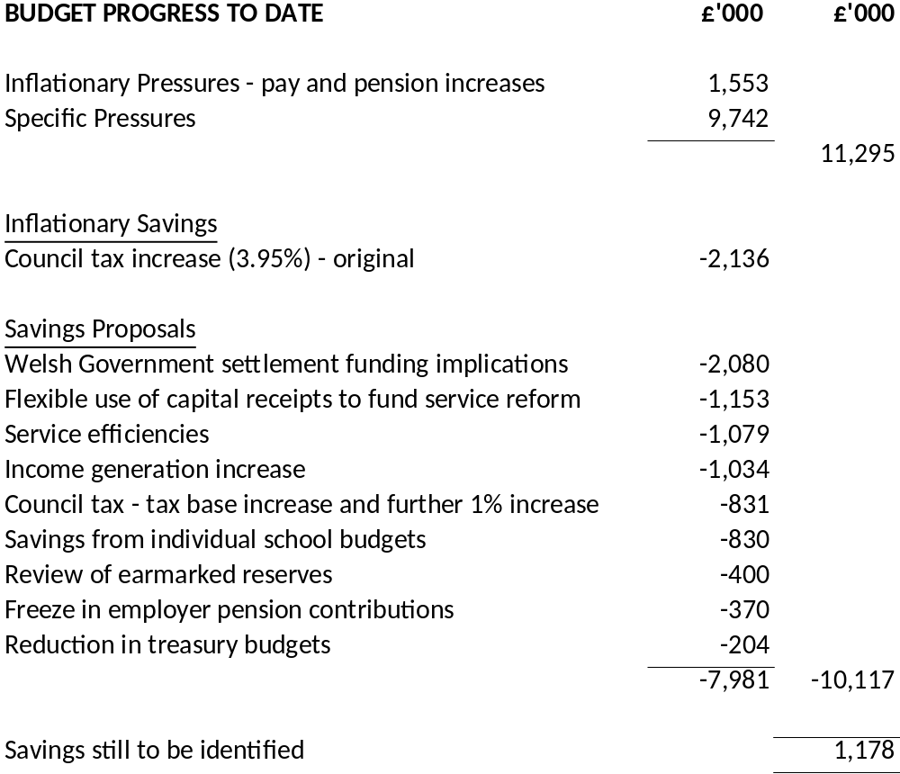
Budget Summary

Slide 15
What it costs to deliver services
  Directorate / Service Expenditure Budgets 2019-20
  (Total £154.0m) - in £m

Slide 16
Understanding how services are grouped
Children and Young People – comprising individual school budgets together with school improvement and LEA run services such as overseeing school admissions and supporting children with Additional Learning Needs
Social Care & Health
Services to adults and which seeks to enable them to live as independently as possible
Services to help the most vulnerable children and families
Services centred around public protection such as trading standards and licencing

Slide 17
Understanding how services are grouped
Enterprise
Supporting economic development in the County
Providing a wide range of tourism, leisure and culture services
Waste and recycling, highways maintenance, transport and other operational services
Planning and housing services
Chief Executive’s Unit
Administers the democratic process through member support and democratic services
Legal services and land charges
Corporates services such as communications, customer services, welsh language and equalities

Slide 18
Understanding how services are grouped
Resources – support services such as finance, ICT, HR, payroll, training, emergency planning, estates, property services, procurement and commercial activities
Corporate Costs – precepts and levies to other statutory bodies as well as other costs such as insurances, bank charges and audit fees
Appropriations – the costs of borrowing together with contributions to or from earmarked reserves
Financing – comprising core Welsh Government funding, council tax income and any contribution from the Council’s general reserve

Slide 19
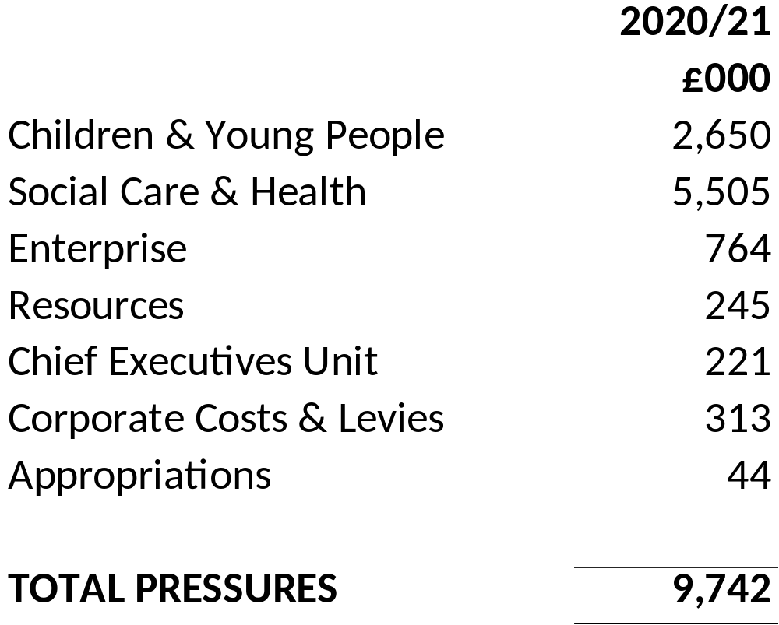
Financial pressures on the Authority

Slide 20
Financial pressures on the Authority
Pressures remain out of the control of the Authority
Pressures have been challenged and where possible managed or mitigated
Significant pressures include:
  Funding Children’s Services looked after children pressures (LAC) – £2.89m
  Sustaining delivery model within adult social care, including recent demand pressures with adults with disabilities – £2.47m
  Children with additional learning needs demand pressures – £1.47m
  Teachers pay and pension increases - £1.18m over and above the 1% original pay award assumption

Slide 21
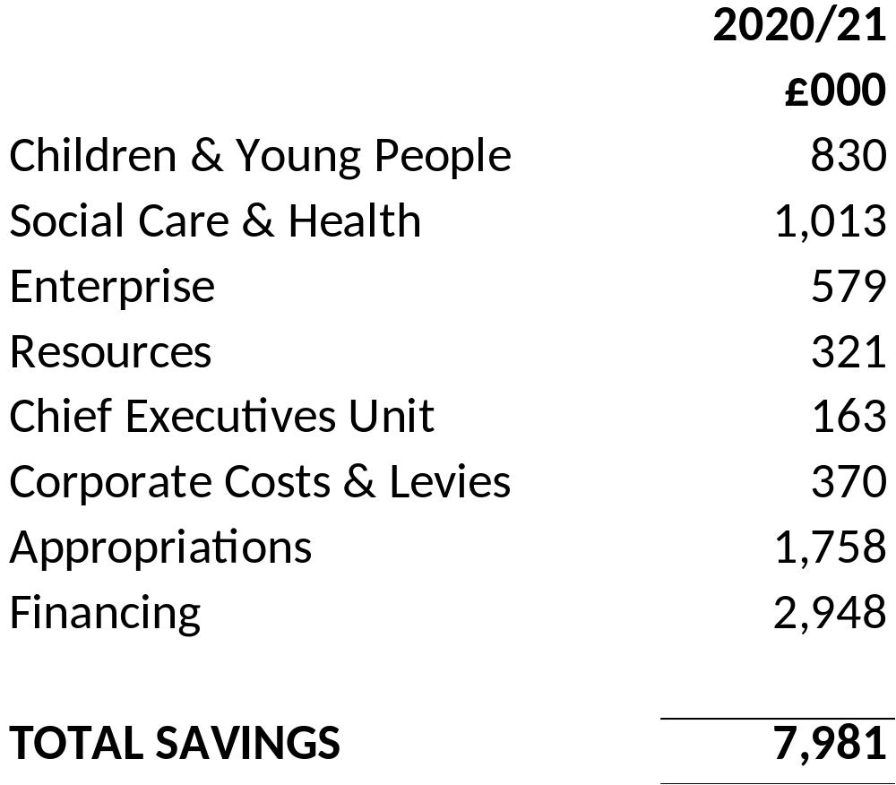
Proposals to make savings

Slide 22
Proposals to make savings
Proposals tested and considered through an initial process of independent challenge by officers and Cabinet members
All proposals assessed early for equality impact and Wellbeing and Future Generation considerations
Consideration for savings included:
  A continued drive for efficiency
  Focusing on what matters to citizens
  Moving to putting resources into preventing problems occurring or getting worse
  Service Redesign including demand management
  Approaches to generate or increase income generation
  As a last resort service reduction, including stopping or closing some services

Slide 23
Proposals to make savings
Assumptions around the increase in core funding (AEF) from Welsh Government, including full funding of teachers pay and pension increases (£2.08m)
Making flexible use of capital receipts to capitalise revenue costs relating to service reform (£1.15m)
Income generation resulting from new charges and increases in existing fees and charges (£1.03m)
A 2% (£830k) saving against Individual Schools budgets, alongside full funding of pay and pension pressures
  Schools will still receive a year-on-year cash increase in their school budgets
  A loan facility being offered to schools to more effectively repay deficit school balances
  Support will continue to be provided to schools to identify opportunities to generate savings

Slide 24
Proposals to make savings
An increase in council tax for modelling purposes of 1% to 4.95% (£509k)
Resulting from a review of earmarked reserves a planned release from the Treasury Equalisation reserve (£400k)
A freeze in the employer pension contribution for the next two years (£370k)
An increase in council tax income resulting from an increase in the number of housing completions forecast (£322k)
A reduction in treasury budgets as a result of updates to the MTFP (£204k)
Savings within Children’s Services through:
  Reduced legal costs brought about by investment in in-house childcare solicitors (£100k);
  Increased and ongoing investment in the Myst project (£250k), a multi-agency partnership working to help children who are looked after, remain in their local communities

Slide 25
Proposals to make savings
A number of areas that could impact on residents:
An increase in council tax for modelling purposes of 1% to 4.95%
Proposals to introduce some new charges and to increase fees and charges in a number of areas in line with inflation
A 2% saving against Individual Schools budgets, alongside full funding of pay and pension pressures
If Welsh Government do introduce a funding floor into the final settlement then this might provide headroom to allow some further changes to be made to the above.

Slide 26
Draft capital proposals
Ongoing commitment to fund Future schools programme – commitment to develop proposals for King Henry and Chepstow comprehensives
Ongoing commitment to Cardiff Capital Region City Deal
Borrowing for commercial investments and acquisitions
Provision for Severn View care home replacement
Abergavenny Hub – to conclude the creation of Hubs in each of the towns
Core programme circa £5.4 million covers Highways and property planned maintenance and county farms
Disabled Facility Grants – £600k – review being undertaken
Progressing Chepstow Transport Study and Severn Tunnel Junction enhancements
Rationalisation of office accommodation
Service reform costs (flexible use of capital receipts)

Slide 27
Capital budget funding and considerations
We still need to find money to address the following:
  Backlog maintenance – Property, disability discrimination act work (e.g. access to buildings etc.), improve roads, rights of way, bridges, culverts and walls – review being undertaken to determine whether any risks require more immediate attention
  Arrest road closures due to land slips
  Transportation/active travel considerations
  Investment in rationalisation of community amenity sites (waste & recycling and depot infrastructure)
  MonLife considerations – notably investment in leisure provision
  Climate emergency and carbon reduction commitments

Slide 28

Timescales
Budget proposals available for consultation – 20th Dec 2019 to 31st Jan 2020
Select Scrutiny – Jan 2020
Public consultation to end of Jan 2020
Final Budget Cabinet – 19th Feb 2020
Council tax setting and budget – 5th March 2020

Slide 29

Any questions?
Please share your thoughts?
Budget survey and further information on our website www.monmouthshire.gov.uk/budget-2020-2021
If you’d prefer please tweet us @MonmouthshireCC

